Slide 1
Software Packet Processing - The Click modular router - netmap: A novel framework for fast packet I/O
EE807 Software-defined Network Computing
Presented by Shinae Woo

Slide 2
The Click modular router
EDDIE KOHLER, ROBERT MORRIS, BENJIE CHEN, JOHN JANNOTTI,
and M. FRANS KAASHOEK

Slide 3
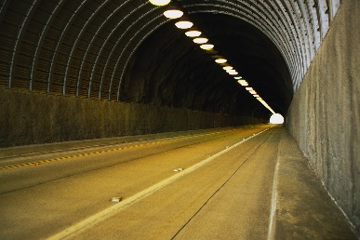
Router’s functionality
Routing + Forwarding
Do much more than routing and forwarding
Firewall
Packet filtering
Network address translation
Packet tunneling
Traffic prioritizing

Slide 4
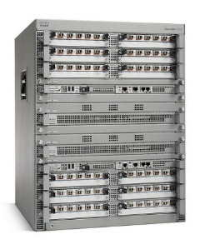
Routers in early 2000
HW routers
Specialized HW + proprietary SW
Monolithic, closed, static and inflexible
Difficult to add/delete functionality
SW routers
Commodity hardware + shipped with kernel
Hard to extend: Need to modify monolithic kernel code
Netgraph
x-kernel
Cisco ASR 1013
Cisco NCS 6008 Single Chassis System
scout
Juniper E120 Broadband Services Router
Streams
Q. How to design an extendable SW router platform?

Slide 5
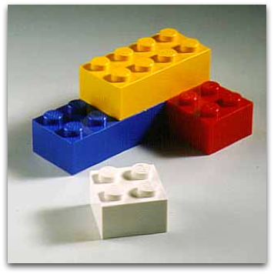
Requirements
1. Flexible and configurable router design
2. Extensible router design
3. Clearly defined interfaces
between router functionalities
No such solutions in early 2000 ☹

Slide 6
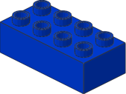
Click Modular Router
ARP query
Packet
classification
Address lookup
Switching packets
Divide
Conquer
Break down to individual router functionalities
Link individual functionalities
to complete a router design

Slide 7
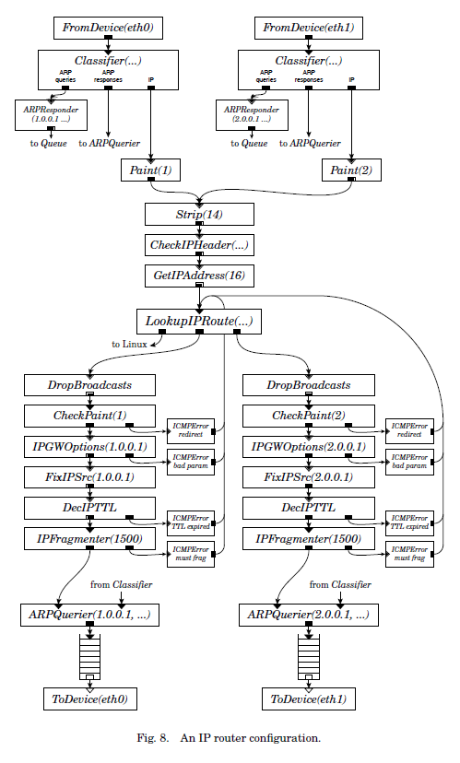
Click architecture
A directed graph with
Elements
A single router function
Connections
Possible packet path between two elements

Slide 8
Elements
A single router function
Input and output ports
Configuration strings
Per-element state, tuning behavior

Slide 9
Connections
Possible paths for packet handoff
Building a routing configuration
1. Choose a collection of elements
2. Connect them into a directed graph

Slide 10
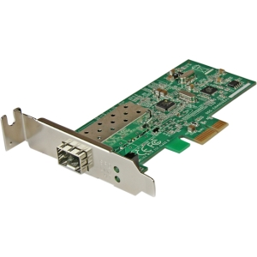
Queue
Packet storage
Start with
packet arrival events
Start with
available packet transmission and scheduling events
Click’s choice
1. Implicit queue in elements
2. Explicit queue outside elements
NULL
VS.
Queue: Unit for scheduling (single task or single thread)

Slide 11
Push and Pull Connections (1)
Single scheduling unit
Single scheduling unit
Source
Queue
Destination
Push
Pull
receive packet p
enqueue packet p
dequeue packet p
ready to transmit
push (p)
pull (p)
return
return

Slide 12
Push and Pull Connections (11)
Single scheduling unit
Single scheduling unit
Push connection (▶■)
Pull connection (▷□)
Agnostic connection (double outline)
Becomes push or pull depending on peer
Either push or pull, not mixed

Slide 13
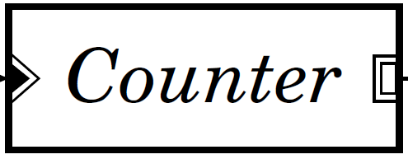
Invalid connections between elements
1. Push output cannot connects to pull input
2. Push output cannot have more than one connection
3. Pull input cannot have more than one connection
4. Agnostic elements cannot
have mixed push/pull context

Slide 14
Click implementation
Two versions
Linux in-kernel driver: Good for production
User-level driver: Good for profiling and debugging
Element
C++ class
20 virtual functions – need overwrite 6 or less
push, pull, run_scheduled
Connection
Virtual function calls between elements
Passing configuration file to the driver

Slide 15
Simple languages for declarations and connections
Compound element
Fully declarative
Declaration
Connection
Not how to process packets
Shaper
ShapedQueue

Slide 16
IP Router
16 elements in push path
1 elements in pull path
Bring local information in packet e.g.,TTL
Bring annotated information with packets
One element creates information
Other element uses information e.g., Destination IP address, Paint (Marking packet with color)

Slide 17
Extensibility
We can easily add additional functionality to IP router
Scheduling
Dropping Policy
Differentiated Services
Ethernet Switch
Covered in this talk

Slide 18
Extensibility (1) Scheduling
Stochastic Fairness Queueing (SFQ)
Providing isolation between competing flows
Distributing packets into multiple queues
Virtual queue

Slide 19
Extensibility (2) Dropping policy
Weighted Random Early Detection (RED)
Red: Dropping packets with network congestion
RED element needs to know ‘nearest downstream queue’
S1. Manual configuration to give the information
S2. Flow-based router context
What is your queue length?
My queue length is 10

Slide 20
Flow-based router context
Answers for
If I were to emit a packet on my second output,
Where might it go?
Which queues might it encounter?
→ Using a simple data-flow algorithm on configuration graph
RED: Where is my nearest down stream queue?

Slide 21
Evaluation environment
Make a bottlneck
Click IP Router
100 Mbit/s
100 Mbit/s
700 MHz Intel Pentium Ⅲ
UDP packets
147,900 64B PPS
Source
Destination
733 MHz Intel Pentium Ⅲ
200 MHz Intel Pentium Pro

Slide 22
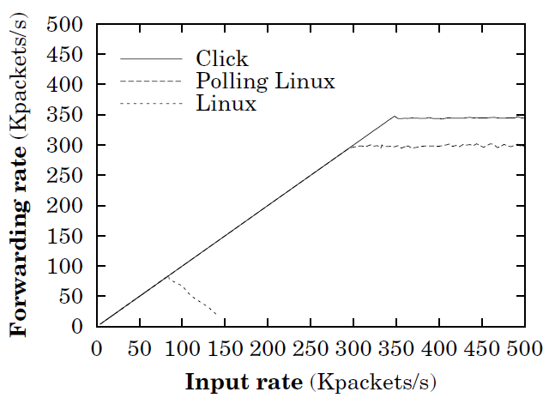
Simple forwarding rate
Peak: 360,000 PPS
Loss-free: 333,000 PPS
Linux routing table algorithm
is slower than Click’s
Click’s polling driver avoiding interrupts and efficient I/O
Receive live rock
Click keeps the baseline performance of Linux

Slide 23
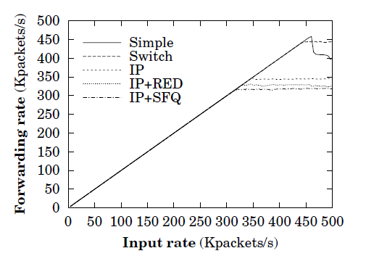
Forwarding rate with richer functionality
Click’s performance drops only gradually
Comparison with real network
Not involve: fragmentation, IP options, ICMP error
Smaller number of ARP entries

Slide 24
Overhead of modularity
Overhead of passing packets between elements
Single virtual function call: 70 ns
16 elements in IP router: 70 ns * 16 = 1 us / packet
Combine multiple elements into one
16 elements → 8 elements
Number of virtual function calls will decrease
Push path latency decreases
1.57 us → 1.03 us

Slide 25
Overhead of modularity
Unnecessarily general element code
Implemented more generality than necessary
Classifier
Required for IP router: ARP, IP packets
Implemented: a small data structure for finding which packet data to examine
Special classifier
24% smaller CPU cycles than general classifier
But only 4% less than total cost

Slide 26
Conclusion
Click Modular Router
An open, extensible, and configurable router framework
Building a complex IP router by connecting small, modular elements
Modularity does not harm the performance of the base Linux system
Easily adding extended functionality
http://www.read.cs.ucla.edu/click/

Slide 27
netmap: a novel framework for fast packet processing
Luigi Rizzo

Slide 28
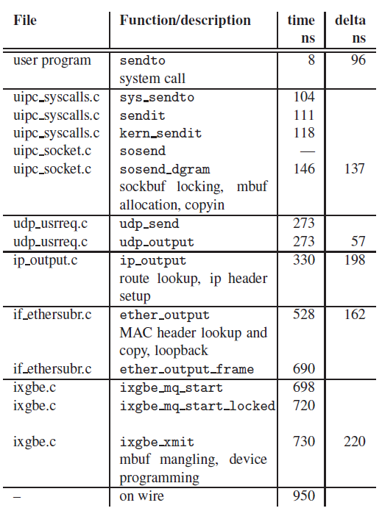
netmap: a novel framework for fast packet processing
Possible number of packets @ a 10G link
14.88 Mpps (64B packets)
Packet processing overhead in commodity OS
Per-packet dynamic memory allocation
System call overhead
Memory copies
netmap
60-65 cycles/packet (67 ns)
system call
1us / packet
1.05 Mbps
sendto() execution path and time in FreeBSD

Slide 29
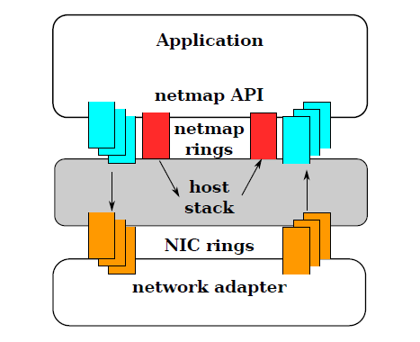
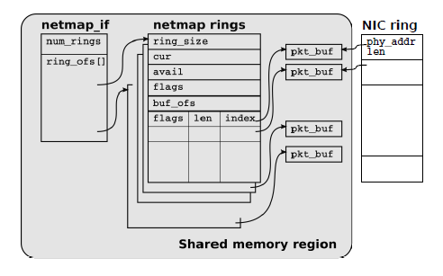
netmap architecture
Netmap’s approaches
Per-packet dynamic memory allocation → Preallocated resources
System call overhead → Large batching
Memory copies → Shared buffer between kernel and userspace

Slide 30
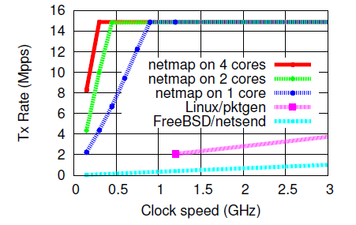
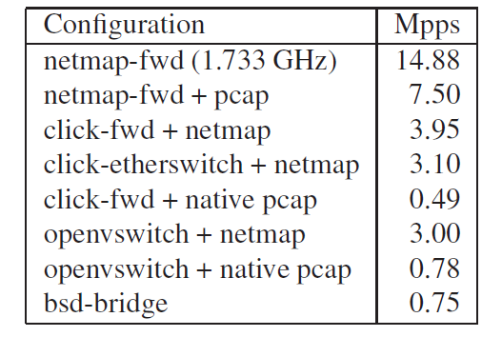
Evaluation
Test equipment
i7-870 4 core @ 2.93MHz
Intel 82599 10G NIC
64B packet Tx
netmap: 60-65 cycles/packet
Line rate
8x

Slide 31
Discussion

Slide 32
Click implicit dependency from annotation
Annotation makes implicit dependency between elements
There are 16 annotation types in the paper (+ custom types now)
How to resolve those dependency?
There are no consideration on the configuration step
Paint
CheckPaint
Set paint annotation
Use paint annotation

Slide 33
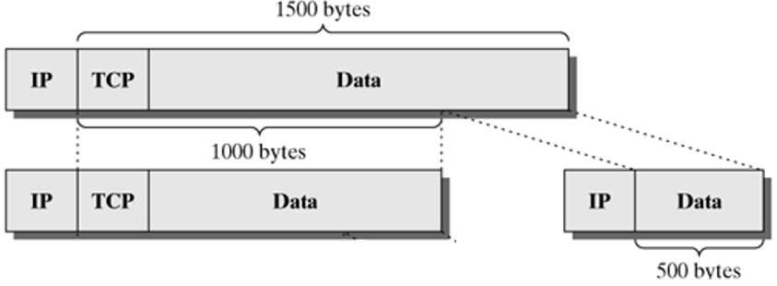
Click Extend to support L4/Stateful functionality
How to support TCP functionality
Can be built as a single element
Cannot support modularity on L4 layer
How to support IP defragmentation
It has to reserve packets until the other parts of packets arrived
Click elements requires to store packets
TCP

Slide 34
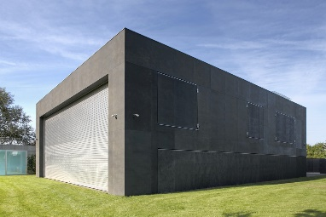
Click Tradeoff between modularity vs efficiency
There are fundamental tradeoff between modularity and efficiency
VS.
How can we get both benefit?
Give a configuration in a modular way
Optimize binary to integrated functionality
IPPush

Slide 35
netmap Comparison between other apporoaches
There are many similar work in this area
PSIO, PF_RING, DPDK
Similar approaches to solve same challenges
Benefit from netmap compared with other approaches
Integrated with FreeBSD
Not depend on specific hardware

