Slide 1
Header Space Analysis:
Static Checking for Networks
Broadband Network Technology
Integrated M.S. and Ph.D.
Eun-Do Kim
Network Standards Research Section
Protocol Engineering Center

Slide 2
Contents
1. Introduction
2. Modeling of Header Space Analysis
3. Using Header Space Analysis
4. Evaluation
5. Conclusions

Slide 3
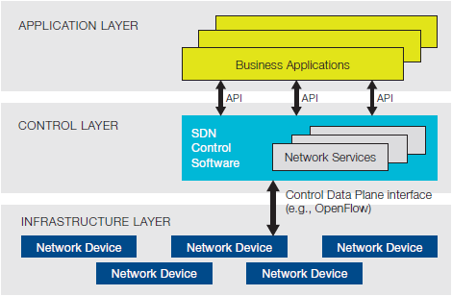
SDN Architectures
- Application Layer / Control Layer / Infrastructure Layer are separated.
According to policies of the Application Layer,
the Control Layer manages
the Infrastructure Layer which is connected to the Control Layer own.
Reference [3], Software-Defined Networking: The New Norm for Networks, ONF, p. 7, Figure 1. Software-Defined Network Architecture.
Animation Slide
-It may be shown as wrong in printouts.-

Slide 4
Packet Processing
- Reactive
- If table-miss occurs,
→ then an incoming packet is processed by interacting with a controller.
New
Flow Entry
OpenFlow Switch #1
Controller
OpenFlow Switch #2
packet-in
Message
Secure Channel
Secure Channel
Flow Tables
- Flow Entries
Table-miss
Flow Tables
- Flow Entries
New
Packet
Host
…
Host
Host
…
Host
Animation Slide
-It may be shown as wrong in printouts.-

Slide 5
Application Conflicts
- We assume that each application on OpenFlow controller works well.
→ Mixture of applications -> Network problems
e.g., reachability problems, forwarding loops, traffic isolation, etc.
Application Conflicts!
Works well!
Works well!
Works well!
Application 1
e.g., Shortest Path Routing
Application 2
e.g., Firewall
Application 3
e.g., NAT
OpenFlow Controller
e.g., NOX, Floodlight, OpenDaylight, IRIS, etc.
OpenFlow Switch
OpenFlow Switch
OpenFlow Switch
Animation Slide
-It may be shown as wrong in printouts.-

Slide 6
Historical Views of Problems (1/2)
- In the beginning, a switch or router was simple.
→ Simple forwarding task
: Index into a forwarding table -> Output port
- Today, however,
→ forwarding grew more complicated.
→ many protocols operate concurrently.
: e.g., MPLS, NAT, ACLs, etc.

Slide 7
Historical Views of Problems (2/2)
- This complexity makes it hard to operate a large network today.
→ Network operators have to manage so many interacting protocols.
→ Trying new protocols is hard.
→ Hosts can be unable to communicate.
Especially, debugging reachability problems is very time consuming.

Slide 8
Reachability Problems
- Simple Example
- There are three simple questions.
→ “Can host $A$ talk to host $B$?”
→ “Can packets loop in my network?”
→ “Can user $A$ listen to communications between users $B$ and $C$?”
→ Simple, but hard to answer!
We need an easy way to solve these problems.
Reference [4], Google Image Search.

Slide 9
Previous Works
- There are very few existing network management tools.
→ However, the existing tools are protocol-dependent.
: e.g., reachability only, IP connectivity only, firewall configuration only, or routing failures only

Slide 10
Header Space Analysis
- Header Space Analysis (HSA)
→ is a general framework.
→ provides a tool for checking networks.
→ provides a protocol-independent way.
- HSA allows network operators to check several network failures.
→ e.g., reachability failures, forwarding loops, and traffic isolation and leakage problems

Slide 11
Goals of HSA
- To analyze networks.
- To guarantee isolation.
- To enable a analysis of networks slice.
→ HSA provides answers to solve failure conditions.
→ HSA runs regardless of protocols.
→ HSA can verify that slices have been correctly configured.
→ Each slice has its own control plane to decide a packet processing.

Slide 12
Contents
1. Introduction
2. Modeling of Header Space Analysis
3. Using Header Space Analysis
4. Evaluation
5. Conclusions

Slide 13
Header Space, $ℋ$
- A header space is defined
→ for ignoring protocol-specific meanings.
→ as a flat sequence of ones and zeros.
: $ℋ:{\left\{0,1\right\}}^{L}$, where $L$ is an upper bound on a header length.
- Each bit can be either $0$, $1$ or $x$.
→ $x$ is the bit to define the wildcard expression.

Slide 14
Network Space, $N$
- For the HSA modeling,
→ Switches -> A set of boxes
→ Ports -> External interfaces
Reference [1], Figure 1 (part).
- The network space $N$ is the space of all possible input ports.
→ HSA represents a packet traversing on a link
: as a point in ${\left\{0,1\right\}}^{L}×\left\{1,…,P\right\}$ space.
$$ℋ$$
$$N$$

Slide 15
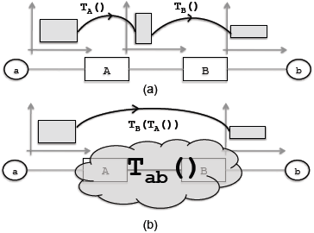
Transfer Function, $T\left( \right)$
- Networking boxes can be modeled with the transfer function $T$.
→ $T$ maps header $h$ arriving on port $p$.
: $T\left(h,p\right) :\left(h,p\right)→\left\{\left(h_{1},p_{1}\right),\left(h_{2},p_{2}\right),…\right\}$
- $T$ depends on the input and output port pairs.
→ $h_{b}= T\left(h_{a},p_{a}\right)$
→ $h_{a}= T^{−1}\left(h_{b},p_{b}\right)$
Reference [1], Figure 1. (a) Changes to a flow as it passes through two boxes with transfer function $T_{A}$ and $T_{B}$. (b) Composing transfer functions to model end to end behavior of a network.

Slide 16
Network Transfer Function, $Ψ\left( \right)$
- HSA combines all the transfer functions $T$ for describing the overall behavior of the network.
- If a network consists of $n$ transfer functions, then
→ $Ψ\left(h,p\right)=\left\{\begin{aligned}T_{1}\left(h,p\right), if p∈{switch}_{1} \\ … \\ T_{n}\left(h,p\right), if p∈{switch}_{n}\end{aligned}\right.$.

Slide 17
Topology Transfer Function, $Γ\left( \right)$
- HSA models the network topology using the topology transfer function $Γ$.
→ $Γ\left(h,p\right)=\left\{\begin{aligned}\left\{\left(h,p^{∗}\right)\right\}, if p connected to p^{∗} \\ \left\{ \right\}, if p is not connected\end{aligned}\right.$
→ It accepts and returns a packet.
: At one end of a link -> At the other end of a link
- Links of $Γ$ are unidirectional.
→ To model bidirectional links, one rule should be added per direction.

Slide 18
Multi-hop Packet Traverse
- Using $Ψ$ and $Γ$, HSA can model a packet traverse.
→ Each hop is modeled
: $Φ\left(h,p\right)=Ψ\left(Γ\left(h,p\right)\right)$
- If $k$ hops,
→ $Φ^{k}\left(h,p\right)=Ψ\left(Γ\left(…\left(Ψ\left(Γ\left(h,p\right)…\right)\right)\right)\right)$
- $Γ$ forwards the packet on a link.
- $Ψ$ passes the packet through a box.

Slide 19
Contents
1. Introduction
2. Modeling of Header Space Analysis
3. Using Header Space Analysis
4. Evaluation
5. Conclusions

Slide 20
Simple Example of an IPv4 Router
- A process of an IPv4 router is like this.
1) Rewrite source and destination MAC addresses.
2) Decrement TTL.
3) Update checksum.
4) Forward to outgoing port.
→ $T_{router}\left(h,p\right)=\left\{\begin{aligned}\left\{\left(h,p_{1}\right)\right\}, if ip_dst(h)∈{subnet}_{1} \\ \left\{\left(h,p_{2}\right)\right\}, if ip_dst(h)∈{subnet}_{2} \\ … \\ \left\{ \right\}, otherwise\end{aligned}\right.$

Slide 21
Reachability Analysis (1/2)
- HSA considers a space of all headers leaving a source,
→ then track this space along a path to a destination.
- At the destination, if no header space remains,
→ then the two hosts cannot communicate.
- HSA defines the reachability function $R$ between $a$ and $b$ as
→ $R_{a→b}=\bigcup_{a→b paths}{\left\{T_{n}\left(Γ\left(T_{n−1}\left(……\left(Γ\left(T_{1}\left(h,p\right)…\right)\right)\right)\right)\right)\right\}}$

Slide 22
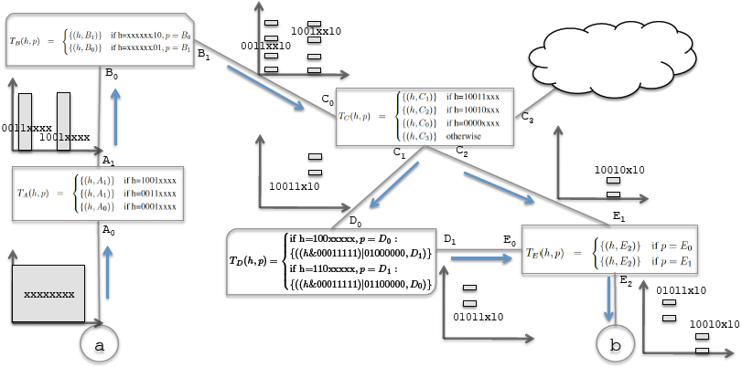
Reachability Analysis (2/2)
- An example of the reachability analysis for a small example network
Reference [1], Figure 2. Example for computing reachability function from $a$ to $b$. For simplicity, we assume a header length of 8 and show the first 4 bits on the x-axis and the last 4 bits on the y-axis. We show the range (output) of each transfer function composition along the paths that connect $a$ to $b$. At the end, the packet headers that $b$ will see from $a$ are $01011x10∪10010x10$.

Slide 23
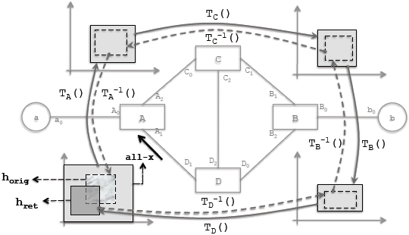
Loop Detection
- A loop occurs when a packet returns to a port that it has visited earlier.
→ HSA reports the loop when the test packet header returns to a port that it was injected from.
Reference [1], Figure 3. An example network for running the loop detection algorithm. The solid lines show the changes in the all-x test packet injected from $A_{1}$ till it returns to the injection port as $h_{ret}$. The dashed lines show the process of detecting infinite loop, where $h_{ret}$ is traced back to find $h_{orig}$, the part of all-x packet that caused $h_{ret}$.

Slide 24
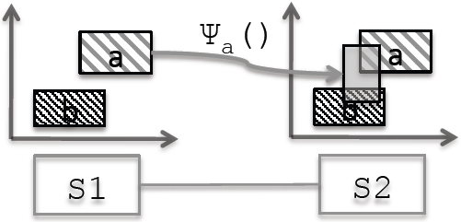
Slice Isolation & Leakage Detection
- A common requirement of isolation is that
→ a traffic stays within its slice.
→ a traffic not leaks to another slice.
- HSA can detect when slices are leaking traffic.
Reference [1], Figure 5. Detecting slice leakage. Although slice $a$ and $b$ have disjoint slice reservation on $S_{1}$ and $S_{2}$, but slice $a$’s reservation on $S_{1}$ can leak to slice $b$’s reservation on $S_{2}$ after it is rewritten by slice $a$’s transfer function rules.

Slide 25
Contents
1. Introduction
2. Modeling of Header Space Analysis
3. Using Header Space Analysis
4. Evaluation
5. Conclusions

Slide 26
Experiment Environments
- They benchmarked the performance on Stanford backbone network.
→ Reachability and loop detection on an enterprise network
→ Slice isolation on random slices
- Details
→ Macbook Pro with
: CPU: Intel core i7, 2.66Ghz quad core (only two cores were used)
: RAM: 4GB
→ 14 operational zone routers, 10 switches, and 2 backbone routers
→ More than 757,000 forwarding rules with 1,500 ACL rules

Slide 27
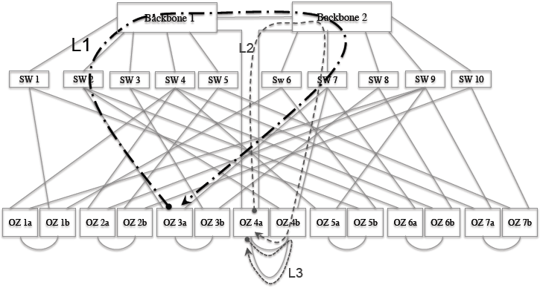
Loop Detection
- The backbone network topology of Stanford University
Reference [1], Figure 7. Topology of Stanford University’s backbone network and 3 types of loops detected using Hassel. Overall, we found 26 loops on 14 loop paths. 10 of these loops, caused by packets destined to 10 IP addresses, are infinite loops masked by bridge learning. 16 other loops are single round loops.
→ 26 loops were found from 30 ports within 560 seconds.

Slide 28
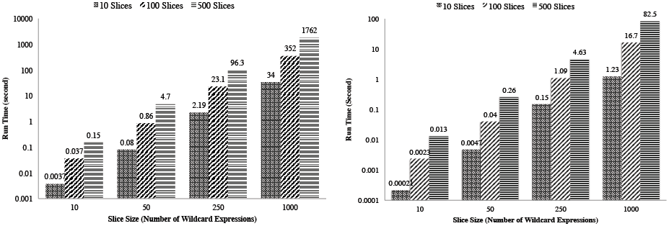
Checking Slice Isolation
- When creating a slice
- Whenever a rewrite action is added
(Left) Reference [1], Figure 8. The time it takes to check if a new slice is isolated from other slices at reservation time.
(Right) Reference [1], Figure 9. The time it takes to determine whether a new rewrite action will cause packets to leak between slices.
→ HSA can be a feasible model to check slice isolation in real networks.

Slide 29
Contents
1. Introduction
2. Modeling of Header Space Analysis
3. Using Header Space Analysis
4. Evaluation
5. Conclusions

Slide 30
Conclusions
- Header Space Analysis is a general framework which can check network failures in a protocol-independent way.
→ e.g., reachability failures, forwarding loops, and traffic isolation and leakage problems
- By parsing forwarding and configuration tables automatically, Header Space Analysis can be used in existing complex networks.
→ It can give network operators a confidence to adopt new protocols, or new slicing mechanisms.

Slide 31
VeriFlow
- VeriFlow is a tool for verifying network-wide invariants in real time.
→ It is focused on an extremely low latency.
- VeriFlow is a layer between an SDN controller and OpenFlow switches.
→ It checks the network violations only when each flow entry rule is inserted, modified or deleted.
- VeriFlow do not check the entire network on each change.
→ It only consider a new rule with existing overlapping rules.

Slide 32
Discussion Points
- While Header Space Analysis tells us network failures, it does not tell us where that flow entry came from.
→ Is there any idea?
- Even if forwarding tables are consistent, Header Space Analysis offers no alternatives as to whether forwarding is efficient.
→ Is there any method for this?
- An operation of Header Space Analysis is based on L2 and L3 layers only.
→ If it supports L4 or higher layers, what benefits can we take?

Slide 33
References
[1] Peyman Kazemian, George Varghese, and Nick McKeown, “Header Space Analysis: Static Checking for Networks,” NSDI'12, 2012.
[2] OpenFlow Switch Specification Version 1.4.0, ONF (Open Networking Foundation), Available: https://www.opennetworking.org/, October. 2013.
[3] Software-Defined Networking: The New Norm for Networks, ONF (Open Networking Foundation), Available: https://www.opennetworking.org/, April. 2012.
[4] Google. [Online]. Available: http://www.google.com/.

Slide 34
Thanks for Attention!
Q & A ?
Eun-Do Kim
maniada@etri.re.kr

