Slide 1
Ananta: Cloud Scale Load Balancing
Presenter: Donghwi Kim

Slide 2
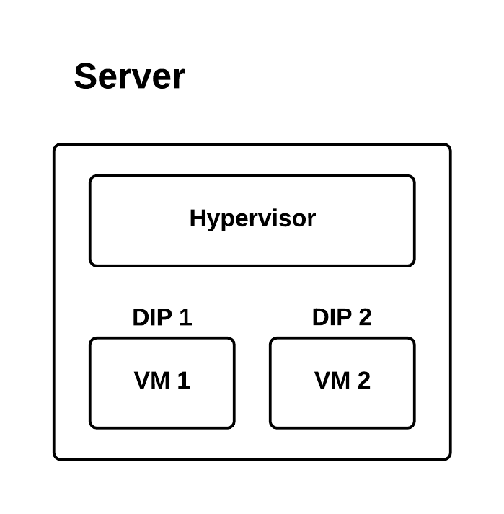
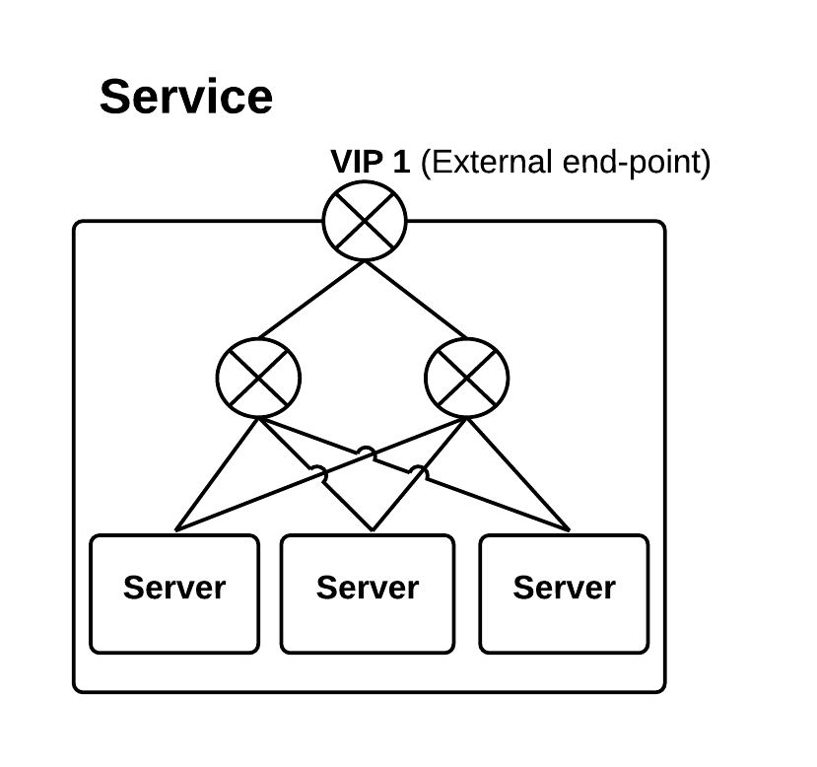
Background: Datacenter
Each server has a hypervisor and VMs
Each VM is assigned a Direct IP(DIP)
Each service has zero or more external end-points
Each service is assigned one Virtual IP (VIP)

Slide 3
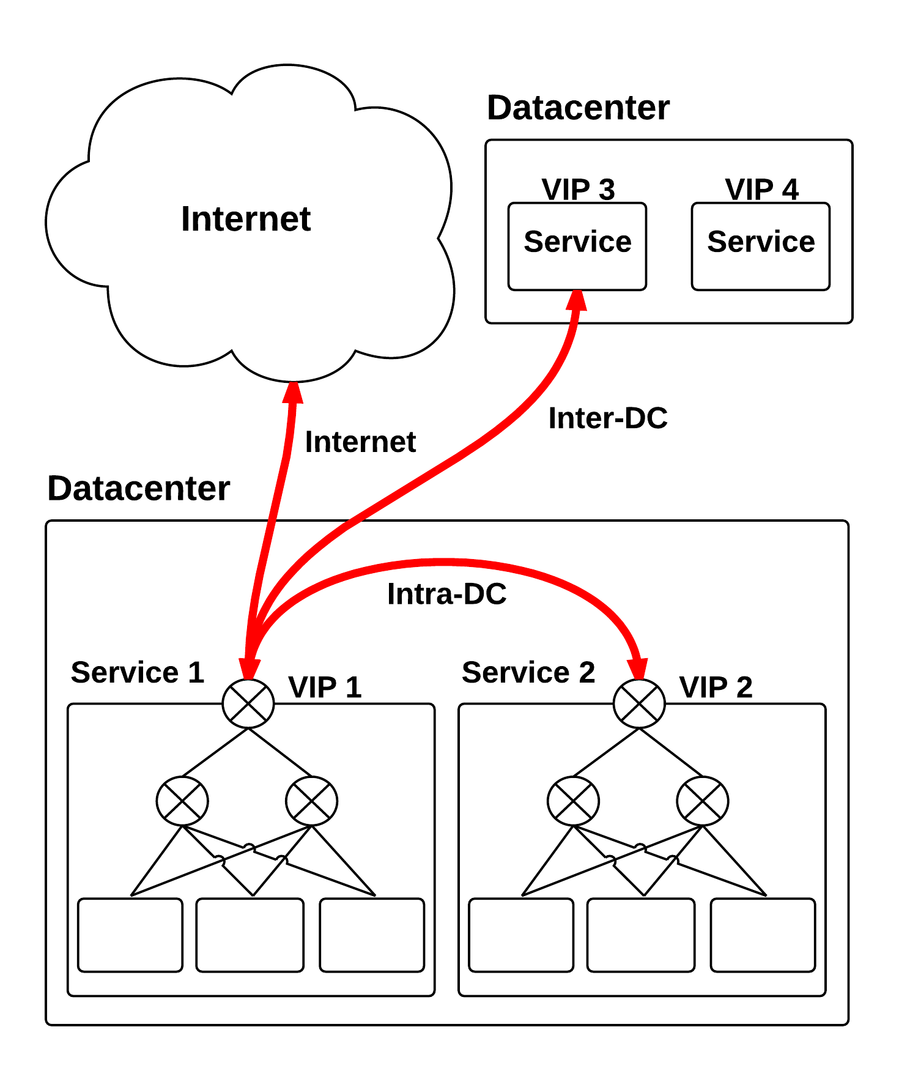
Background: Datacenter
Each datacenter has many services
A service may work with
Another service in same datacenter
Another service in other datacenter
A client over the internet

Slide 4
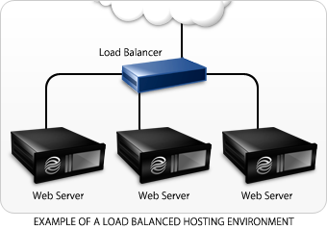
Background: Load-balancer
Entrance of server pool
Distribute workload to worker servers
Hide server pools from client with network address translator (NAT)

Slide 5
Inbound VIP Communication
src: Client, dst: VIP
payload
src: Client, dst: VIP
payload
src: Client, dst: VIP
payload
Internet
Do destination address translation (DNAT)
LB
src: Client, dst: DIP2
payload
payload
src: Client, dst: DIP1
payload
src: Client, dst: DIP3
VIP
Front-end
VM
Front-end
VM
Front-end
VM
DIP 1
DIP 2
DIP 3

Slide 6
Outbound VIP Communication
Datacenter
Network
src: VIP1, dst: VIP2
payload
Do source address translation (SNAT)
LB
LB
VIP 1
src: VIP1, dst: VIP2
payload
VIP 2
Front-end
VM
Back-end
VM
Front-end
VM
Front-end
VM
Front-end
VM
src: DIP2, dst: VIP2
payload
DIP 1
DIP 2
DIP 3
DIP 4
DIP 5
Service 1
Service 2

Slide 7
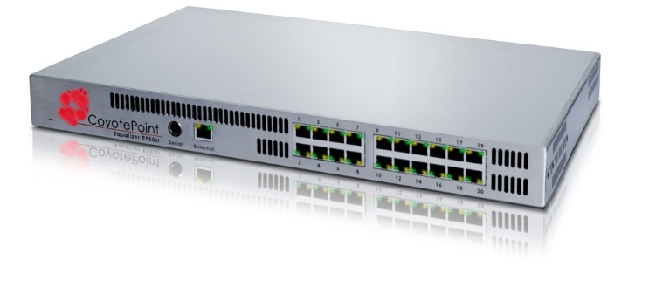
State of the Art
A load balancer is a hardware device
Expensive, slow failover, no scalability
LB

Slide 8
Cloud Requirements
Scale
Reliability
Requirement | State-of-the-art
~40 Tbps throughput using 400 servers | 20Gbps for $80,000
100Gbps for a single VIP | Up to 20Gbps per VIP
Requirement | State-of-the-art
N+1 redundancy | 1+1 redundancy or slow failover
Quick failover

Slide 9
Cloud Requirements
Any service anywhere
Tenant isolation
Requirement | State-of-the-art
Servers and LB/NAT are placed across L2 boundaries | NAT supported only in the same L2
Requirement | State-of-the-art
An overloaded or abusive tenant cannot affect other tenants | Excessive SNAT from one tenant causes complete outage

Slide 10
Ananta

Slide 11
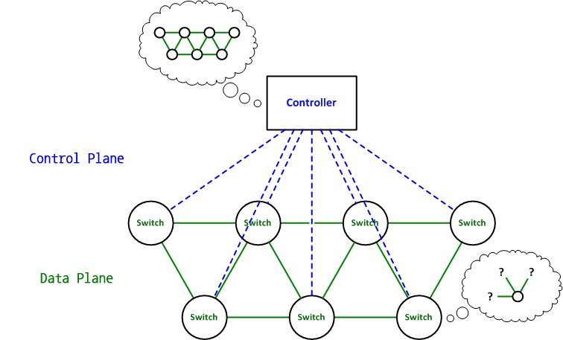
SDN
SDN: Managing a flexible data plane via a centralized control plane
Controller
Control Plane
Switch
Data plane

Slide 12
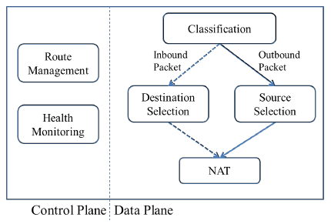
Break down Load-balancer’s functionality
Control plane:
VIP configuration
Monitoring
Data plane
Destination/source selection
address translation

Slide 13
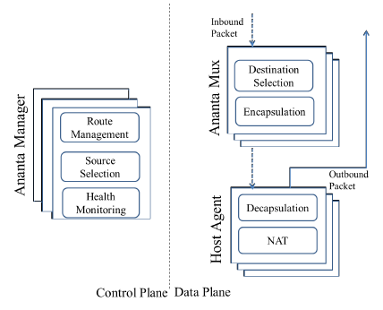
Design
Ananta Manager
Source selection
Not scalable (like SDN controller)
Multiplexer (Mux)
Destination selection
Host Agent
Address translation
Reside in each server’s hypervisor

Slide 14
Data plane
1st tier (Router)
packet-level load spreading via ECMP.
2nd tier (Multiplexer)
connection-level load spreading
destination selection.
3rd tier (Host Agent)
Stateful NAT
dst: VIP1
dst: VIP2
dst: VIP1
dst: DIP3
dst: VIP2
dst: DIP1
dst: VIP1
dst: DIP2
dst: VIP1
Multiplexer
Multiplexer
. . .
Multiplexer
dst: DIP1
dst: DIP2
dst: DIP3
VM Switch
VM Switch
VM Switch
Host Agent
Host Agent
. . .
Host Agent
. . .
. . .
. . .
VM₁
VM_{N}
VM₁
VM_{N}
VM₁
VM_{N}

Slide 15
Inbound connections
Host
s: MUX, d: DIP
2
s: CLI, d: VIP
Router
s: CLI, d: VIP
4
…
Router
s: CLI, d: DIP
Router
MUX
Host Agent
MUX
3
1
MUX
5
8
VM
DIP
Client
s: VIP, d: CLI
7
6
s: DIP, d: CLI

Slide 16
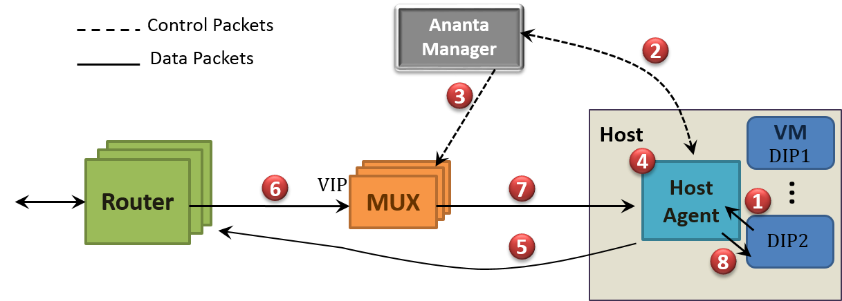
Outbound (SNAT) connections
Map VIP:777 to DIP
Map VIP:777 to DIP
s: SVR:80, d: VIP:777
s: MUX, d: DIP:555
s: SVR:80, d: VIP:777
s: SVR:80, d: DIP:555
Port??
Server
s: VIP:777, d: SVR:80
s: DIP:555, d: SVR:80

Slide 17
Reducing Load of AnantaManager
Optimization
Batching: Allocate 8 ports instead of one
Pre-allocation: 160 ports per VM
Demand prediction: Consider recent request history
Less than 1% of outbound connections ever hit Ananta Manager
SNAT request latency is reduced

Slide 18
VIP traffic in a datacenter
Large portion of traffic via load-balancer is intra-DC

Slide 19
Step 1: Forward Traffic
Host
VIP1
MUX
Host Agent
MUX
VM
MUX1
DIP1
Data Packets
…
1
Host
VIP2
MUX
Host Agent
VM
MUX
2
MUX2
DIP2
…
Destination

Slide 20
Step 2: Return Traffic
Host
VIP1
MUX
Host Agent
MUX
4
VM
MUX1
DIP1
Data Packets
…
1
3
Host
VIP2
MUX
Host Agent
VM
MUX
2
MUX2
DIP2
…
Destination

Slide 21
Step 3: Redirect Messages
Host
VIP1
MUX
Host Agent
MUX
VM
Redirect Packets
MUX1
DIP1
…
6
7
5
Host
VIP2
MUX
Host Agent
VM
MUX
MUX2
DIP2
…
Destination

Slide 22
Step 4: Direct Connection
Host
VIP1
MUX
Host Agent
MUX
VM
Redirect Packets
MUX1
DIP1
Data Packets
…
8
Host
VIP2
MUX
Host Agent
VM
MUX
MUX2
DIP2
…
Destination

Slide 23
SNAT Fairness
Ananta Manager is not scalable
More VMs, more resources
DIP1
DIP2
DIP3
DIP4
6
Pending SNAT Requests per DIP. At most one per DIP.
5
1
2
3
4
3
Pending SNAT Requests per VIP.
VIP1
2
VIP2
1
4
Global queue. Round-robin dequeue from VIP queues. Processed by thread pool.
SNAT processing queue
3
2
4
1

Slide 24
Packet Rate Fairness
Each Mux keeps track of its top-talkers (top-talker: VIPs with the highest rate of packets)
When packet drop happens, Ananta Manager withdraws the topmost top-talker from all Muxes

Slide 25
Reliability
When Ananta Manager fails
Paxos provides fault-tolerance by replication
Typically 5 replicas
When Mux fails
1st tier routers detect failure by BGP
The routers stop sending traffic to that Mux.

Slide 26
Evaluation

Slide 27
Impact of Fastpath
Experiment:
One 20 VM tenant as the server
Two 10 VM tenants a clients
Each VM setup 10 connections, upload 1MB data

Slide 28
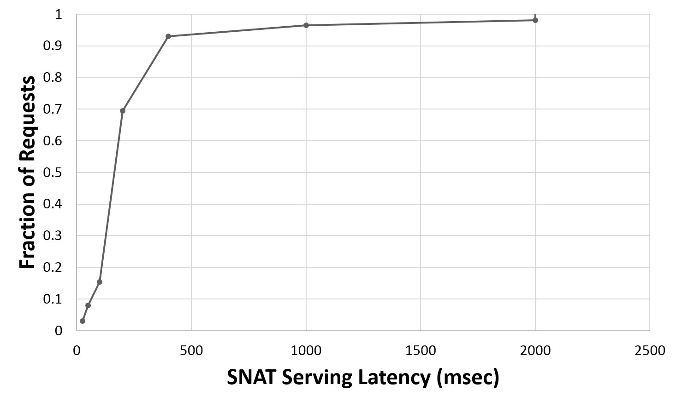
Ananta Manager’s SNAT latency
Ananta manager’s port allocation latency over 24 hour observation

Slide 29
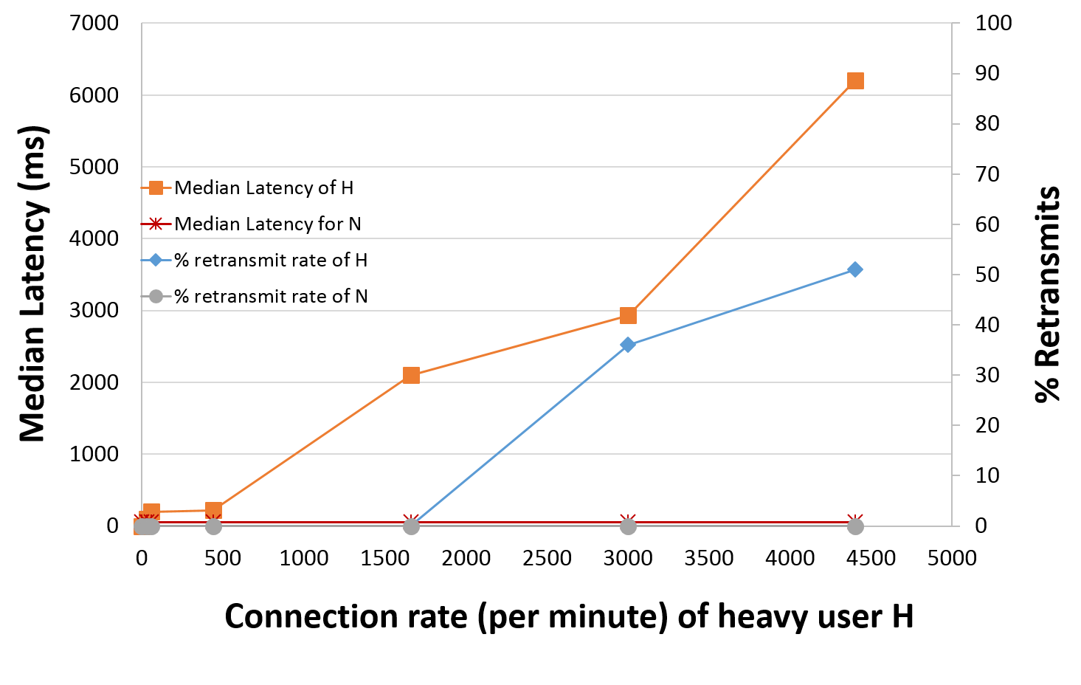
SNAT Fairness
Normal users (N) make 150 outbound connections per minute
A heavy user (H) keep increases outbound connection rate
Observe SYN retransmit and SNAT latency
Normal users are not affected by a heavy user

Slide 30
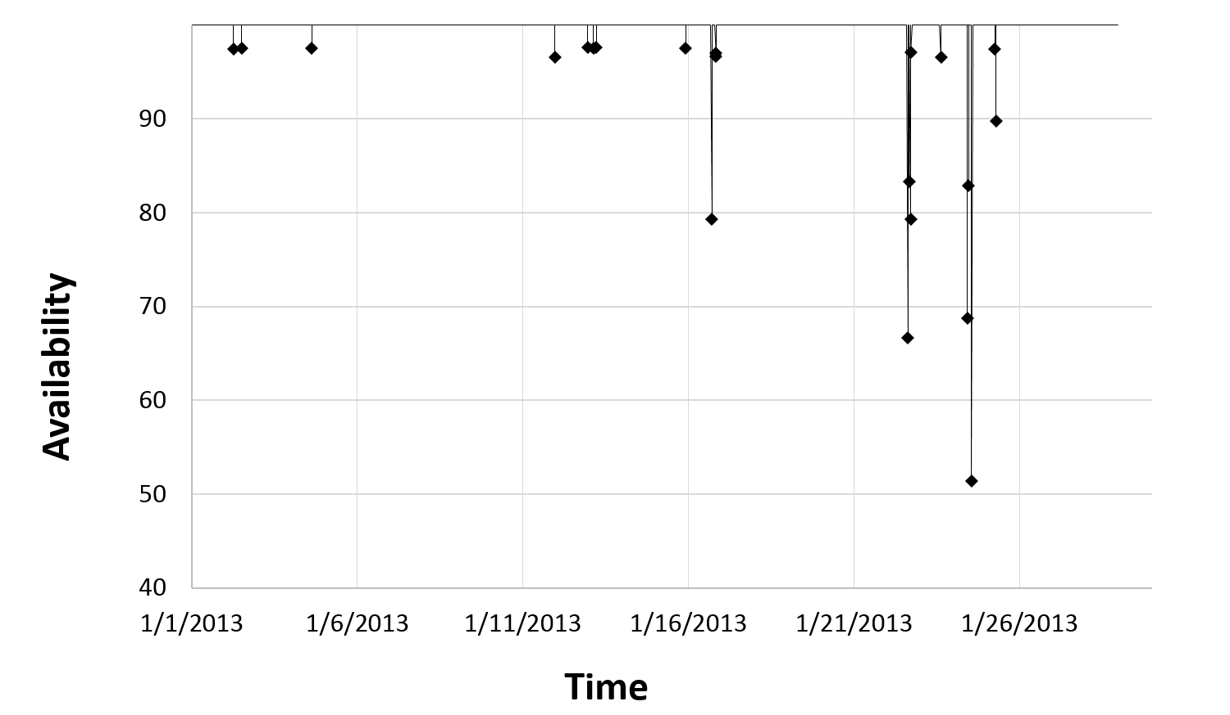
Overall Availability
Average availability over a month: 99.95%

Slide 31
Summary
How Ananta meet cloud requirements
Requirement | Description
Scale | Mux: ECMP Host agent: Scale-out naturally
Reliability | Ananta manager: Paxos Mux: BGP
Any service anywhere | Ananta is on layer 4 (Transport layer)
Tenant isolation | SNAT fairness Packet rate fairness

Slide 32
Discussion
Ananta may lose some connections
When it recovers from MUX failure
Because there is no way to copy MUX’s internal state.
TCP flows
1st tier Router
MUX
5-tuple | DIP
… | DIP1
… | DIP2
???
MUX (NEW)
5-tuple | DIP

Slide 33
Discussion
Detection of MUX failure takes at most 30 seconds (BGP hold timer). Why don’t we use additional health monitoring?
Fastpath does not preserve the order of packets.
Passing through a software component, MUX, may increase the latency of connection establishment.* (Fastpath does not relieve this.)
Scale of evaluation is too small. (e.g. Bandwidth of 2.5Gbps, not Tbps). Another paper insists that Ananta requires 8,000 MUXes to cover mid-size datacenter.*
*DUET: Cloud Scale Load Balancing with Hardware and Software, SIGCOMM‘14

Slide 34
Thanks ! Any Questions ?

Slide 35
Lessons learnt
Centralized controllers work
There are significant challenges in doing per-flow processing, e.g., SNAT
Provide overall higher reliability and easier to manage system
Co-location of control plane and data plane provides faster local recovery
Fate sharing eliminates the need for a separate, highly-available management channel
Protocol semantics are violated on the Internet
Bugs in external code forced us to change network MTU
Owning our own software has been a key enabler for:
Faster turn-around on bugs, DoS detection, flexibility to design new features
Better monitoring and management

Slide 36
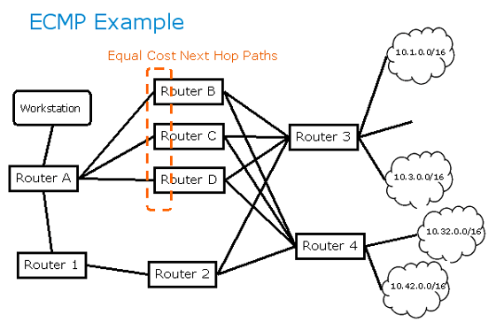
Backup: ECMP
Equal-Cost Multi-Path Routing
Hash packet header and choose one of equal-cost paths

Slide 37
Backup: SEDA

Slide 38
Backup: SNAT

Slide 39
VIP traffic in a data center
Notes:
- This is just the current usage. In reality, we expect the intra-DC VIP traffic to increase faster and that is what we have provisioned for.

Slide 40
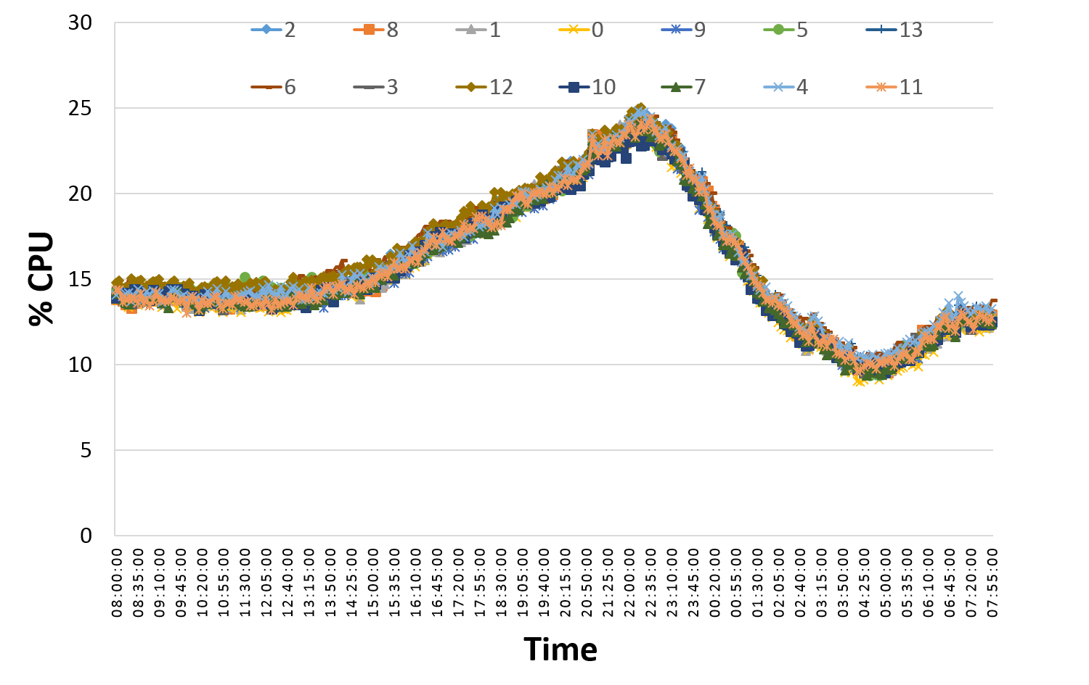
CPU usage of Mux
CPU usage over typical 24-hr period by 14 Muxes in single Ananta instance

Slide 41
Remarkable Points
The first middlebox architecture that moves parts of it to the host
Deployed and served for Microsoft datacenter more than 2 years

