Slide 1

Abstractions for Network Update
Authors: Mark Reitblatt, Nate Foster, Jennifer Rexford, Cole Schlesinger, David Walker
Presenter: Byungkwon Choi
INA
Notes:
Hi, I’m byungkwon Choi. Today, I’m going to make a presentation about network configuration update. This paper provides network configuration update abstractions that prevent errors during updates and give convenience to application programmers.

Slide 2

Networks exist in a state of flux
SSH: Drop
SSH: Drop
Upgrade → Reboot
Traffic Flows
* reference: author’s slides
Notes:
In data centers, applications generate traffic flows and rely on network to deliver them.
The traffic distribution of these flows can change with the updates in network.
For example, before shutting down a switch, we typically move rules on the switch out to other switches and move flows out to other switches.
After the switch goes online again, we move the rules and flows back.

Slide 3
Networks exist in a state of flux
Traffic Flows
Virtual Machines
* reference: author’s slides
Notes:
While the network is in flux, applications’ behaviors are also changing the traffic distribution simultaneously.
For instance, an application owns some virtual machines and these virtual machines have some traffic flows with each other.
When the application decides migrate some virtual machines to other locations, the VM migration can reshape the traffic flows.
In networks, updates like these examples are happening everyday.

Slide 4








1-1
Example: Distributed Access Control
Security Policy
Src | Traffic | Action
 | SSH | Drop
 | Non-SSH | Allow
 | Any | Allow
F1
I
F2
F3
Traffic
* Design from author’s slide
Notes:
And I’d like to give you an example for an error during an update. The clouds on the left mean external network and the cloud on the right mean internal network. The black hat means untrusted source and white hat means trusted source. And the traffic flows from external network to internal network and there are 4 switches between them. The switch I is an ingress switch and the switches F1, F2, F3 are internal switches.
And the security policy is that SSH packets from untrusted source are being dropped and non-SSH packets from untrusted source are being allowed. And all packets from trusted source are being allowed.

Slide 5


1-1
Example: Distributed Access Control
Security Policy
Other:
SSH:
Src | Traffic | Action
 | SSH | Drop
 | Non-SSH | Allow
 | Any | Allow
F1
F2, F3
F1
Any:
I
F2
Any:
F3
Traffic
* Design from author’s slide
Notes:
In order to stick to the security policy, the appropriate configuration rules are set in each switch. And it has been set to treat more trustworthy traffic than untrustworthy traffic. So, the traffics from trusted source are forwarded to 2 switches F2, F3. And the switch F1 drops SSH packets because it handles untrusted source and SSH packets from untrusted source should be dropped as stated in the security policy table.

Slide 6
1-1
Example: Distributed Access Control
Security Policy
Other:
SSH:
Src | Traffic | Action
 | SSH | Drop
 | Non-SSH | Allow
 | Any | Allow
F1, F2
F3
F1
Other:
SSH:
I
F2
Any:
F3
Traffic
* Design from author’s slide
Notes:
And let’s assume that it would like to allocate more resources in order to handle untrustworthy traffic right now. And then, ingress switch I forwards untrustworthy traffic to switch F1 and F2 and switch F2 is being also dropping SSH packets. The network configuration should be changed like this.

Slide 7
1-1
Example: Distributed Access Control
Security Policy
Other:
SSH:
Src | Traffic | Action
 | SSH | Drop
 | Non-SSH | Allow
 | Any | Allow
F1
F2, F3
F1
Any:
I
F2
Any:
Order
I
F1
F2
F3
F3
Traffic
* Design from author’s slide
Notes:
However, because we cannot update the network all at once, the individual switches need to be reconfigured one-by-one. And the order is like this.

Slide 8
1-1
Example: Distributed Access Control
Security Policy
Other:
SSH:
Src | Traffic | Action
 | SSH | Drop
 | Non-SSH | Allow
 | Any | Allow
F1, F2
F3
F1
Any:
I
F2
Any:
Order
F1
F2
F3
F3
Traffic
* Design from author’s slide
Notes:
At first, the configuration rule on the ingress switch I is updated.

Slide 9
1-1
Example: Distributed Access Control
Security Policy
Other:
SSH:
Src | Traffic | Action
 | SSH | Drop
 | Non-SSH | Allow
 | Any | Allow
F1, F2
F3
F1
Any:
I
F2
Any:
Order
F2
F3
F3
Traffic
* Design from author’s slide
Notes:
And the switch F1 is updated secondly.

Slide 10

1-1
Example: Distributed Access Control
Security Policy
Other:
SSH:
Src | Traffic | Action
 | SSH | Drop
 | Non-SSH | Allow
 | Any | Allow
F1, F2
F3
F1
Any:
I
F2
Any:
Order
F2
F3
F3
Traffic
* Design from author’s slide
Notes:
Meanwhile, an SSH packets from untrusted source has been sent.

Slide 11
1-1
Example: Distributed Access Control
Security Policy
Other:
SSH:
Src | Traffic | Action
 | SSH | Drop
 | Non-SSH | Allow
 | Any | Allow
F1, F2
F3
F1
Any:
I
F2
Any:
Order
F2
F3
F3
Traffic
* Design from author’s slide
Notes:
The SSH packets could be forwarded to switch F2.

Slide 12
1-1
Example: Distributed Access Control
Security Policy
Other:
SSH:
Src | Traffic | Action
 | SSH | Drop
 | Non-SSH | Allow
 | Any | Allow
F1, F2
F3
F1
Any:
I
F2
Any:
Order
F2
F3
F3
Traffic
* Design from author’s slide
Notes:
The SSH packet will be forwarded into the internal network because switch F2 has not been updated yet.

Slide 13
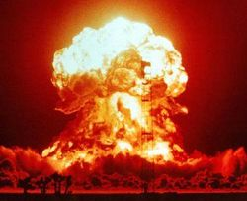
1-1
Example: Distributed Access Control
Security Policy
Other:
SSH:
Src | Traffic | Action
 | SSH | Drop
 | Non-SSH | Allow
 | Any | Allow
F1, F2
F3
F1
Any:
I
F2
Any:
Order
F2
F3
F3
Traffic
* Design from author’s slide
Notes:
Consequentially, it brings about a result violating the security policy.

Slide 14
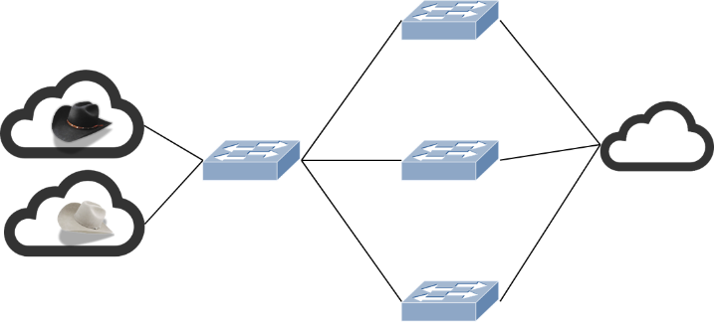

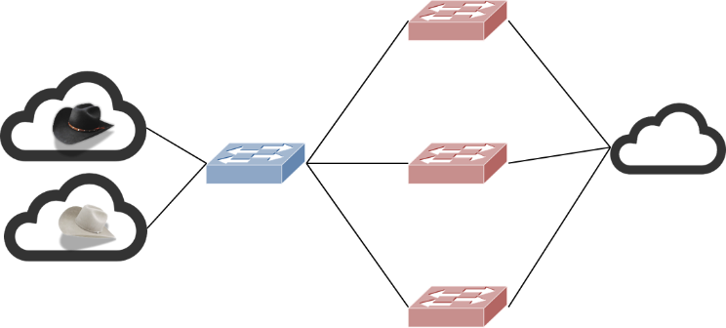
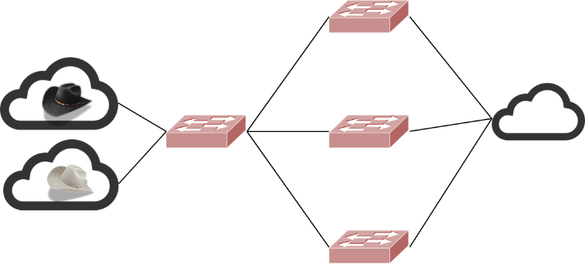
1-1
Goal
Security Policy
Before update
During update
After update
Notes:
So, the goal is to stick to the security policy before an update, during an update, and, after an update.

Slide 15
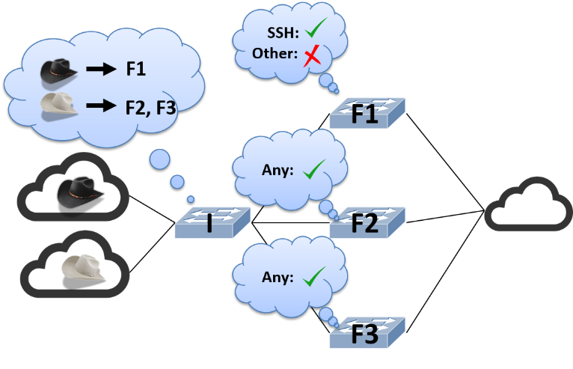
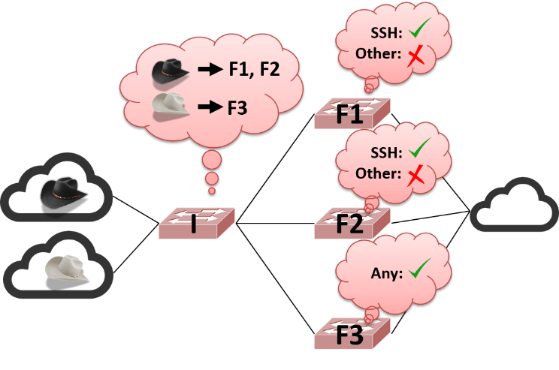
1-1
Valid Transition Plan
1. Update I to forward all trusted traffic to F3, while continuing to forward untrusted to F1.
2. Wait until in-flight packets have been processed by F2
3. Update F2 to drop SSH packets
4. Update I to forward untrusted traffic to F2 also, while continuing to forward trusted traffic to F3.
Notes:
On the other hand, It is possible to resolve this problem by finding well-planned setting order.
한편 새로운 알고리즘을 적용하지 않고, 업데이트 하는 순서를 잘 정함으로써 해당 문제를 해결할 수도 있습니다.

Slide 16
1-1
Valid Transition Plan
Tedious and error-prone,
Sometimes step-by-step is not possible to!
1. Update I to forward all trusted traffic to F3,
while continuing to forward untrusted to F1.
2. Wait until in-flight packets have been processed by F2
3. Update F2 to drop SSH packets
4. Update I to forward untrusted traffic to F2 also,
while continuing to forward trusted traffic to F3.
Notes:
However, the procedure to do that is tedious and error-prone and sometimes it is impossible to find the setting order.
So, we need fundamental solution.
하지만 이러한 과정은 지루할 뿐만 아니라 사람이 해야 하기 때문에 에러가 발생하기 쉽고, 가끔은 이렇게 잘 동작하는 플랜을 찾는 것 자체가 불가능한 경우도 있습니다. 따라서 우리는 좀 더 근본적인 해결책을 필요로 합니다.

Slide 17
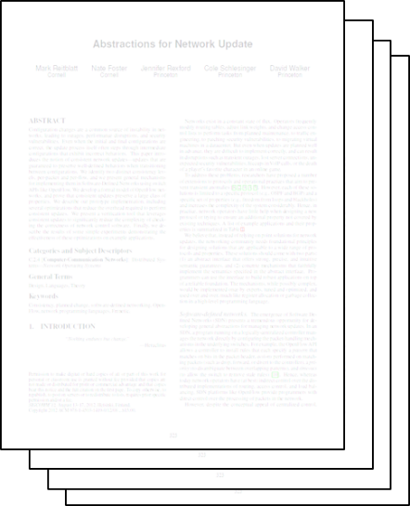
1-1
Prior Works
Consensus
Routing
Reliable BGP
Graceful
Migration
Seamless
Migration
* reference: author’s slides
Notes:
Of course, there had been lots of prior works before.

Slide 18
1-1
Prior Works
Consensus
Routing
Reliable BGP
Limited to a specific
protocol/set of properties,
Increasing the complexity!
Graceful
Migration
Seamless
Migration
Notes:
These solutions are limited to a specific protocol and specific set of properties and it is increasing the complexity of the system considerably.

Slide 19

1-1
Network Update Abstractions
Tools for whole network update
; Preventing errors during update
; Preserving many properties
; Allowing the programmer to update the entire network in one fell swoop
Notes:
In order to resolve this problem, they provide tools that prevents errors during an update, preserve many properties, and, give more convenience to application programmers for network configuration update.

Slide 20
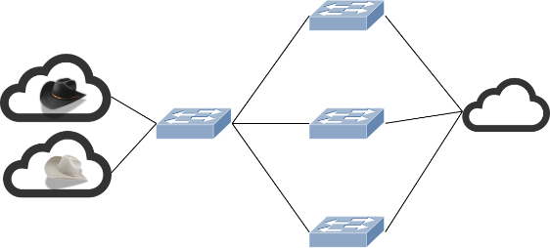
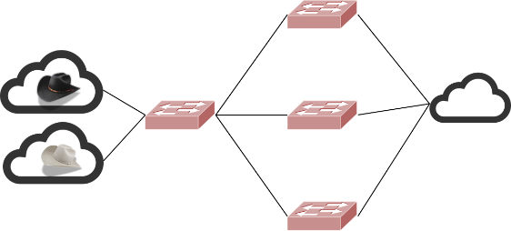

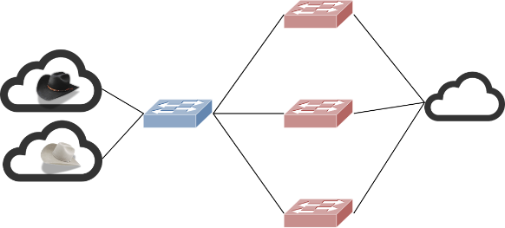
1-1
Per-Packet Consistent Update
Each packet is processed with old or new configuration,
but not a mixture of the two.
or
Old configuration
New configuration
Packet
Mixture of the two
Notes:
At first, they suggest a network update abstraction named per-packet consistent update. It guarantee that each packet is processed with old or new configuration not mixture of the two. That means that if you update network configuration using per-packet consistent updates, you can be guaranteed to stick to the security policy if the old and new configuration only need to stick to the security policy. The network update method itself does not break the security policy.

Slide 21
1-1
Universal Property Preservation
- Theorem
Per-packet consistent updates preserve all trace properties.
- Trace Property
Any property of a single packet’s path through the network
- Examples of Trace Properties
Loop freedom, access control, waypointing …
- Universal Property Preservation
If a trace property such as loop-freedom or access control holds of the network configurations before and after an update, It is guaranteed that a trace property holds of every trace generated throughout the update process.
Notes:
Additionally, they proved that per-packet consistent updates preserve all trace properties. The trace property means any property of a single packet’s path through the network. Some examples of trace property are loop freedom, access control, and, waypointing. Preserving a trace property means if a trace property holds of the network configurations before and after an update, it is guaranteed that a trace property has been preserved during the update.

Slide 22
1-1
2-Phase Update
- Algorithm
(1) Installing new rules on internal switches, leaving old configuration in place
(2) Installing edge rules on ingress switches that stamp with the new version number
Other:
SSH:
F1
Any:
SSH
SSH
F1
Ingress Switch
Internal Switch
< After adopting the 1st step of 2-Phase Update algorithm >
Notes:
There could be lots of method to implement per-packet update and they design an mechanism named 2-Phase update. 2-phase update is consist of 2 steps. The first step is to install new configuration rules on internal switches and it also leaves old configuration rules in place. When the first step has been done, edge rules stamping with the new version number on packets are installed on ingress switches. It is the second step. And this picture describes network state after the first step of 2-phase update. When a packet arrived at the ingress switch, the ingress switch stamps old version number the blue one on the packet. And the packet is forwarded to the internal switch and processed with the old rules colored blue because the version of the packet is old. After all internal switches have new rules, the ingress switches are being updated with new edge rules.

Slide 23
1-1
2-Phase Update in Action
Other:
SSH:
F1
F2, F3
F1
Any:
I
F2
Any:
F3
Notes:
So, I’ll give you an explanation of 2-phase update with picture. At first, the old rules have been installed on the switches.

Slide 24
1-1
2-Phase Update in Action
Other:
SSH:
Other:
SSH:
F1
F2, F3
F1
Other:
SSH:
Any:
I
F2
Any:
Any:
F3
Notes:
On the first step of 2-phase update, the new configuration rules are installed on the internal switches, leaving the old rules in place.

Slide 25
1-1
2-Phase Update in Action
SSH:
Other:
Other:
SSH:
F1, F2
F3
F1
Other:
SSH:
Any:
I
F2
Any:
Any:
F3
Notes:
And when the installation of new rules on the internal switches has been finished, the new edge rules are being installed on the ingress switches.

Slide 26
1-1
2-Phase Update in Action
SSH:
Other:
Other:
SSH:
F1, F2
F3
F1
Other:
SSH:
I
F2
Any:
F3
Notes:
Finally, the old rules on the internal switches will be expired.

Slide 27
1-1
Atomic Update?
Security Policy
Other:
SSH:
Src | Traffic | Action
 | SSH | Drop
 | Non-SSH | Allow
 | Any | Allow
F1
F2, F3
F1
Any:
I
F2
SSH
Any:
F3
Traffic
Notes:
Some one can think the 2-phase update is similar with atomic update. But, some error could occur with atomic update.
When the trusted source sends an SSH packet,

Slide 28
1-1
Atomic Update?
Security Policy
Other:
SSH:
Src | Traffic | Action
 | SSH | Drop
 | Non-SSH | Allow
 | Any | Allow
F1
F2, F3
F1
Any:
I
SSH
F2
Any:
F3
Traffic
Notes:
It passes through the ingress switch and could be forwarded to switch F2,

Slide 29
1-1
Atomic Update?
Security Policy
Other:
SSH:
Src | Traffic | Action
 | SSH | Drop
 | Non-SSH | Allow
 | Any | Allow
F1, F2
F3
F1
Other:
SSH:
I
SSH
F2
Any:
F3
Traffic
Notes:
At that time, the network configuration has been updated with atomic update.

Slide 30

1-1
Atomic Update?
Security Policy
Other:
SSH:
Src | Traffic | Action
 | SSH | Drop
 | Non-SSH | Allow
 | Any | Allow
F1, F2
F3
F1
Other:
SSH:
I
F2
Any:
F3
Traffic
Notes:
And the SSH packet should be forwarded to the internal network according to the security policy, however, switch F2 will drop the packet because the switch F2 has been updated. It is a problem that could occur with atomic update. But, kind of this problem does not appear to happen because each packet will be processed with only one configuration not mixture one when using per-packet consistent update.

Slide 31
1-1
Correctness
Question: Is 2-Phase Update Per-Packet consistent update?
Answer: YES
; Implementing per-packet consistent updates can be reduced to 2 blocks.
(1) Unobservable Update:
; An update that does not change the set of traces generated by a network.
; The 1st step of 2-Phase Update is an unobservable update.
(2) One-touch Update
; An update with the property that no packet can follow a path through the network
that reaches an updated part of the switch rule space more than once
; The 2nd step of 2-Phase Update is an one-touch update.
Unobservable Update + One-touch Update = Per-packet Update
2-Phase Update = Per-packet update
Notes:
And we can have a question whether 2-phase update is really per-packet consistent update or not. As you know, the answer is yes. According to their experiences, all techniques to implement per-packet consistent updates can be reduced to 2 fundamental building blocks.
The first one is unobservable update and the second one is one-touch update. The unobservable update is an update that does not change any traces generated by a network. The first step of 2-phase update is an update but all traces are not changed because the packets are processed with old rules until the update of ingress switches. So, the first step of 2-phase update is an unobservable update.
And one-touch update means all packets reach the target switches less than twice. Only once or never. All packets from external networks pass through the ingress switches only once, so, the second step updating the ingress switches is an one-touch update.
So, we can say the 2-phase update is per-packet consistent update.

Slide 32

1-1
Verification
In order to verify whether configuration sticks to security policy,
Programmer can turn any trace property checker into a verification engine.
Old configuration
New configuration
Security Policy
Analyzer
Security Policy
Analyzer
Verification Tools
- Anteater[SIGCOMM `11]
- Header Space Analysis [NSDI `12]
- ConfigChecker [ICNP `09]
Notes:
And this paper provide another abstractions for verification. Application programmers can check if a configuration that programmer makes sticks to the security policy by checking the security policy before and after the update. Because per-packet consistent update preserves all trace properties as I mentioned in the previous slide.

Slide 33
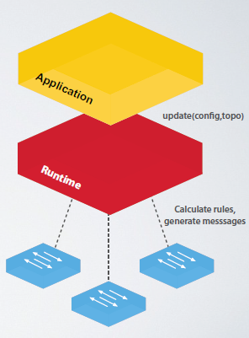
1-1
Optimized Mechanisms
- Update Proportionality
The cost of installing a new configuration should be proportional to
the size of the configuration change.
- Cases for Optimizations
(1) Extension: strictly adding paths
(2) Retraction: strictly removing paths
(3) Subset: affecting small # of paths
* reference: author’s slides
Notes:
And they have optimized 2-phase update mechanism in order to stick to update proportionality.
그리고 그들은 per-packet consistent update를 최적화하기도 하였습니다.
Update mechanism은 반드시 configuratio이 변화하는 정도에 cost가 비례해야 한다는 update proportionalit를 따라야 하는데, 기존의 full 2-phase updat에 의하면
Cost는 변화하는 정도가 아닌 새로운 configuration의 size에 비례합니다.
따라서 그들은 모든 configuration rule들을 update하는 것이 아니고 이전 configuration rule들 중 변하는 것들만 update하도록 하였는데 그렇게 할 수 있는 상황으로는 크게 3가지가 있습니다.

Slide 34
1-1
Subset Optimization
Other:
SSH:
F1
F2, F3
F1
Any:
I
F2
Any:
F3
Notes:
In the previous example, actually it has only to update subset of switches rather than all switches.
그 중에 subset optimization은 path의 일부만 update되는 상황에서의 optimization을 의미합니다.

Slide 35
1-1
Subset Optimization
Other:
SSH:
F1
F2, F3
F1
Other:
SSH:
Any:
I
F2
Any:
F3

Slide 36
1-1
Subset Optimization
Other:
SSH:
F1
F2
F2
F1
Other:
SSH:
Any:
I
F2
Any:
F3

Slide 37
1-1
Subset Optimization
Other:
SSH:
F1
F2
F2
F1
Other:
SSH:
I
F2
Any:
F3
Notes:
So, it could be possible to update the entire network with fewer operations by updating subset of switches that should be updated in order to stick to the new configuration.

Slide 38
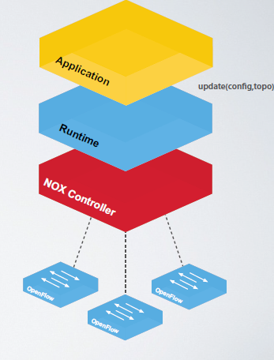
1-1
Implementation
Runtime
- NOX Library
- OpenFlow 1.0
- 2.5k lines of Python
- Using VLAN tags for versions
* reference: author’s slides
Notes:
2-phase update has been implemented with NOX Library and Openflow.
The way to stamp version number on packets uses VALN tagging.

Slide 39
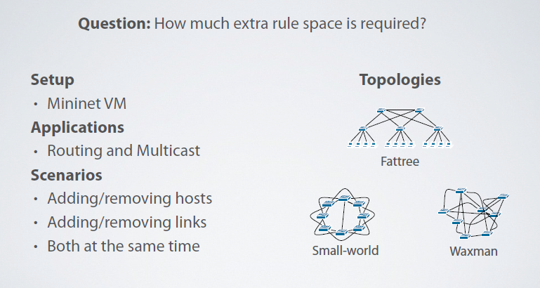
1-1
Evaluation
* reference: author’s slides
Notes:
And they compare the original version of 2-phase update with the optimized version of 2-phase update in terms of rule space and the number of operations.
In order to do that, they use Mininet VM and they have implemented 2 network application routing and multicast.
They have conducted the experiment with 3 kinds of topologies and 3 kinds of scenarios.

Slide 40
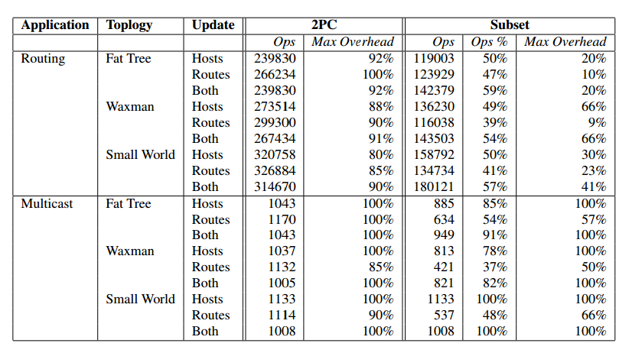
1-1
Experimental Results
Results comparing 2-Phase Update(2PC) with their subset optimization(Subset)
* reference: Table 2 in the paper
- Subset was more effective than 2PC with routing application.
- Fewer improvements for the multicast example
Notes:
As a result, that’s quite natural, the optimized version is more effective than the original version in terms of both the number of operations and space. Maximum overhead is about how many rule space needs in order to conduct an update with corresponding mechanism.
However, the results of them are similar with multicast application. Because almost all paths change when the spanning tree changes.

Slide 41
1-1
Conclusion
Update abstractions
  Per-packet consistent update
  : Only one configuration adopted to each packet
  : Preserving all trace properties
Mechanisms
  2-Phase Update
  Optimizations
Network update without errors and
in one fell swoop using an high-level abstract operation
Notes:
In this paper, they provide a network configuration update abstraction named per-packet consistent update. And they design 2-phase update mechanism and optimization mechanism. When using per-packet consistent update, network operators could conduct no error network updates in one fell swoop.

Slide 42
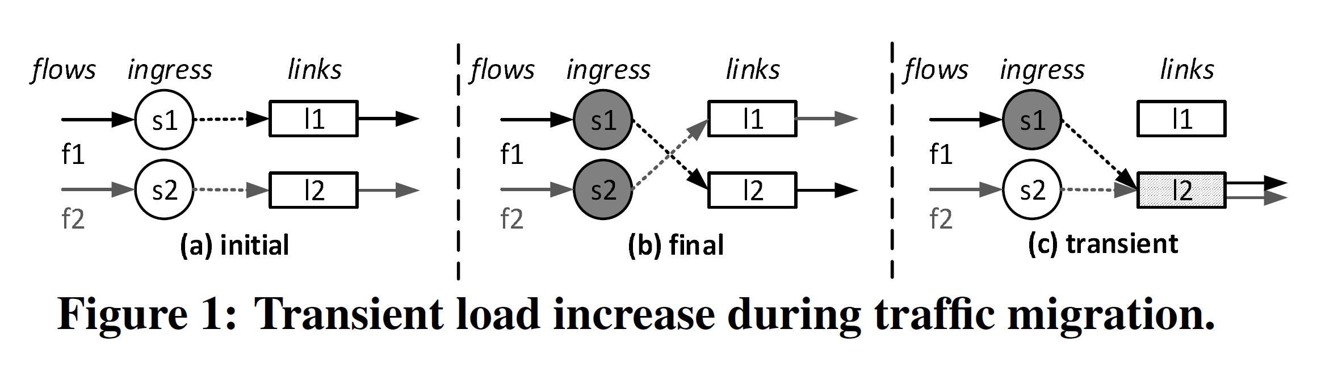
1-1
Additional Problem: Excess of Link Capacity
During traffic migration
  Difficulty in synchronizing the changes to the flows
  Could lead to severe congestion
  Cannot be solved by 2-Phase Update mechanism
Notes:
However, there is an additional problem that the previous paper doesn’t resolve. That is about link capacity.
Let’s assume that an initial distribution of traffic is like figure 1 (a) and a target distribution of traffic is like figure 1 (b).
During the update, a situation like figure 1 (c) can happen because we cannot update the network all at once.
And if the summation of the loads for flow f1 and f2 exceeds l2 link capacity, packet loss can happen. And it cannot be solved by 2-phase update.

Slide 43
zUpdate: Updating with Zero Loss
Constraint:
Congestion-free
Constraint:
Update Requirements
Constant:
Current Traffic Distribution
Variable:
Intermediate
Traffic Distribution
Variable:
Intermediate
Traffic Distribution
Variable:
Target Traffic
Distribution
* reference: author’s slides
23 / 26
Notes:
And the other paper provides zUpdate which is an update with zero loss.
In order to reach the target traffic distribution, zUpdate calculates a sequence of intermediate traffic distributions.

Slide 44
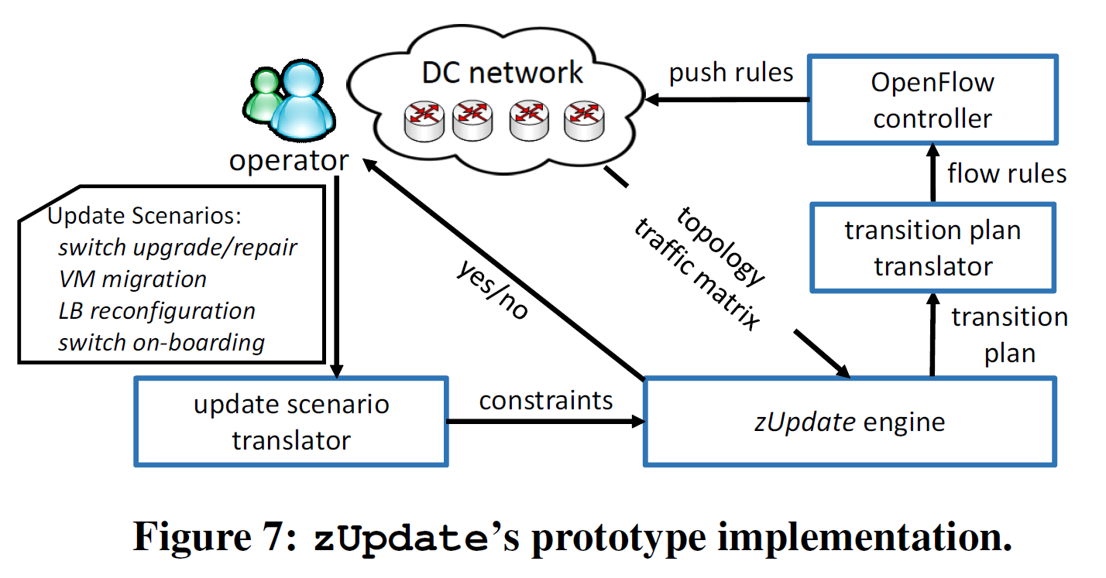
zUpdate: Updating with Zero Loss
24 / 26
Notes:
Here are the key components and workflow of zUpdate. When an operator sends update scenarios to the translator, the translator converts the operator’s request into the suitable input of zUpdate engine. If it is possible to update with that scenario, zUpdate says yes to the operator and gives an output which is a sequence of traffic distributions. The other translator converts the output into the corresponding flow rules. And finally, the openflow controller sends them to the switches.

Slide 45
zUpdate: Updating with Zero Loss
Conclusion
  Switch and flow asynchronization can cause severe congestion
  during datacenter network(DCN) updates.
  We present zUpdate for congestion-free DCN updates
    Novel algorithms to compute update plan
    Practical implementation on commodity switches
    Evaluations in real DCN topology and update scenarios
* reference: author’s slides
25 / 26
Notes:
In this paper, we learn that asynchronous changes in network updates can arouse severe congestions.
They introduce zUpdate to perform congestion-free network updates. They formulate the problem, design a novel algorithm to compute the update plan automatically, build a prototype on OpenFlow 1.0 and showing it works well in different real scenarios.

Slide 46
Discussion
How to know timing to conduct the 2nd step of 2-Phase Update?
  Nothing to check whether the installation of new rules on internal switches has been done on or not
What if a traffic distribution changes during the calculation?
  Is it possible too to update with zero loss at this time?
* reference: author’s slides
26 / 26
Notes:
As I read these papers, several questions came to mind.
In the first paper, they did not mention anything about timing for the second step of 2-phase update. The first step should be done before conducting the second step of 2-phase update.
In the second paper, they said that the required time for the computing several steps of transition plan takes several minutes. The initial traffic distribution may change during the computation and the transition plane maybe incorrect.

Slide 47
1-1
Thank you!
Q & A
Notes:
Thanks for listening my presentation. Any questions?

