Slide 1
Serval: An End-Host Stack for Service-Centric Networking
EE807 - Software-defined Networked Computing
Erik Nordstrom, David Shue, Prem Gopalan, Robert Kiefer, Matvey Arye, Steven Y. Ko, Jennifer Rexford, Michael J. Freedman
Princeton University
Presenter : YoungGyoun Moon
Some slides are brought from the authors’ presentation.

Slide 2
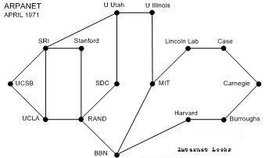
The Internet of the 1970s
Network designed only for accessing hosts
Killer apps = telnet, ftp

Slide 3
The Internet of the 2000s
Users require accessing “services”
Agnostic of actual service location and host
Datacenter

Slide 4
Requirements for Service Access
Finding a Service Location
Map service name to location
Connecting to Service
Load balance between pool of replicas
Maintaining Connectivity to Service
Migrate between interfaces and networks

Slide 5
Finding a Service Location
Service Node 1
Load balancing
DNS
Service Node 2
DNS update
Service Node 3
Fault tolerance
DNS binds service to location at client (early binding)
Problem: caching and ignoring TTL / slow failover

Slide 6
Connecting to Service
Load-balanced Web Service
Service Node
Datacenter LB maps a single IP to multiple servers
Problem: must repeat this for every packet → fate sharing
Problem: increases complexity and cost

Slide 7
Maintaining Connectivity to Service
(a) Mobile client hosts
(b) VM Migration
Fixed Network
Cellular Network
Datacenter
Host A
Host B
Problem: flows break when switching networks/interfaces
Problem: requires flat addressing or tunneling

Slide 8
Today’s Abstractions
Service is IP + port
Exposes location
Specifies app. protocol
One service per IP
Flow is “five tuple”
Binds flow to location
Cannot migrate between interfaces or networks
ex) KAIST web server
→ 143.248.5.130:80
connect (IP + port)
Application
demux (IP + port)
Transport
forward (IP)
Network

Slide 9
Serval Abstractions
Cleans the slate
Network layer unmodified
Service Access Layer
Connects to services
Maintains connectivity
Application
Transport
Service Access
forward (IP)
Network

Slide 10
Serval Abstractions
Service = ServiceID
Group of processes with identical functionality
Flow = FlowID
Invariant demux key
Location = IP address
Location, interface (can change dynamically)
connect (serviceID)
Application
Transport
serviceID
demux ( )
Service Access
flowID
forward (IP)
Network

Slide 11
A Clean Role Separation in the Stack
What you access (serviceID), over which flows (flowID), and at which service instance (IP address)
TCP/IP
Serval
connect (IP + port)
connect (serviceID)
Application
demux (IP + port)
Transport
serviceID
Service Access
demux ( )
flowID
forward (IP)
forward (IP)
Network

Slide 12
A Service-Aware Network Stack
Client side
Server side
bind(sock, serviceID)
listen(sock)
connect (sock, serviceID)
Network stack must resolve service to instance
Network stack must advertise service

Slide 13
Service Names (ServiceIDs)
Provider prefix
Provider-specific
Self-certifying
ServiceIDs allocated in blocks
Prefix ensures global uniqueness
Enables prefix-based matching/aggregation
A ServiceID late binds to service instance
ServiceID in first packet of connection
Service-level routing and forwarding

Slide 14
Contributions
Naming abstractions
Services, flows
Clean role separation in the network stack
Software architecture for services (Serval)
How network stack resolves/advertises service

Slide 15
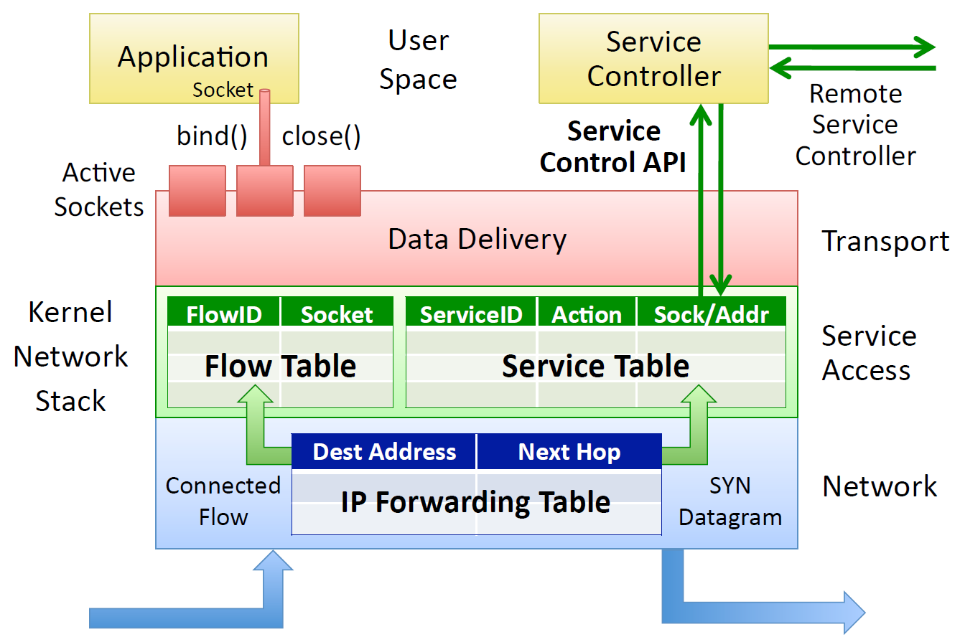
Serval End-host Architecture
Service-level control/data plane split

Slide 16
Adding a Service Instance
Service Controller
Register Service X
Application
bind(X)
listen()
s
Service Access Layer
ServiceID | Action | Rule state
X | DEMUX | Send to socket s

Slide 17
Removing a Service Instance
Service Controller
Unregister Service X
Application
s
close()
Service Access Layer
ServiceID | Action | Rule state
X | DEMUX | Send to socket s
ServiceID | Action | Rule state
Removed DEMUX Rule

Slide 18
Data Plane: The Service Table
ServiceID | Action | Rule State
Prefix A | FORWARD | Send to address A1
Prefix B | FORWARD | Send to [A2, A3, A4]
Prefix C | DEMUX | Send to listening sock s
Prefix D | DELAY | Queue and notify service controller
Prefix E | DROP | -
default | FORWARD | Send to A5

Slide 19
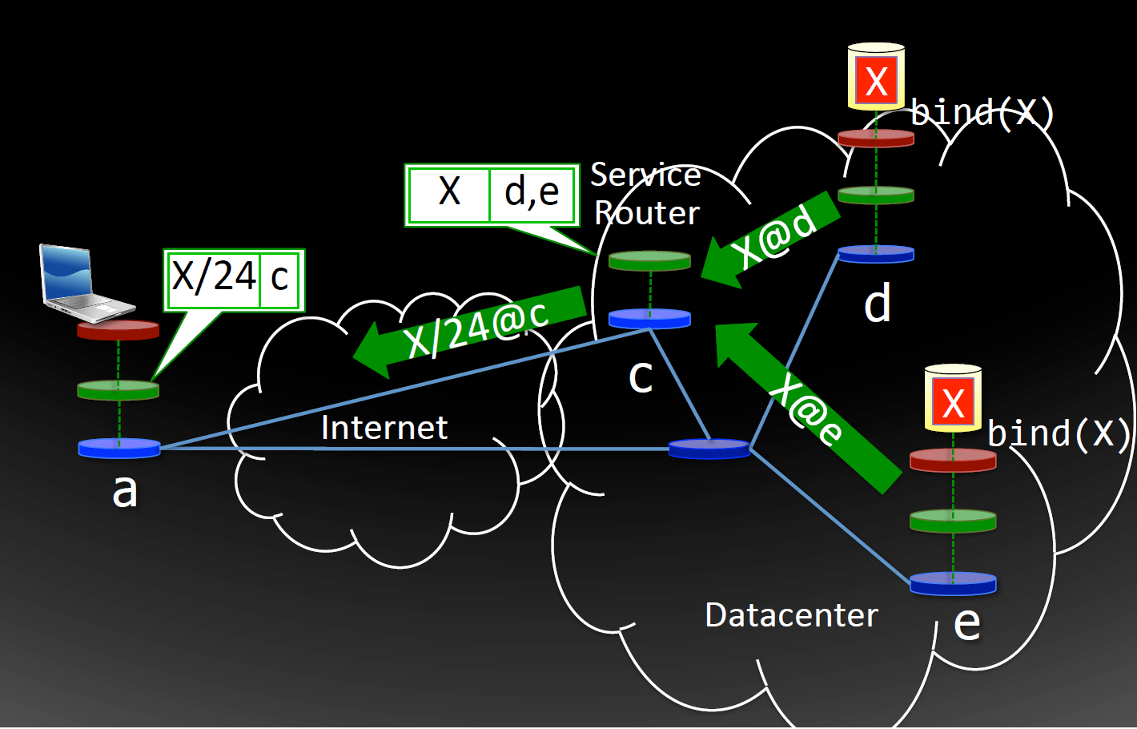
Service Router

Slide 20
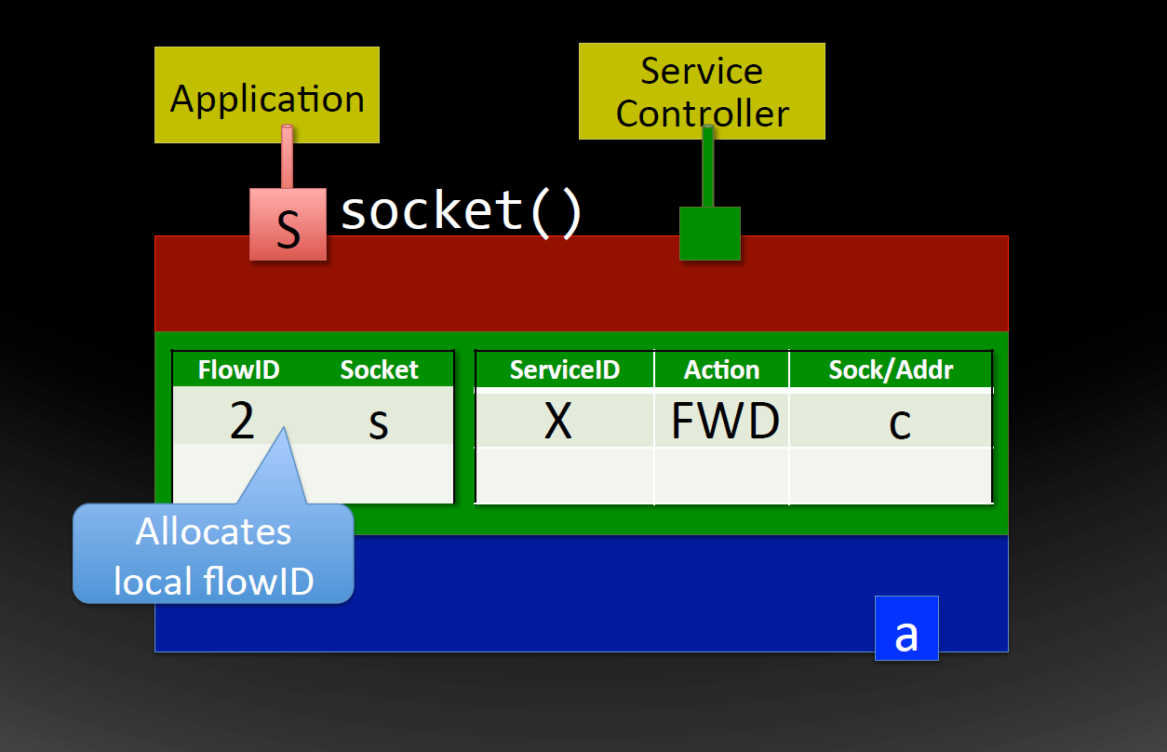
Client – Connecting to Service X

Slide 21
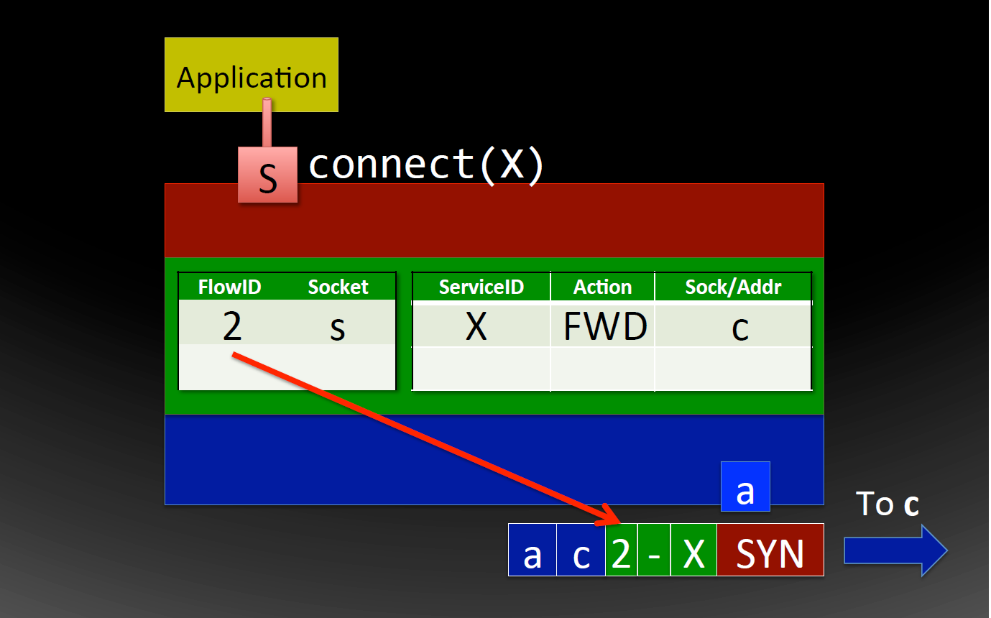
Client – Connecting to Service X

Slide 22
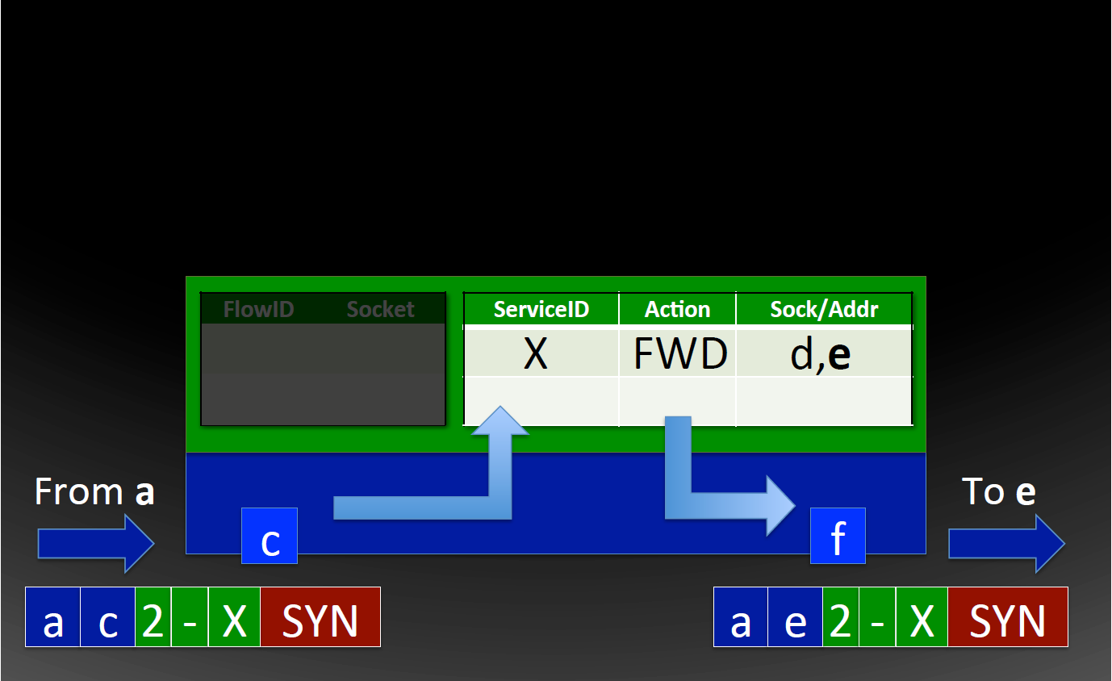
Service Router – Load Balancing

Slide 23
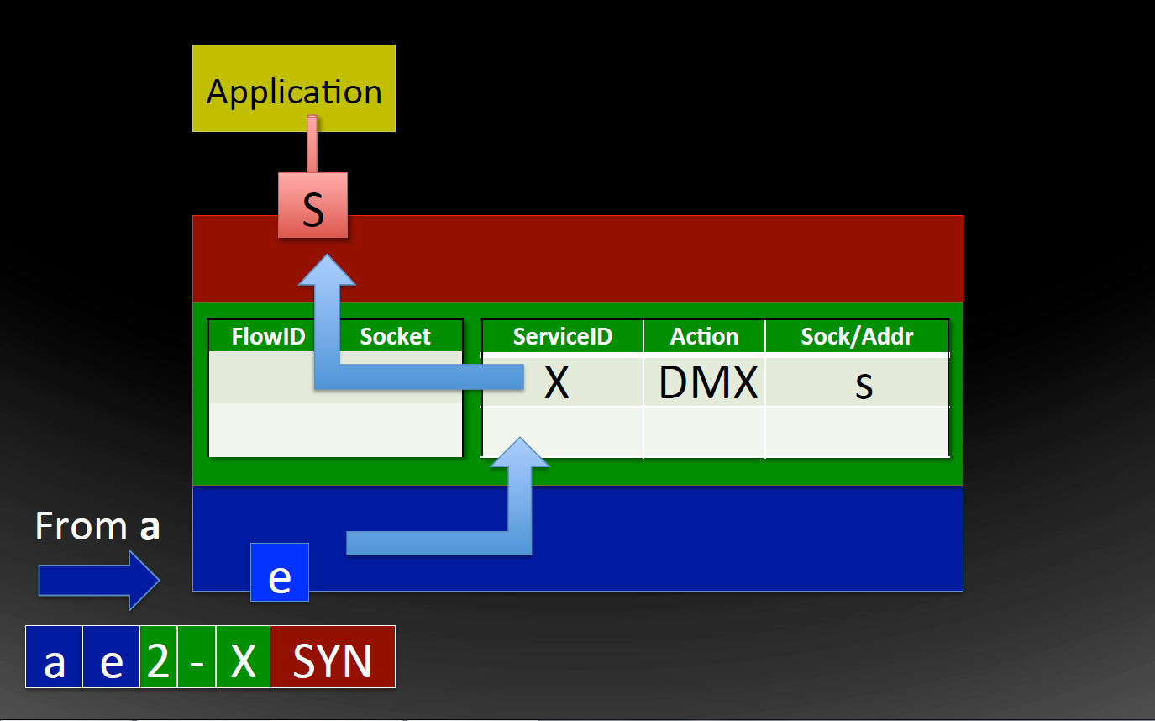
Server – Providing Service X

Slide 24
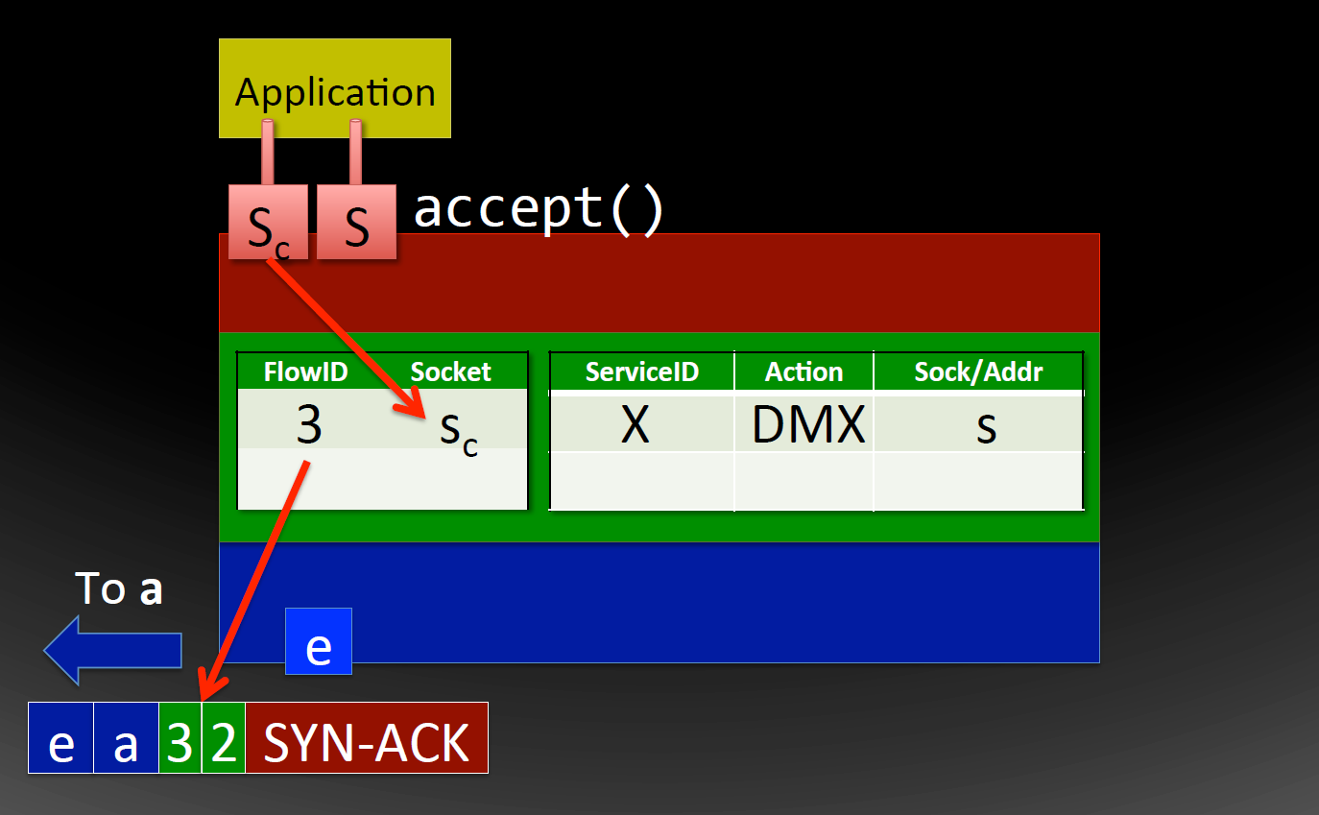
Server – Providing Service X

Slide 25
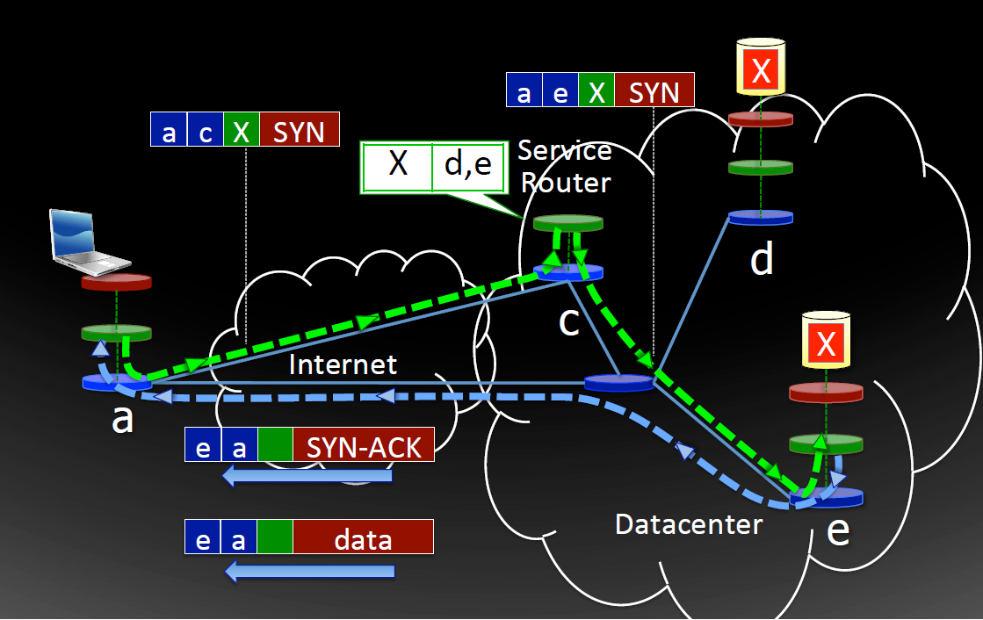
Service Access with Serval

Slide 26
Requirements for Service Access
Finding a Service Location
Map service name to location
Connecting to Service
Load balance between pool of replicas
Maintaining Connectivity to Service
Migrate between interfaces and networks

Slide 27
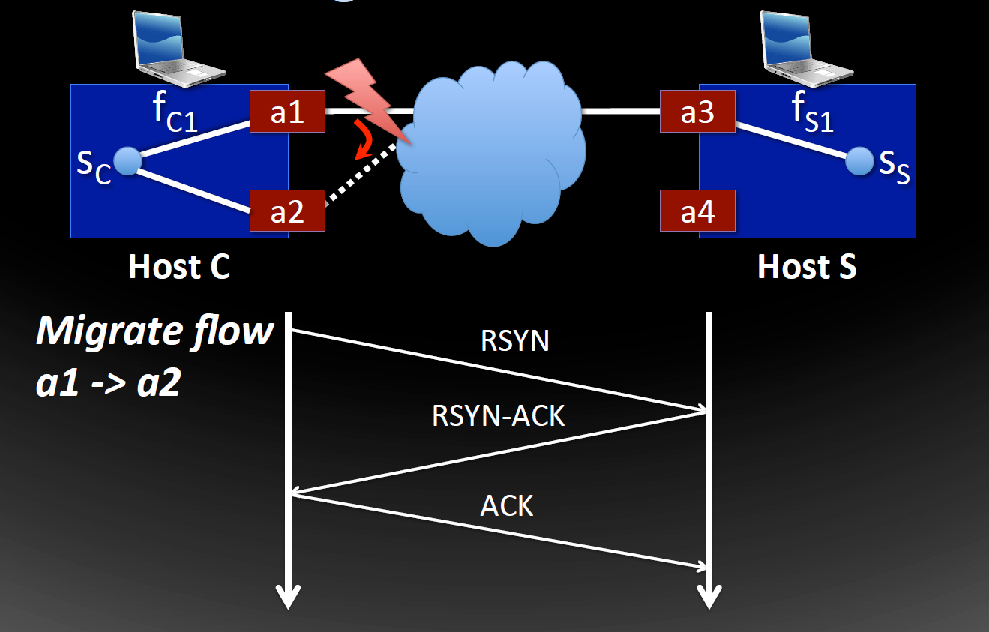
Migration of Flows

Slide 28
Serval Prototype
End-host network stack (28,000 LOC)
Linux kernel module
BSD sockets with AF_SERVAL protocol familiy
AF_INET sockets can be used simultaneously
Legacy middleboxes / NATs handled via encap.
Translator for incremental deployment
Unmodified apps and end-hosts
Available at www.servalproject.org

Slide 29
Base Performance Benchmark
TCP Throughput
Service Table Throughput
 | Mean (Mbit/s)
TCP/IP | 934.5
Serval | 933.8
Translator | 932.1
 | Mbit/s
IP forwarding | 987
Serval | 872

Slide 30
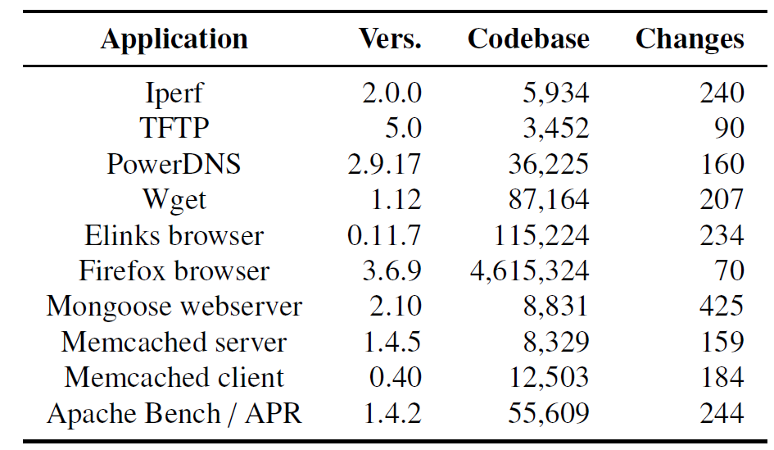
Applications are Easy to Port

Slide 31
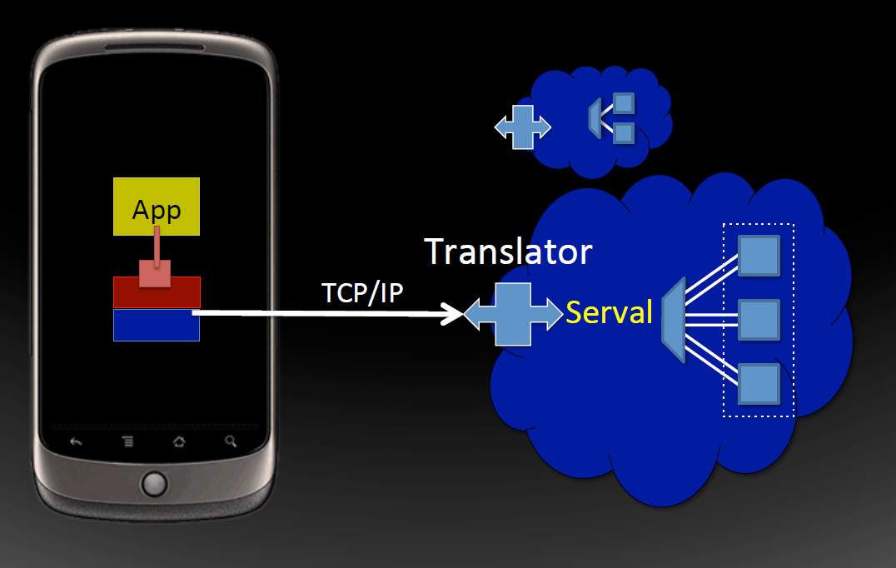
Incremental Deployment

Slide 32
Experimental Case Studies
Replicated Web Services
Please refer to the paper
Back-End Distributed Storage
Use of Migration on Clients/Servers

Slide 33
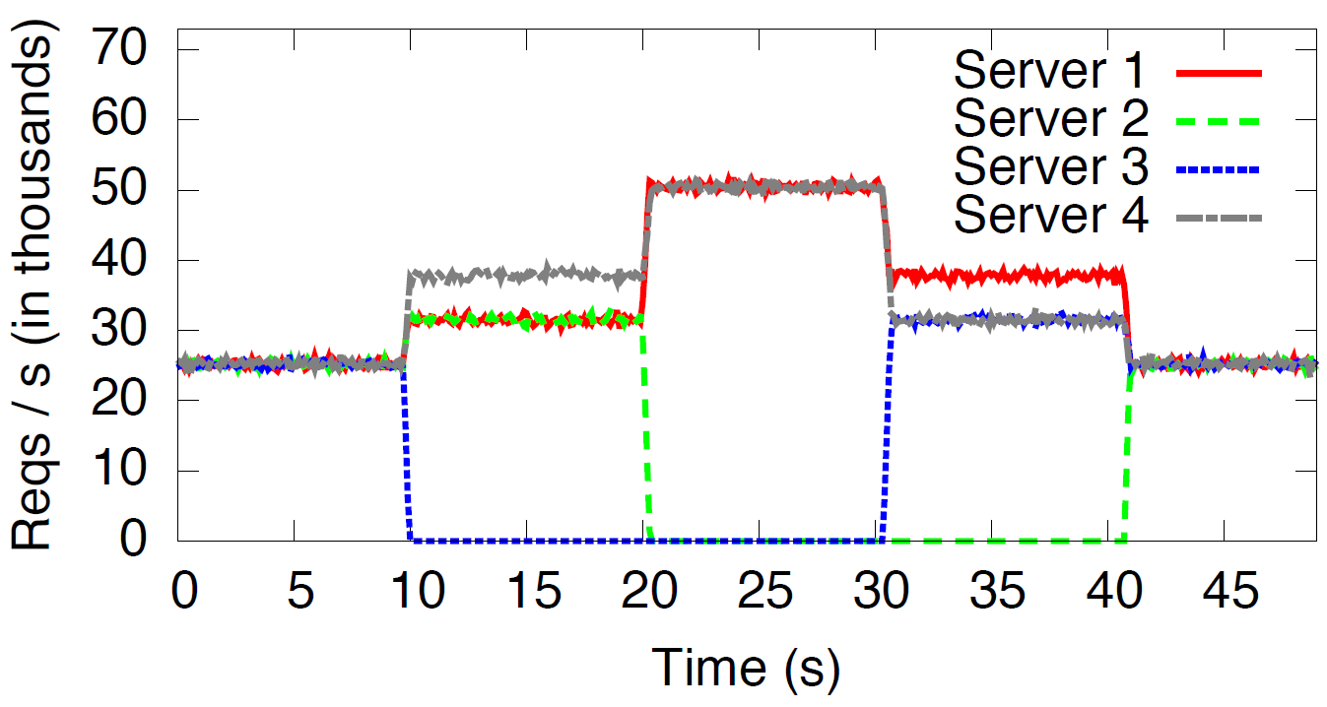
Back-end Distributed Storage
Dynamic partitioning mapping over 4 Memcached servers
1 service router distributes queries over the four back-end servers
Each has two 2.4 GHz AMD Opteron 2376 quad-core CPUs with GigE interface
Server 3 leaves
Server 2 leaves
Server 3 joins
Server 2 joins

Slide 34
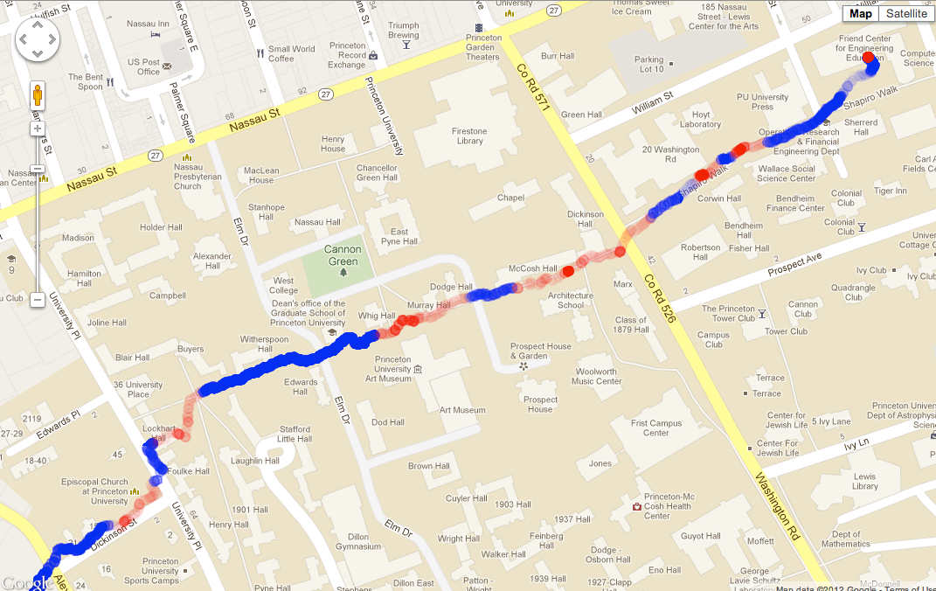
Use of Migration on Client
Wi-Fi
Cellular
Single Serval TCP connection that never breaks

Slide 35
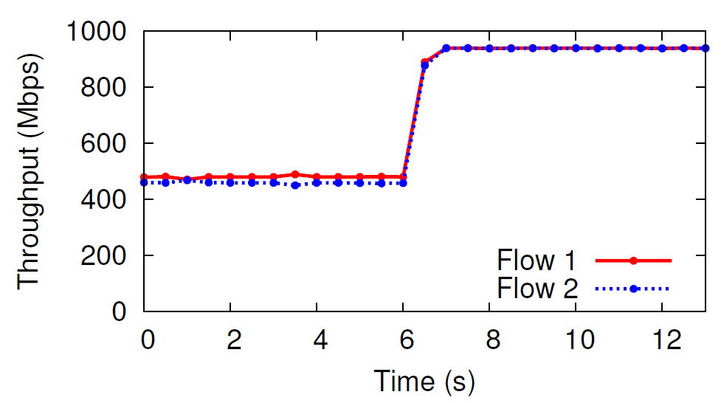
Use of Migration on Servers
Load balancing across NICs
Flow 1 moved to eth 1
Both flows use eth0

Slide 36
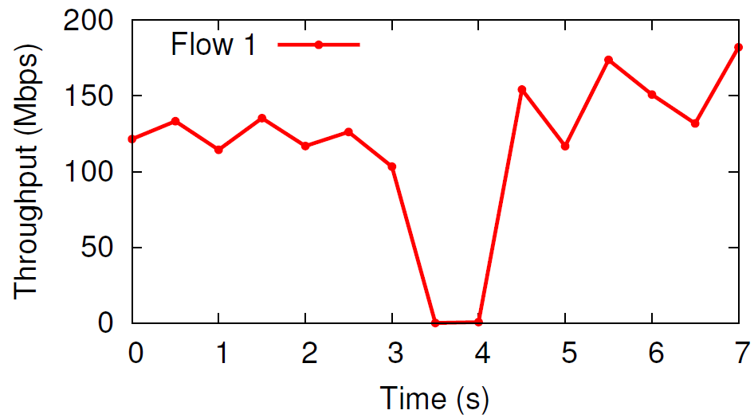
Use of Migration on Servers
Migrating VMs across subnets
VM is assigned a new address
TCP stalls due to RSYN handshake

Slide 37
Related Work
Locator/identifier separation
HIP, i3, LISP, DOA, LNA
Data-oriented networking
DONA, CCNx
Support for mobility and migration
TCP Migrate, Mobile IP, DTP, ROAM
Multipath and multi-homing
MPTCP, SCTP

Slide 38
Conclusion
New naming abstractions
Clean role separation in the stack
Makes it easier to build and manage services
Software architecture for services
Flexible service resolution and discovery
Maintains robust connectivity
Joint service and network management

Slide 39
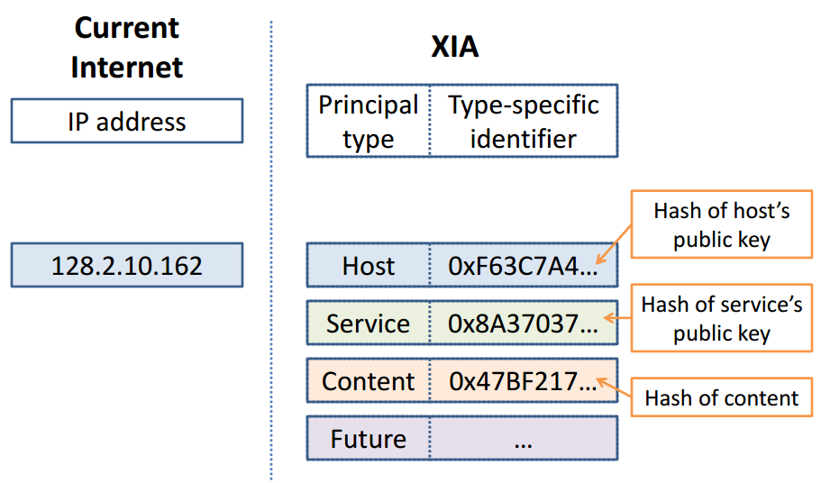
XIA : eXpressive Internet Architecture
Efficient support for evolvable internetworking
Define your own communication model
[Source: brought from the authors’ NSDI 12 slide]

Slide 40
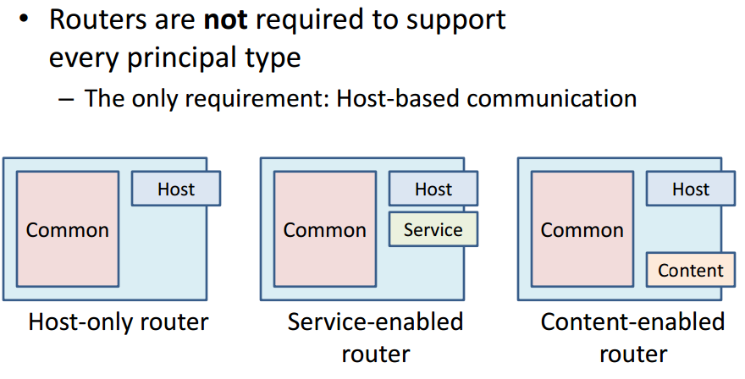
XIA : eXpressive Internet Architecture
[Source: brought from the authors’ NSDI 12 slide]

Slide 41
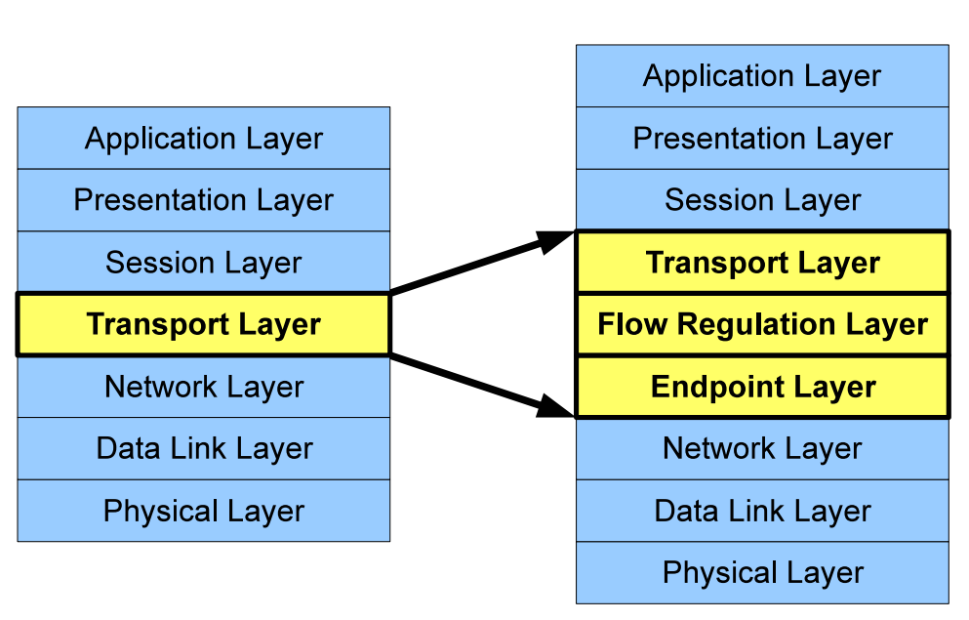
Breaking Up the Transport Logjam
Incremental rollout of new or improved transports
Architecture
Endpoint layer : intra-host addressing/routing via port num
Flow Layer : manages end-to-end performance of flows
Transport Layer : communication abstractions
Ex) reliable byte stream / multi-stream (SCTP) / media frame (RTP)

Slide 42
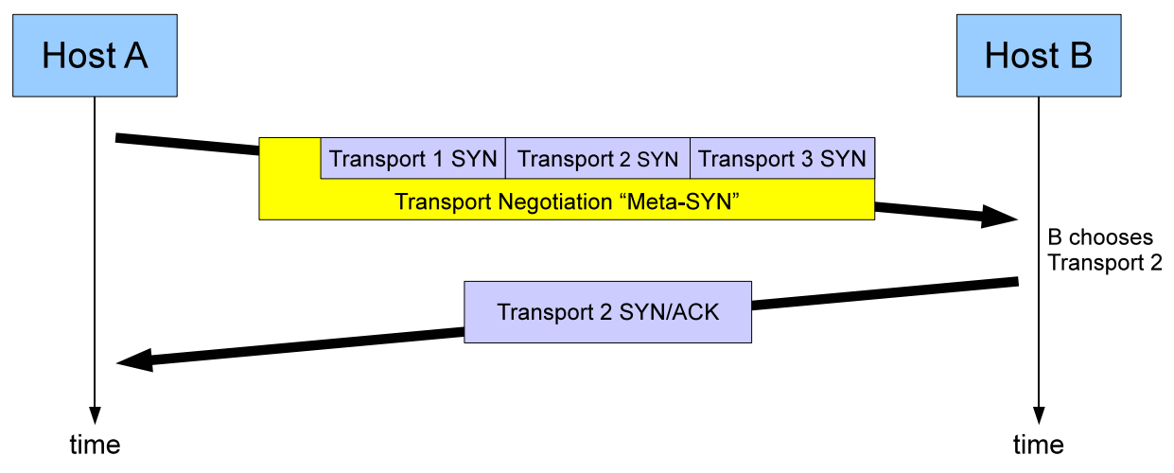
Breaking Up the Transport Logjam
Benefits
Transport Implementation Flexibility
Transport-Independent Middlebox Traversal
Negotiation of Alternative Transports
RTSP
RTMP
TCP

Slide 43
Discussion

Slide 44
Discussion
Serval extends SDN to the edges
SDN allows network-wide control on L2/L3
Serval provides service-level control plane
What’s different with CCN?
In line with CCN philosophy
CCN has no notion of host even at its lowest level
No existing CCN-based architecture clearly separates between service-level control/data plane

Slide 45
Discussion
Deployment overhead
Service controllers
Additional cost to maintain globally unique provider ID
→ (Professor) We can use hash of domain name.
Additional cost to communicate between the controllers
Service routers
Higher computation, increased latency, installation cost
Serval Translator
Increased latency due to proxy, installation cost

Slide 46
Discussion
FlowID security
Serval RSYN process done without authentication
Can Serval protect against connection hijacking?
Some utilities from DNS are not supported
DNS caching is useful for many short-lived flows

Slide 47
Thanks for listening ☺

