Slide 1
Software Dataplane Verification
Mihai Dobrescu and Katerina Argyraki
EPFL, Switzerland
Awarded Best Paper @ NSDI, 2014
Presented by YH

Slide 2
Emergence of Software Dataplanes
Software dataplanes
  Network devices that perform packet processing functionalities via software (e.g., in general-purpose machines)
Flexible compared to traditional hardware switches/routers
  Easily upgrade obsolete software
  Quickly add patch to fix bugs, security vulnerabilities
  Add new functionalities (e.g., traffic monitoring, sampling, etc.)
Intrusion
Detection
Application Acceleration
IP Forwarding

Slide 3

Frequent Reprogramming = Bugs!
Add more “cool” functionalities into software dataplanes
  Code becomes more complex → bugs, bugs, bugs!
  Crash, infinite loop, performance degradation, etc.
ALL YOUR BUGS BELONG TO ME!
Intrusion
Detection
Application Acceleration
IP Forwarding
Packet
How do we guarantee that new software is bug-free?

Slide 4



Software Dataplane Verification
Check whether software satisfies a target property
Developer
Software Dataplane Verification
I trust you since it is verified ☺
Switch/Router
Administrator
Target Property P
IDS
Source Code
Software Dataplane Verification
P satisfied!

Slide 5
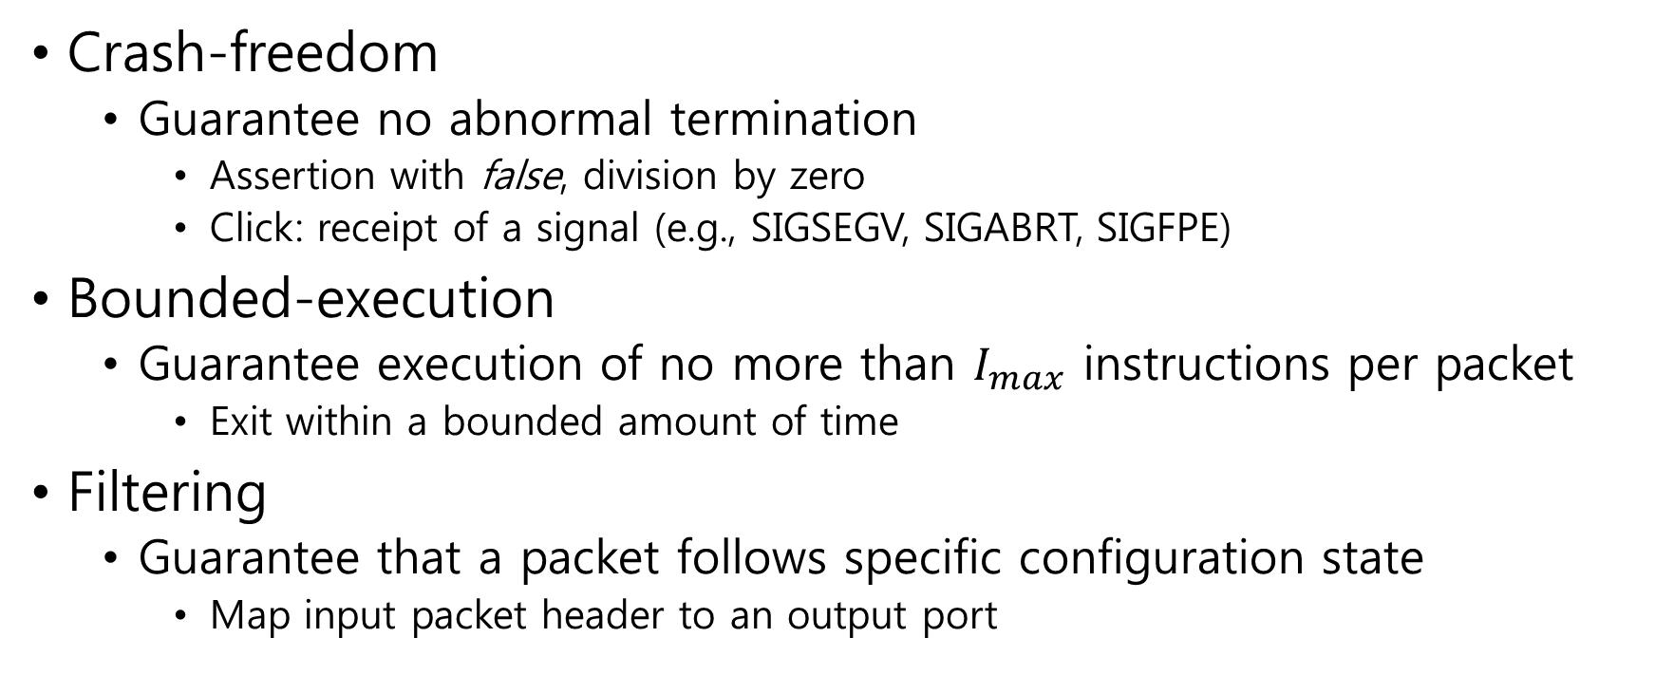
Target Property
Crash-freedom
  Guarantee no abnormal termination
    Assertion with false, division by zero
    Click: receipt of a signal (e.g., SIGSEGV, SIGABRT, SIGFPE)
Bounded-execution
  Guarantee execution of no more than $I_{max}$ instructions per packet
    Exit within a bounded amount of time
Filtering
  Guarantee that a packet follows specific configuration state
    Map input packet header to an output port

Slide 6
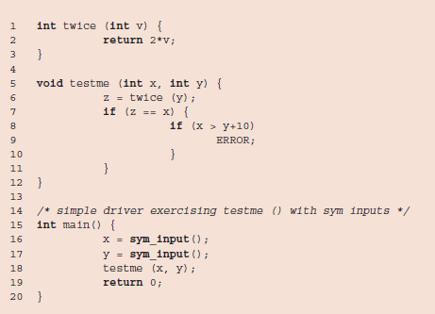
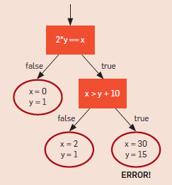






Verification by Symbolic Execution
Symbolic Execution (SE)
  Analyze program assuming input as a symbolic value
  Opposite of static analysis (run with a fixed input value)
$s= \{x→x_{0}, y→y_{0}, z →2y_{0}\}$
$x_{0} ≠2y_{0}$
$x_{0}=2y_{0}$
($x_{0}=2y_{0}) ⋀ (x_{0}>y_{0}+10)$
($x_{0}=2y_{0})⋀ (x_{0}≤y_{0}+10)$
$s= \{x→x_{0}, y→y_{0}\}$

Slide 7
Symbolic Execution Framework
Interpret LLVM bitcode (Intermediate Representation, IR)
  %dst = add i32 %src0, %src1
Find counter-example for given constraints
  {i < 10, j > 8}: satisfiable with i → 5, j → 9
Process flow
LLVM
bitcode
Interpreter
(Executor)
Branch
Constraint
Solver
1. Initialize SE engine
Load engine modules
Install IR interpreter
Load LLVM bitcode
2. Run interpreter
Select path
Load instructions
Execute instructions
3. Branch code
switch, if/else
Create query
4. Solve constraint query
Does branch result in
true/false/unknown?
Get counter-example

Slide 8
Symbolic Execution Usage
At start: validate that a program is bug-free automatically
  Cover as much code as possible
  Error check: division by zero, buffer overflow
Security concerns
  Identify malware by automatically searching for any code path that results in malicious behaviors
  MAYHEM [IEEE S&P’12]
Other applications
  Validate complex programs: Cloud9 [EuroSys’11], S2E [ASPLOS’12]
  Validate network programs for all possible paths: [NSDI’14]

Slide 9



Limitation in Applying Symbolic Execution
Path explosion
  Number of paths to explore increases exponentially
  N branches per element → $2^{n}$ paths
  M elements → $2^{m∗n}$ paths
…
if (in.x < 0)
out = 0;
else
out = in;
if (in.z > 2)
out = 3;
else
out = in;
…
…
if (in.y < 10)
out = 4;
else
out = in;
…
…
Notes:
So SE sounds like a great tool to use. Then can we simply apply this to any application? Like network in our case?
No. We can’t.
Assume element = each network application to install

Slide 10

Domain-specific Verification
Packet-processing follows a pipeline structure
  Each element does not share a mutable state
  Decompose pipeline into independent elements
  Domain = network element
    $2^{m∗n}$ paths → ~$m∗2^{n}$ paths
Classifier
Check
IP Header
Check
IP Option
IP Lookup
…
Notes:
In this paper, we solve this challenge with a key assumption that most packet-processing applications follow a pipeline structure.

Slide 11
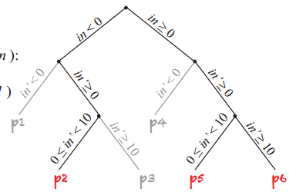
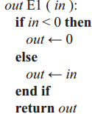
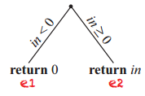
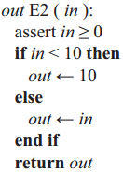
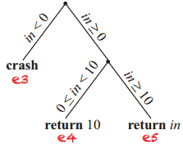
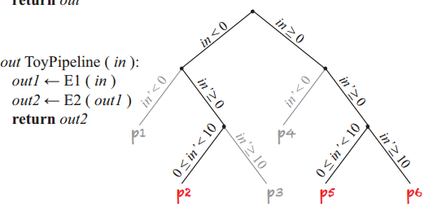
Pipeline Decomposition
Identify “suspect segments” from independent elements
  Suspect segment = e3
Assemble elements and determine target violation
  Suspect segments = p1, p4
  Paths are never executed
  Crash-freedom
Notes:
Let me give you an example on how we decompose a pipeline.
…
Great. So we finally solved the path explosion problem with pipeline decomposition…
No we did not. There’s another functionality that we use very often that causes path explosion.

Slide 12
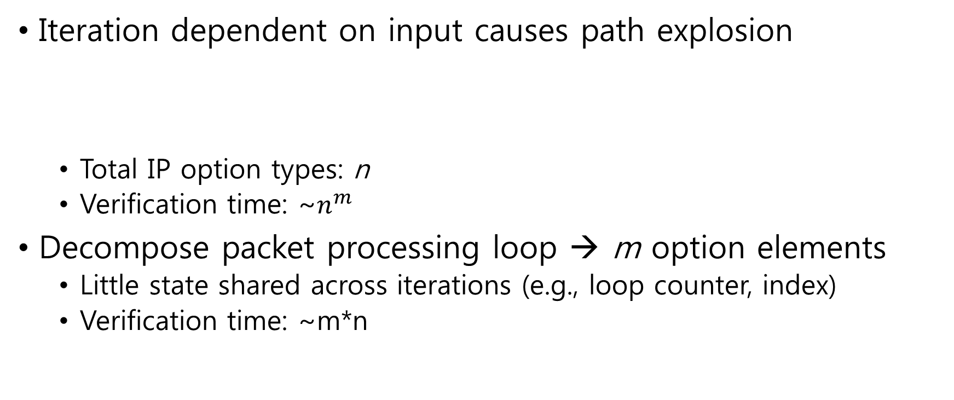
Loops
Iteration dependent on input causes path explosion
  Total IP option types: n
  Verification time: ~$n^{m}$
Decompose packet processing loop → m option elements
  Little state shared across iterations (e.g., loop counter, index)
  Verification time: ~m*n
IP Option #1
IP Option #2
IP Option #3
…
IP Option #m
IP Option #1
IP Option #2
IP Option #3
…
IP Option #m
Notes:
Let’s say we have “m” number of IP options in a packet. And there are total of “n” different IP options.
…
How is this possible? Because if we actually look at each iteration in a loop, there isn’t much state shared except values like loop counter or index.

Slide 13
Loop Decomposition Condition
Any shared mutable state is part of packet metadata
Move local variables into packet metadata
  index: location of next IP option to read
  index is now symbolic and unconstrained
  start of IP option may start from anywhere on IP header
Modification from existing code
  Click IP-options: 26 LoC (16%)
Notes:
This brings to one condition rule.
Since we started out with a packet as the only possible mutable state, we say that any shared mutable state is part of packet metadata.
Simply, it just means that any variable shared between iterations should become symbolic.
…
Now… are we finally free of path explosion problem? No…

Slide 14
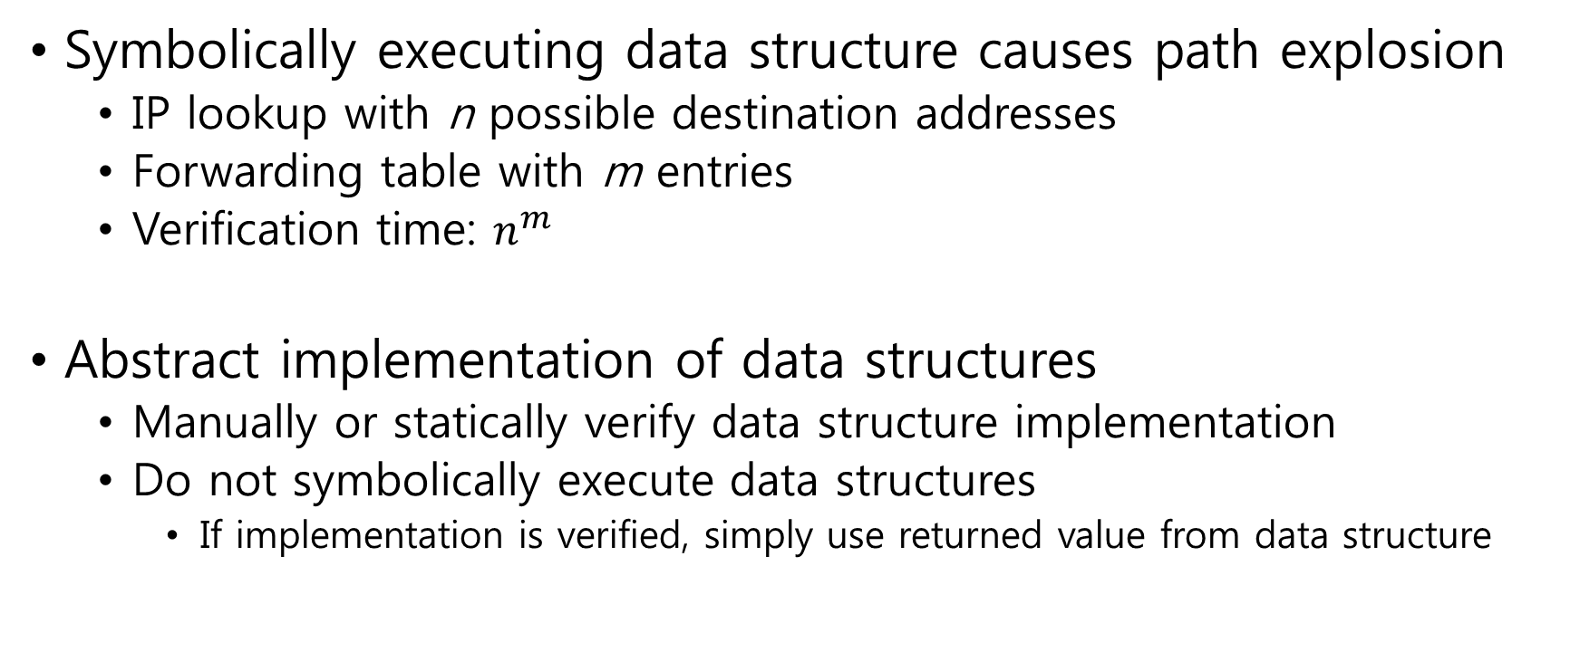
Data Structures
Symbolically executing data structure causes path explosion
  IP lookup with n possible destination addresses
  Forwarding table with m entries
  Verification time: $n^{m}$
Abstract implementation of data structures
  Manually or statically verify data structure implementation
  Do not symbolically execute data structures
    If implementation is verified, simply use returned value from data structure
out_port = table[dest_prefix]
out_port = table.read(dest_prefix)
Table Implementation
Notes:
Data structures can become the source of path explosion.

Slide 15
Data Structures Conditions
Data structures should expose well-known interfaces
  Our method: key-value store
  → API: read, write, membership test, expiration
Elements should only use verified data structures
  Our method: pre-allocated arrays (no dynamic)
  → hash table, longest prefix match
Tradeoff
  Rewrite existing code (Click IP lookup: 20%, Click NAT: 100%)
  Consume more memory for pre-allocated arrays
Notes:
Data structures should expose well-known interfaces that are easily verifiable.

Slide 16
Mutable Private State
Mutable state owned by only one element
  E.g., NAT (per-connection state), traffic monitor (per-flow statistics)
  State is dependent on sequence of packets, not just one
Break-up “suspect segment” analysis into 2 steps
  1. Search for “suspect values” that violates target property
    Take any value allowed by its type
  2. Determine whether violation holds given the logic of entire element
    Restrict value by the particular type of state
Notes:
Finally we are done with the path explosion problem. But there is another problem.
In some cases, there are elements that own a mutable state to itself but not pass to other elements.

Slide 17
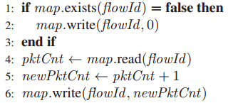

Mutable Private State Example
Collect per-flow packet counters
map: private data structure
Make everything symbolic (packet, metadata, pktCnt)
  If pktCnt = max, newPktCnt overflow!
Check feasibility of the suspect value
  Prove by induction that max is a feasible value of pktCnt

Slide 18
Evaluation
Test on pipelines created with Click
  Can we perform complete and sound verification of software dataplanes?
  How does verification time increase with pipeline length?
  Can we use our tool to uncover bugs, useful performance characteristics, or unintended dataplane behavior?

Slide 19
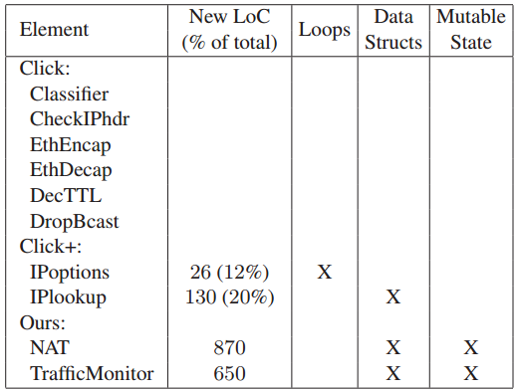
Feasibility
Verified packet-processing elements
  Crash-freedom, bounded-execution
Notes:
Table indicates origin of each element.
Modifications consisted of loop rewriting and replacing data structures with verifiable ones.

Slide 20
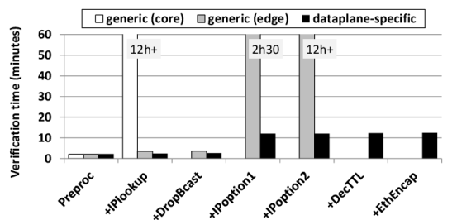
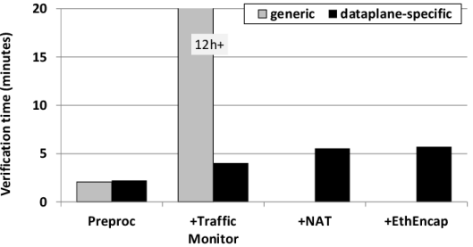
Scalability
IP router with forwarding table
  core: 100,000 entries, edge: 10 entries
  core fails with large forwarding table
  edge fails with IP options
Network gateway
  Traffic monitor: loop
  NAT: data structure
  EthEncap: mutable private state
  generic fails with loop & data structure
Notes:
Network gateway: generic fails when we add either loop or data structure

Slide 21
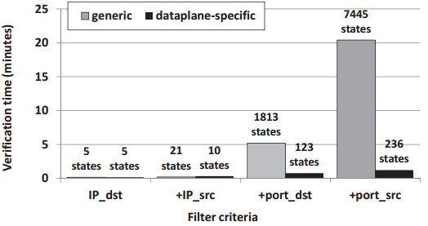
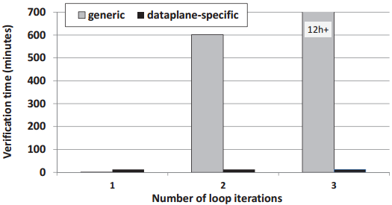
Microbenchmark
Pipeline microbenchmark
  Sequence of simple filtering
  Add filtering elements
  generic fails with increasing paths
Loop microbenchmark
  Simple IP options processing loop
  Add loop iterations
  generic fails with exponential increase of execution paths
Notes:
Pipeline Microbenchmark: generic executes all feasible paths of the pipeline. Dataplane executes all feasible segments of each element in isolation.
Loop Microbenchmark: generic executes all feasible paths of the entire loop. Dataplane executes all feasible segments of one loop iteration.

Slide 22
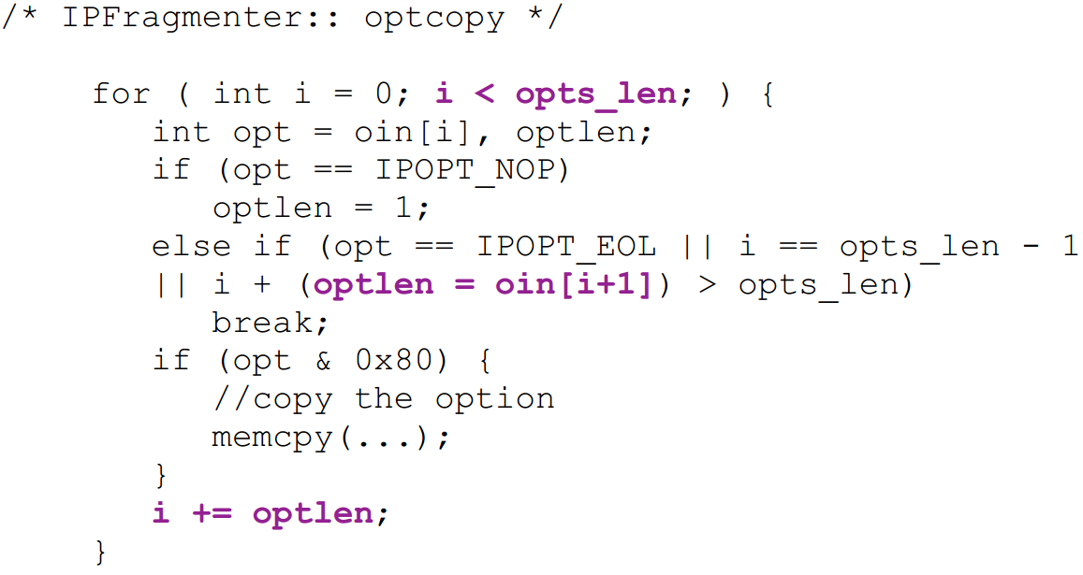
Usefulness
Found number of bugs in Click elements

Slide 23
Conclusion
Dataplane-specific Verification
  Symbolic execution + composition
  Pipeline structure → separate elements
  Loops → separate iterations
  Data structures → pre-allocated key/value stores
Enable efficient software dataplane verification
  Complete and sound analysis

Slide 24
KLEE
S2E uses KLEE as a base tool
  Limitation of KLEE: requires source code to interpret
Minimize memory usage
  Keep track of all memory objects → object level copy-on-write
  Share objects between multiple states vs. fork at every branch
Minimize constraint solver overhead
  Reduce query as much as possible before passing to solver
  Expression rewriting, constraint set simplification, implied value concretization, constraint independence, counter-example cache
Handle environment variables
  File I/O, system calls

Slide 25
Limitations (from paper)
  Conditions for loops and data structures either require modification or complete rewrite of code. This is not negligible for more complex applications (e.g., IDS). Any way to bypass this condition?
  Having pre-allocated array results in memory overhead. Minimizing memory usage is crucial for SE. Is this the right way?
  Authors provide only two specific examples for mutable private state (NAT, flow table). Is there a fundamental way to solve this problem?
Other points
  Can we really apply pipeline structure on all applications?
  Since it is developer’s job to write a verifiable code, can’t we use tools that provide richer features by interpreting source code directly?
  How do we determine appropriate size for pre-allocated arrays?
  Over-approximation (pipeline decomposition, mutable private state) may be an overkill on performance
  Evaluations are only done on toy applications. Is this really applicable to practical, complex applications?

