Slide 1
A NICE Way to Test OpenFlow Applications
(NSDI’12)
Marco Canini, Daniele Venzano, Peter Peresini, Dejan Kostic, and Jennifer Rexford
Presenter: Changjun Kim

Slide 2



Software-Defined Networking
Third-party Software
Notes:
Software defined network makes revolution in todays network.
Programmable network: Wider range of functionality, raises the risk of the bugs

Slide 3

Bugs in OpenFlow Applications
Controller
Execute packet_in event handler
Normal Case
OpenFlow
program
Default: forward
to controller
Install rule;
forward packet
Host A
Host B
Packet
Switch 1
Switch 2
Flow Table
Rule 1
Match
Actions
Counters
Rule 2
Dst: Host B
Fwd: Switch 2
pkts / bytes
Rule N
Notes:
Openflow application without bug

Slide 4

Bugs in OpenFlow Applications
Controller
Bug
OpenFlow
program
Rule delayed
Install rule
Host A
Host B
Packet
Switch 1
Switch 2
Flow Table
Rule 1
Goal: systematically test possible behaviors to detect bugs
Match
Actions
Counters
Rule 2
Dst: Host B
Fwd: Switch 2
pkts / bytes
Rule N
Notes:
Openflow application with a bug

Slide 5
Challenges of Testing OpenFlow Apps
Testing OpenFlow apps depends on large environment
It explodes along 3 dimensions
Large space of switch states
Large space of input packets
Large space of event orderings
Notes:
Scalability challenges
Program run their program that maintain state
Data plane driven, react to a huge space of possible packets
Communication delay, rules may not be installed in order

Slide 6
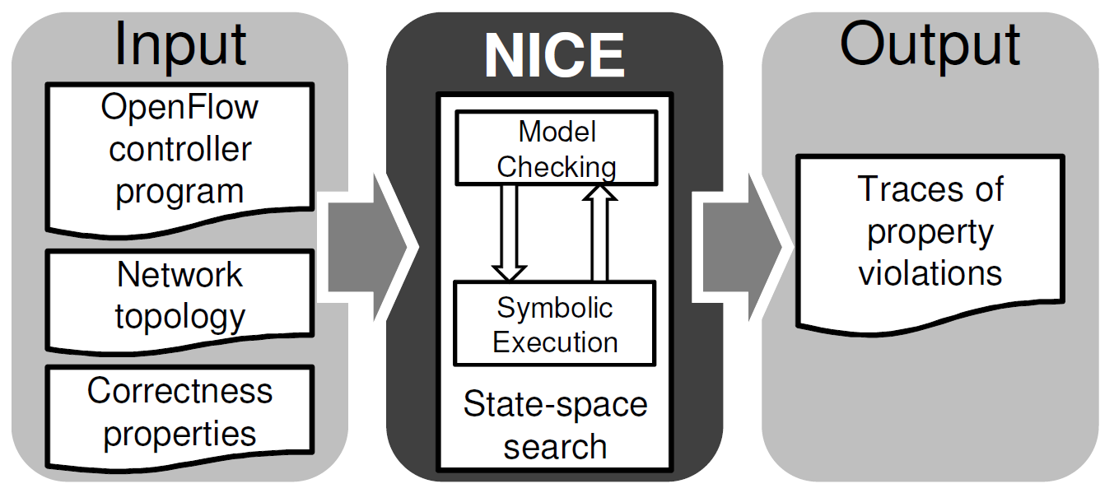
NICE(No bugs In Controller Execution)
Notes:
Correctness properties(No loop, No blackholes)
NICE systematically explores the space of possible system behaviors -> Find property violation
Model checking: explore system execution path
Symbolic execution: reduce the space of inputs
Search strategies: reduce the space of event orderings

Slide 7
NICE: MC, SE & Strategies
Model checking
  Explore system execution paths
Symbolic Execution
  Reduce the space of inputs
Search strategies
  Reduce the space of event orderings

Slide 8
NICE: MC, SE & Strategies
Model checking
Symbolic execution
Search strategies

Slide 9
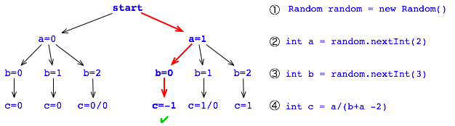
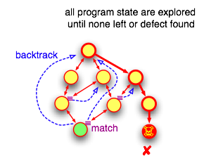
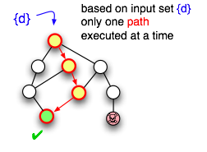
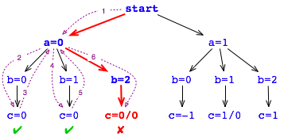
Model Checker(JPF)
Testing
Model checking
Notes:
Model checker initializes a stack of states with the initial state of the system
checker chooses one state from the stack and one of its enabled transitions
checker tests the correctness properties on the newly reached state
new state violates a correctness property, the checker saves the error and the execution trace
the checker adds the new state to the set of explored and schedules the execution of all transitions enabled in this state

Slide 10
Model Checking in NICE
State 6
State 3
State 1
State 7
Controller program
Set of event handlers
OpenFlow Switches
Simplified model with communication channels, transitions and a flow table
End hosts
Simplified program as clients or server
Ctrl: Packet_in
Switch: Process_pkt, Process_of
Host: Send, receive
transition
State 0
State 4
State 8
transition
State 2
State 9
State 5
State 10

Slide 11
NICE: MC, SE & Strategies
Model checking
Symbolic execution
Search strategies

Slide 12
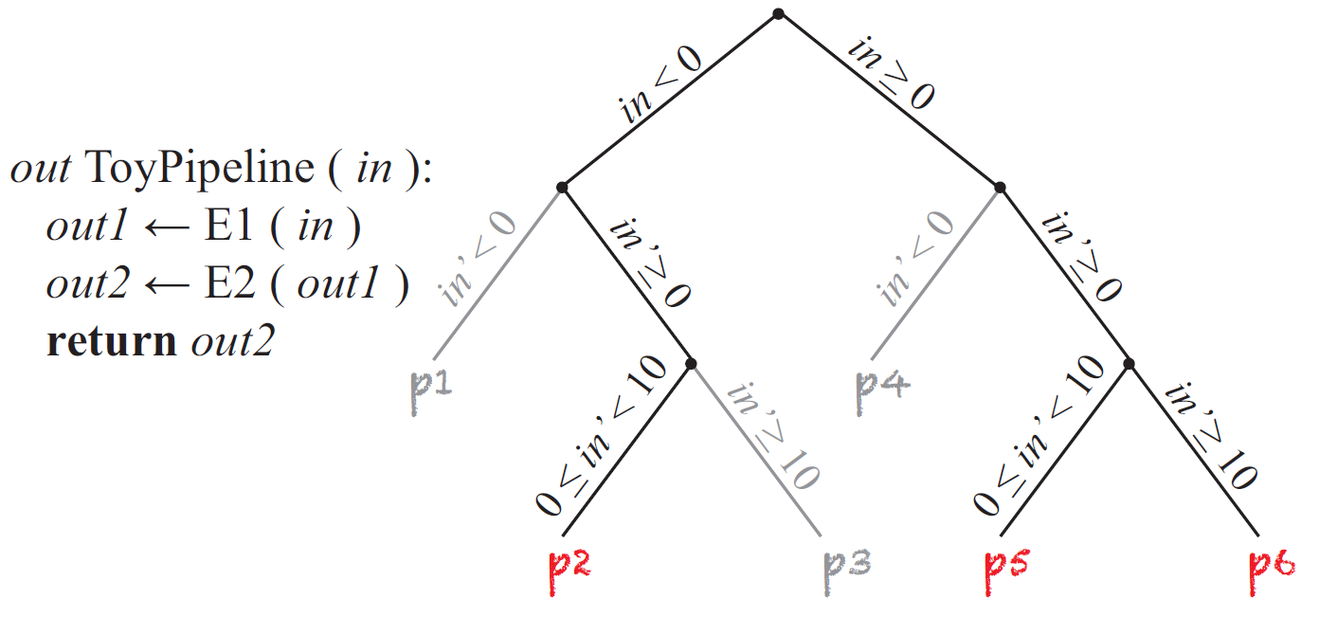
Symbolic Execution
At any branch engine queries for two assignment of symbolic inputs
Logically forks the execution and follow the feasible paths
Notes:
Runs a program with symbolic variables as inputs
At any branch, logically forks the execution to follow the feasible path

Slide 13
Symbolic Execution
Does not scale well
Does not explicitly model the state space
Does not explore all system execution paths
Notes:
The number of code paths grows exponentially as the number of branches and the size of inputs
Cause repeated exploration of the same state

Slide 14
Symbolic Execution
Symbolic packet λ
1 path =
1 equivalence class of packets =
1 packet to inject
Infeasible from initial state
is λ.dst
broadcast?
λ .dst ∈ {Broadcast}
λ .dst ∉ {Broadcast}
yes
no
λ.dst in
mactable?
Packet arrival handler
no
λ .dst ∉ {Broadcast}
∧
λ .dst ∉ mactable
yes
λ .dst ∉ {Broadcast}
∧
λ .dst ∈ mactable
Flood packet
Install rule and forward packet
Notes:
Branch에 오면 2개의 query를 받아 두 가지 경우로 나누어진다.
모든 경우를 cover 할 때 까지 fork 한다.
같은 경로를 가지는 모든 packet을 한 equivalence class of packet으로 묶을 수 있다.
SE만 쓰지 않는 이유: All code path를 visit 하지만, Does not execute all system execution paths (Infeasible from initial state)
Controller의 path 뿐만이 아닌 모든 state를 체크하고 싶다.

Slide 15
NICE: MC, SE & Strategies
Model checking
  Explore the system execution paths
Symbolic execution
  Determine the inputs for state transition
Search strategies

Slide 16
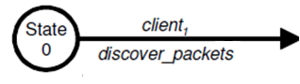
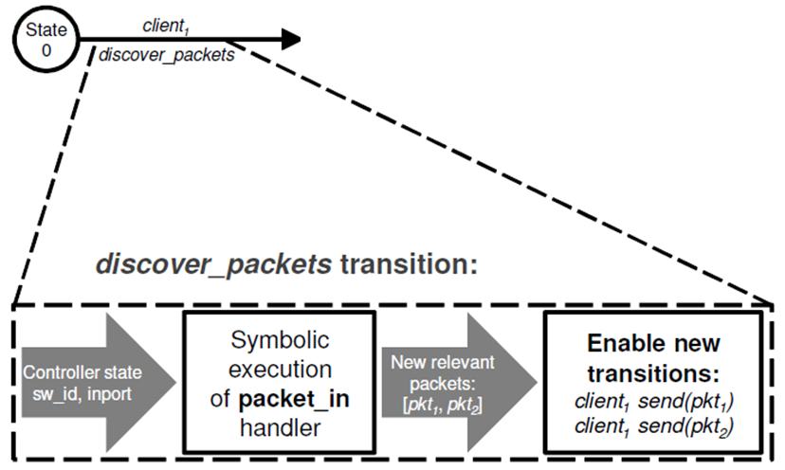
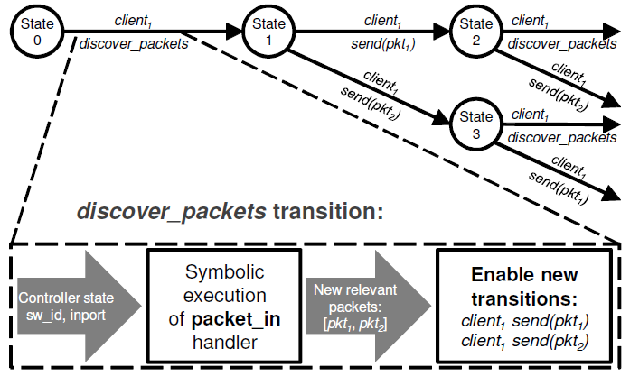
Combining SE with MC
Notes:
At any given controller state, we want to identify the packets that each client should send.
So we create a special client transition called discover packets that symbolically executes the packet in handler.
Symbolic execution of the handler starts from the initial state defined by the concrete controller state (e.g., State 0 in Figure 4) and a concrete “context” (i.e., the switch and input port that identify the client’s location)
For every feasible code path in the handler, the symbolic-execution engine finds an equivalence class of packets that exercise it.
For each equivalence class, we instantiate one concrete packet (referred to as the relevant packet) and enable a corresponding send transition for the client.

Slide 17
NICE: MC, SE & Strategies
Model checking
Symbolic execution
Search strategies

Slide 18
Search strategies
PKT-SEQ
  Bound the possible end host transitions
NO-DELAY
  Each communication between a switch and the controller is done as a single atomic action
UNUSUAL
  Only explores event orderings with unusual and unexpected delays
FLOW-IR
  Exploring only the relative between the events affecting each group
Notes:
NO-DELAY: Basic design error, no race conditions
Flow independence reduction

Slide 19
Application correctness
Safety properties & liveness properties
Library
  No forwarding loops
  No black holes
  Direct paths
  Strict direct paths
  No forgetting packets
Notes:
Safety property: Something bad never happens
Liveness property: Eventually something good happnes
DP: future packets of the same flow do not go to the controller
SDP: two hosts have successfully delivered at least one packet of a flow in each direction, so successive packets reach the controller

Slide 20
Implementation highlights
Written in Python for OpenFlow controller program on NOX platform
Model checker
  Remember the sequence of transitions
  Restore it by replaying such sequence
“Concolic” execution engine
  Track the constraints on symbolic variables during code execution
Collection of models
  Including switch and hosts
Notes:
Concolic: concrete + symbolic – Not symbolic input but concrete input(Variable이 concrete 하게 상수로 주어짐)
- FROM CUTE: A concolic unit testing engine for C

Slide 21
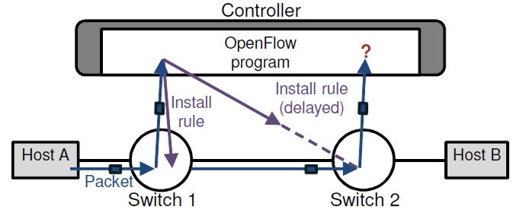
Performance Evaluation
Experimental setup
  Layer-2 ping from host A to host B
  MAC-learning switch program on controller

Slide 22
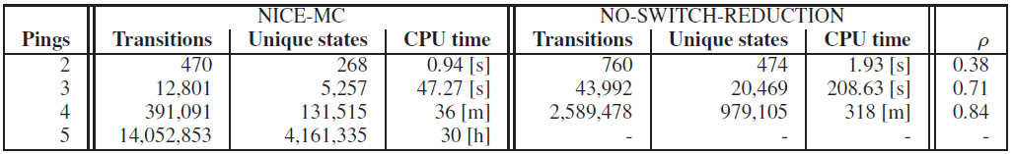

Performance Evaluation(2)
NICE-MC(w.o. SE) vs. NO-SWITCH-REDUCTION
  MC
    Simplified switch model
    Combine the semantically equivalent model
  $ρ=\frac{Unique\left(NO−SWITCH−REDUCTION\right)−Unique\left(NICE−MC\right)}{Unique\left(NO−SWITCH−REDUCTION\right)}$

Slide 23
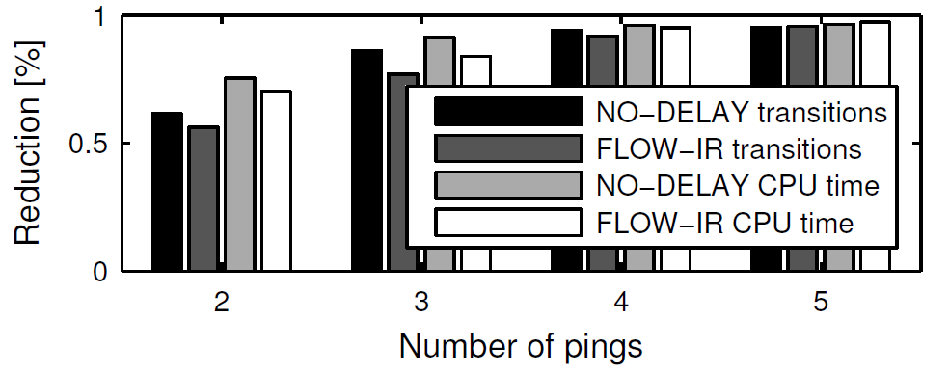
Performance Evaluation(3)
Heuristic-based search strategies
  Relative state-space search reduction of heuristic-based search strategies vs. NICE-MC
  28-fold state space reduction for 3 pings
Notes:
Flow independence reduction
%가 사실은 lambda인 듯

Slide 24
Experiences with Real Apps
Tested with 3 NOX applications
  MAC-learning switch(PySwitch)
  Web server load balancer
  Energy-efficient traffic engineering
Uncover 11 bugs
  3, 4, 4 bugs, respectively
  3 insidious bugs due to network race conditions
Notes:
Webserver load balancer: All packets of same request go to same server replica
TE: USE appropriate path based on network load. Dynamically on-off.

Slide 25
MAC-learning switch (3 bugs)
OpenFlow
program
Host A
1
2
2
1
Host B
3
A->B | port 2
A->B | port 1
BUG-I: Host unreachable after moving
Notes:
Soft timeout이면 영원히 보낼 수 없음. No Black Holes property 위반

Slide 26
MAC-learning switch (3 bugs)
OpenFlow
program
Host A
1
2
2
1
Host B
3
B->A | port 1
B->A | port 2
A->B | port 2
A->B | port 1
BUG-I: Host unreachable after moving
BUG-II: Delayed direct path
Notes:
Strict Direct Paths property 위반
반대방향 설정을 하지 않아서

Slide 27
MAC-learning switch (3 bugs)
OpenFlow
program
Host A
1
2
2
1
3
2
1
3
BUG-I: Host unreachable after moving
BUG-II: Delayed direct path
BUG-III: Excess flooding
Notes:
No Forwarding Loops property 위반

Slide 28
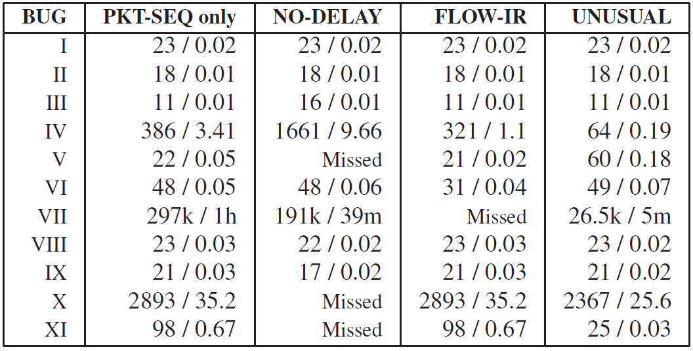
Experiences with real Apps
Comparison with heuristic
(number of transitions / running time in secs)

Slide 29
Conclusion
State-space search based on MC & SE
Explore the state space of unmodified controller programs written for the NOX
Find 11 bugs on real apps

Slide 30
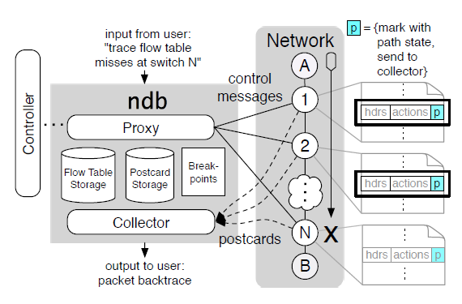
NDB: Where is the Debugger for my Software-Defined Network?
Developed a prototype network debugger “ndb” inspired by gdb(The GNU project debugger)
Pinpoint the sequence of events leading to a network error using debugger actions; breakpoint and backtrace
Send a “post card” every time a packet visits a switch
Can diagnose bugs that affect the correctness of forwarding
Notes:
Postcard: Truncated copy of the packet’s header, matching flow entry, switch and output port

Slide 31
Discussion points
If no packets in equivalence class reach the controller, representative packet is useless. Any possible improvement?
Infinite execution trees in SE vs. coverage of heuristic(PKT-SEQ)
Are there other properties to be added to library?
Scalability of handler
Difference between other verification tools, HSA and Veriflow

Slide 32
Thank you & Q&A

Slide 34
Back-up slides

Slide 35
Web Server Load Balancer (4 bugs)
OpenFlow
program
Host A
1
3
Server 1
Host B
Server 2
2
4
Custom property: all packets of same request go to same server replica
BUG-IV: Next TCP packet always dropped after reconfiguration
BUG-V: Some TCP packets dropped after reconfiguration
BUG-VI: ARP packets forgotten during address resolution
BUG-VII: Duplicate SYN packets during transitions

Slide 36
Energy-Efficient TE (4 bugs)
Precompute 2 paths per <origin,dest.>
  Always-on and on-demand
Make online decision:
  Use the smallest subset of network elements that satisfies current demand
BUG-VIII: The first packet of a new flow is dropped
BUG-IX: The first few packets of a new flow can be dropped
BUG-X: Only on-demand routes used under high load
BUG-XI: Packets can be dropped when the load reduces

