Slide 1
SIMPLE-fying Middlebox Policy Enforcement Using SDN
Zafar Ayyub Qazi, Cheng-Chun Tu, Luis Chiang
Vyas Sekar, Rui Miao, Minlan Yu
Presenter : ChoongHee Cho
Some slides are brought from the authors’ presentation.

Slide 2
Current Network composition
Network component:
  - Nodes(e.g. switch or router)
: select L2 or L3 path
  - Links
: connected road between the nodes
  - Middleboxes
: L4-L7 function for network packet.
(e.g. critical performance, security, and
policy compliance capabilities, etc.)

Slide 3
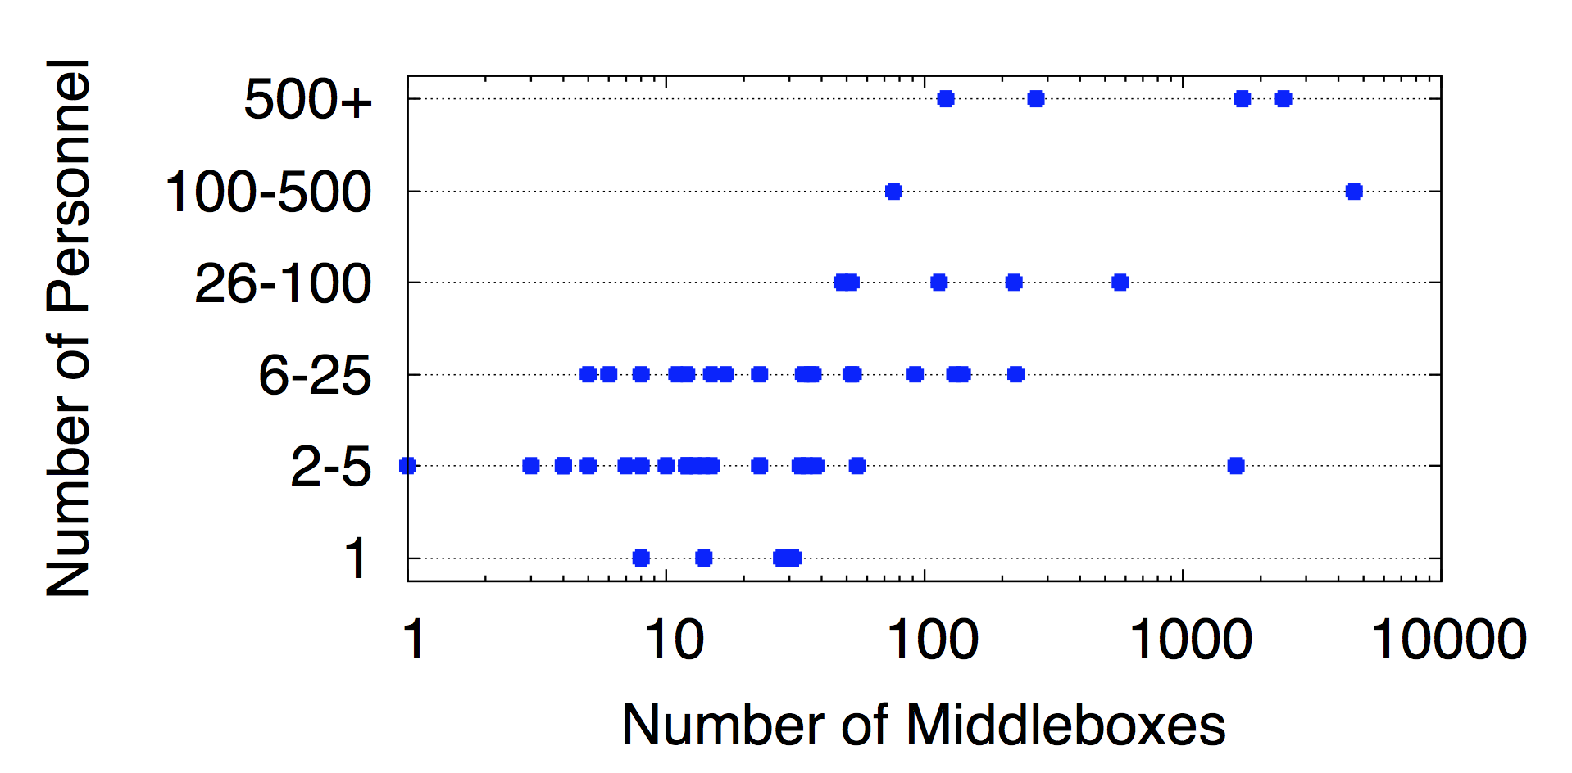
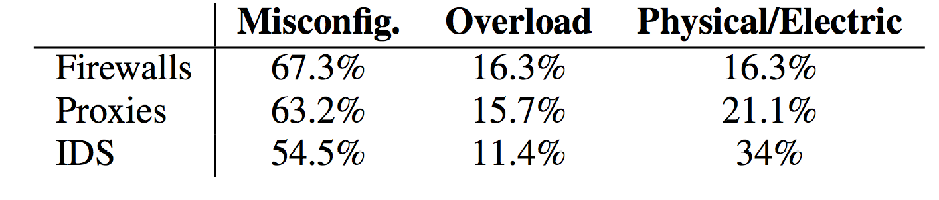
Middleboxes management is hard!
Survey across 57 network operators (J. Sherry et al. SIGCOMM 2012)
e.g., a network with ~2000 middleboxes required 500+ operators
Critical for security, performance, compliance
But expensive, complex and difficult to manage

Slide 4

Middlebox with SDN
Benefits of SDN:
  logically centralized management
  providing the ability to programmatically configure forwarding rules.

Slide 5
Can SDN simplify middlebox management?
Centralized Controller
Web
Firewall
IDS
Proxy
OpenFlow
“Flow” | FwdAction
… | …
“Flow” | FwdAction
… | …
Proxy
IDS
Scope: Enforce middlebox-specific steering policies
Necessity + Opportunity:
Incorporate functions markets views as important

Slide 6
What makes this problem challenging?
Centralized Controller
Web
Firewall
IDS
Proxy
OpenFlow
“Flow” | FwdAction
… | …
“Flow” | FwdAction
… | …
Proxy
IDS
1. Middleboxes introduce new dimensions beyond L2/L3 tasks.
2. Difficult to change middleboxes
Achieve this with unmodified middleboxes and existing SDN APIs

Slide 7

Our Work: SIMPLE
Web
Firewall
IDS
Proxy
Policy enforcement layer for
middlebox-specific “traffic steering”
Flow | Action
… | …
Flow | Action
… | …
Legacy
Middleboxes
OpenFlow
capable

Slide 8
Outline
Motivation
Challenges
SIMPLE Design
Evaluation
Conclusions
8

Slide 9
Challenges
Policy Composition
Resource Constraint
Dynamic Modifications
9

Slide 10
Challenge: Policy Composition
*
Firewall
IDS
Proxy
Policy Chain:
Firewall
Proxy
IDS
Oops! Forward Pkt to IDS or Dst?
S1
S2
Dst
“Loops”
Traditional flow rules may not suffice!

Slide 11
Challenge: Resource Constraints
Policy Chain:
*
Firewall
IDS
Proxy
Firewall
Proxy
Space for
traffic split?
S2
S4
S1
S3
IDS1 = 50%
Resource constraints
1) middlebox processing constraint
2) limited TCAM space in SDN switches
IDS2 = 50%
IDS
We should consider not only the middlebox resource constraints
but also switch TCAM space constraints

Slide 12
Challenge: Dynamic Modifications
User1: Proxy → Firewall
User2: Proxy
Proxy may modify flows
User 1
Proxy
S1
S2
User 2
Firewall
Are forwarding rules at S2 correct?

Slide 13
New dimensions beyond Layer 2-3 tasks
1) Policy Composition → Potential loops
2) Resource Constraints → Switch + Middlebox
3) Dynamic Modifications → Correctness?
How can SIMPLE address these with unmodified middleboxes and
existing SDN APIs?

Slide 14
Outline
Motivation + Context for the Work
Challenges
SIMPLE Design
Evaluation
Conclusion

Slide 15
SIMPLE System Overview
Web
Firewall
IDS
Proxy
Policy Chains
SDN Controller
Topology, Traffic
Policy
Spec
Mbox, Switch
constraints
Resource Manager
Rule Generator
Dynamics Handler
Flow | Action
… | …
Flow | Action
… | …
Legacy
Middleboxes
OpenFlow
capable

Slide 16
Composition → Tag Processing State
*
Firewall
IDS
Proxy
Policy Chain:
Firewall
Proxy
IDS
Fwd to Dst
S1
S2
Post-Firewall
Dst
Post-Proxy
ORIGINAL
Post-IDS
Insight: Distinguish different instances of the same packet

Slide 17
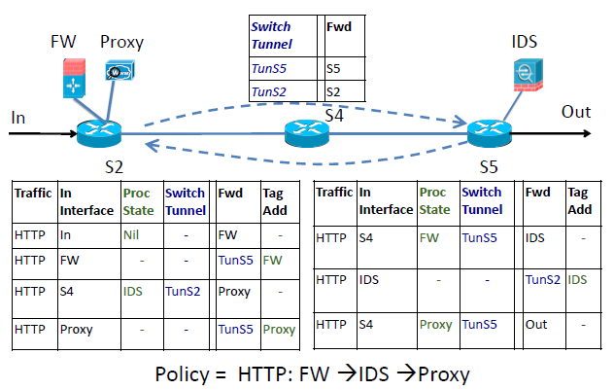
Composition → Tag Processing State

Slide 18
SIMPLE System Overview
Web
Firewall
IDS
Proxy
Policy Chains
SDN Controller
Topology, Traffic
Policy
Spec
Mbox, Switch
constraints
Resource Manager
Rule Generator
Dynamics Handler
Flow | Action
… | …
Flow | Action
… | …
Legacy
Middleboxes
OpenFlow
capable

Slide 19
Resource Constraints→ Joint Optimization
Topology & Traffic
Middlebox
Capacity + Footprints
Switch
TCAM
Policy
Spec
Resource Manager
Optimal & Feasible
load balancing
Theoretically hard!
Not obvious if some configuration is feasible!

Slide 20
Offline + Online Decomposition
Policy
Spec
Network
Topology
Switch
TCAM
Mbox Capacity
+ Footprints
Traffic
Matrix
Resource Manager
ILP-based
Offline Stage
LP-based
Online Step
Deals with Switch constraints
Deals with only load balancing

Slide 21
Offline Stage: ILP based pruning
Feasible
Sufficient freedom
Set of all possible middlebox load distributions
Pruned Set
Balance the middlebox load

Slide 22
SIMPLE System Overview
Web
Firewall
IDS
Proxy
Policy Chains
SDN Controller
Topology, Traffic
Policy
Spec
Mbox, Switch
constraints
Resource Manager
Rule Generator
Dynamics Handler
Flow | Action
… | …
Flow | Action
… | …
Legacy
Middleboxes
OpenFlow
capable

Slide 23
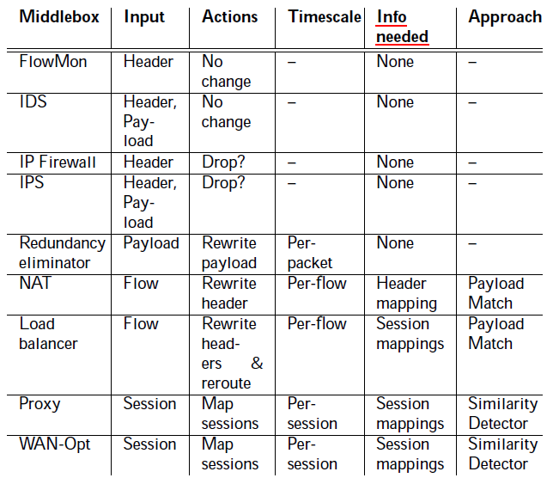
Modifications → Infer flow correlations

Slide 24
Modifications → Infer flow correlations
Three cases of flow correlations
  1) Not change the packet headers and flows
Directly map the incoming and outgoing flows
  2) Change packet header fields
NAT
Do an exact payload match between the incoming and outgoing packets
  3) Create new sessions or merge existing sessions
Calculate the (partial) similarities across flows

Slide 25
Modifications → Infer flow correlations
Correlate
flows
Install rules
Payload Similarity
With Rabin fingerprints
User 1
Proxy
S1
S2
User 2
User1: Proxy → Firewall
User2: Proxy
Firewall

Slide 26
SIMPLE Implementation
Web
FW
IDS
Proxy
Resource Manager
(Resource Constraint)
CPLEX
Modifications Handler
(Dynamic modifications)
Rule Generator
(Policy Composition)
POX extensions
OpenFlow 1.0
Flow | Tag/Tunnel | Action
… |  | …
Flow | Tag/Tunnel | Action
… |  | …

Slide 27
Outline
Motivation + Context for the Work
Challenges
SIMPLE Design
Evaluation
Conclusion

Slide 28
Evaluation and Methodology
What benefits SIMPLE offers? load balancing?
How scalable is the SIMPLE optimizer?
How close is the SIMPLE optimizer to the optimal?
How quickly it reacts to middlebox failure and traffic overload?
How accurate is the dynamic inference?
Methodology
  Small-scale real test bed experiments (Emulab)
  Evaluation over Mininet (with up to 60 nodes)
  Large-scale trace driven simulations (for convergence times)
  OpenvSwitch (v 1.7.1) as the SDN switch
  Custom Click modules to act as middleboxes

Slide 29
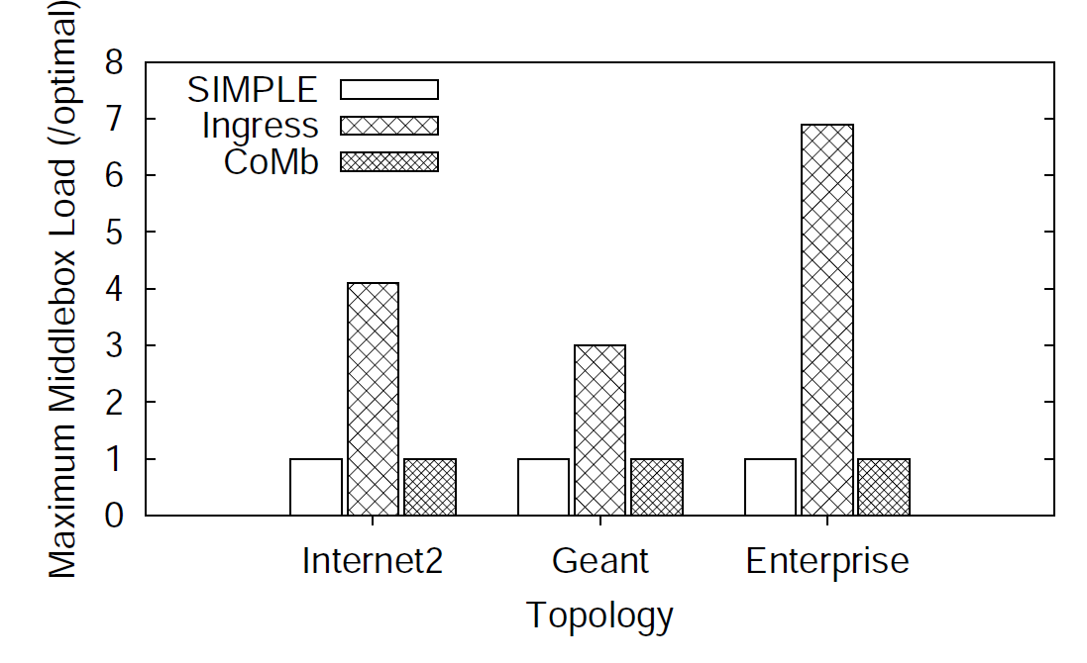
Benefits: Load balancing
Optimal
3-6X better load balancing and near optimal

Slide 30
Overhead: Reconfiguration Time
33 node topology including 11 switches
Around 125 ms to reconfigure, most time spent in pushing rules

Slide 31
Other Key Results
LP solving takes 1s for a 252 node topology
  4-5 orders of magnitude faster than strawman optimization schemes
95 % accuracy in inferring flow correlations
  Duo to false policy rate and missed policy rate
Scalability of pruning(for a 250-node):
  1800s → 110s

Slide 32
Conclusions
Middleboxes: Necessity and opportunity for SDN
Goal: Simplify middlebox-specific policy enforcement
Challenges: Composition, resource constraints, modifications
SIMPLE: policy enforcement layer
  Does not modify middleboxes
  No changes to SDN APIs
  No visibility required into the internal of middleboxes
Scalable and offers 3-6X improvement in load balancing

Slide 33
FlowTags
Commonalities and differences between SIMPLE and FlowTags
SIMPLE
FlowTags
Commonalities:
  Want to overcome the traffic handling problems of dynamic middlebox actions
  Uses SDN Architecture and Tags
Differences :
  FlowTags needs simple extensions of middlebox software
  FlowTags middleboxes have FlowTags tables and controller–middlebox interfaces
  FlowTags has verification, network diagnosis methods in the controller

Slide 34
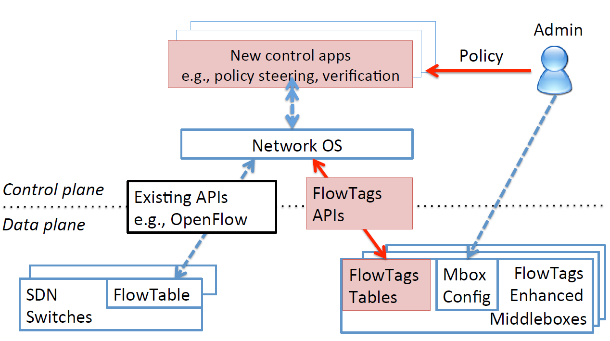
FlowTags architecture

Slide 35
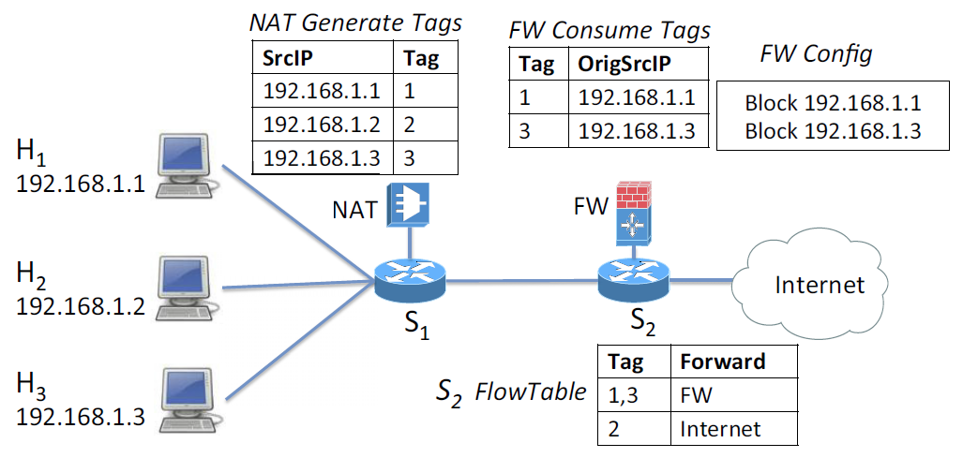
FlowTags example

Slide 36
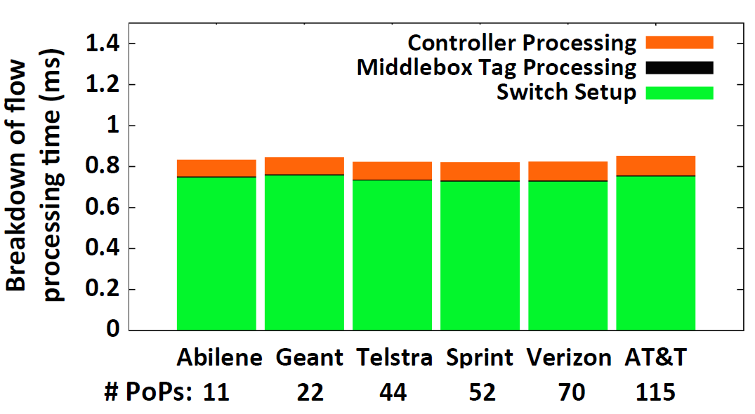
Evaluation

Slide 37
Discussion
Possibility of rule that would not apply to switches at the same time – update timing issue.
Precomputing cost for switch, middlebox, and link failure scenarios.
  Pre-computing for all scenarios?
Countermeasure against DDOS attack(if all of packet is new)
Possibility of duplication use of ToS field
Multiple packets per flow case

Slide 38
The End

Slide 39
Apendix

Slide 40
Decompose Optimization:
Slow Offline + Fast Online Steps
Rule
Model
Traffic
Matrix
Mbox
Capacity
Policy
Spec
Enumerate
Physical
Sequences
Prune for
Feasible
Configs
LP with
PrunedSet
PrunedSet
Network
Topology
Offline Pruning
Online Load Balancing
Notes:
In order to efficiently solve the optimization problem, we decompose the problem into a slow offline stage and fast online step.
Offline stage that tackles the switch constraints
An online step runs a linear program that only deals with load balancing.
In the offline stage given a set of logical chains, we select a subset of the available physical sequences that will not violate the switch capacity constraints. The offline pruning stage only needs to run when the network topology, switches, middlebox placements, or the network policy changes. The online load balancing stage runs more frequently when traffic patterns change on shorter timescales.

Slide 41
Enumerating Physical Sequences
Proxy1
Policy Chains
Firewall
IDS
Proxy
FW1
10.1/16, HTTP → *
S2
S4
S1
S5
S3
S6
FW2
IDS1
 | Physical Sequence
FW1-IDS1-Proxy1 | S1 S2 FW1 S2 S4 S5 IDS1 S5 S4 S2 Proxy1 S2 S4 S5 S6
FW2-IDS1-Proxy1 | S1 S3 FW2 S3 S5 IDS1 S5 S4 S2 Proxy1 S2 S4 S5 S6

Slide 42
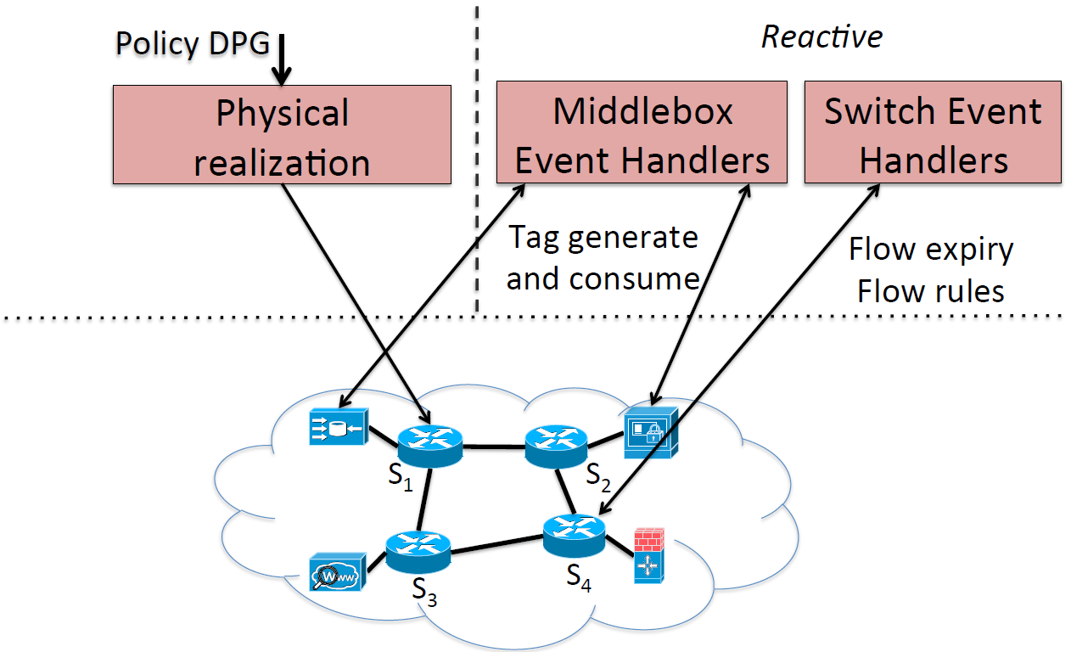
FlowTags‐enhanced controller

Slide 43
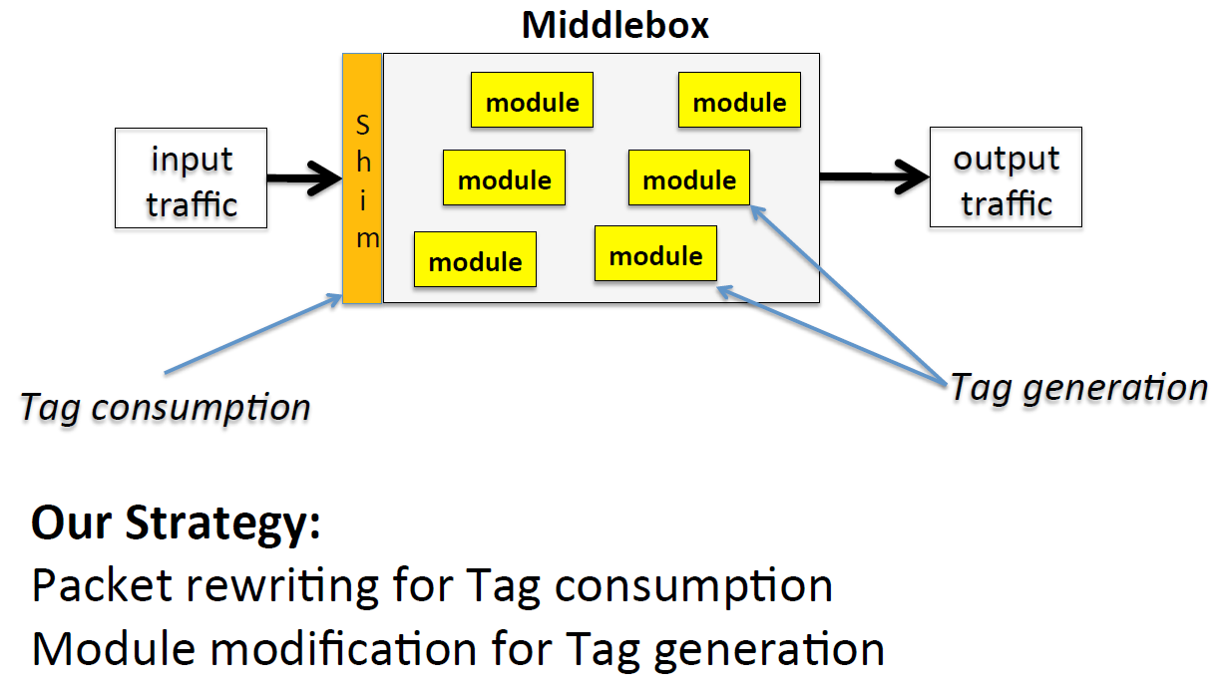
Middlebox extension strategies to add FlowTags support
Notes:
Module modification and Packet rewriting.
장점:
Input traffic consumption is One shot.
Suited for getting internal context in term of Tag generation.

