Slide 1


OpenNF: Enabling Innovation in Network Function Control
Presented by Shinae Woo
Borrowed many of the original author’s slides
Aaron Gember-Jacobson, Chaithan Prakash,
Raajay Viswanathan, Robert Grandl, Junaid Khalid,
Sourav Das, Aditya Akella

Slide 2
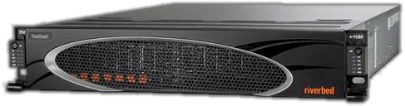

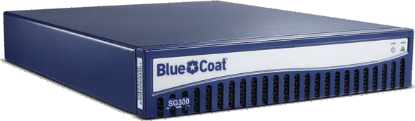

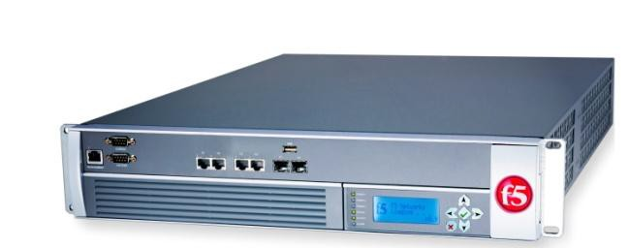



Network functions (NFs)
Perform sophisticated stateful
actions on packets/flows
WAN
optimizer
Caching
proxy
Intrusion detection system (IDS)

Slide 3














NF trends
NFV → dynamically allocate NF instances
SDN → dynamically reroute flows
Dynamic reallocation of packet processing
Xen/KVM
3

Slide 4









Example: elastic NF scaling
Satisfy performance SLAs
Minimize operating costs
Accurately monitor traffic
CPU
Packet loss
4

Slide 5


Problem: NFV+SDN is insufficient
To simultaneously…
Satisfy performance SLAs
Minimize operating costs
Accurately monitor traffic
Cannot effectively implement
new services or abstractions!

Slide 6













Why NFV + SDN falls short
Packet loss
SLA:
<1%
1. SLAs | 2. Cost | 3. Accuracy
Reroute new flows [Stratos - arXiv:1305.0209]
6
Reroute existing flows
[SIMPLE - SIGCOMM ‘13]
Wait for flows to die
[Stratos - arXiv:1305.0209]

Slide 7





Why NFV + SDN falls short
Packet loss
1. SLAs | 2. Cost | 3. Accuracy
Reroute new flows [Stratos - arXiv:1305.0209]
Reroute existing flows [SIMPLE - SIGCOMM ‘13]
6
Wait for flows to die
[Stratos - arXiv:1305.0209]

Slide 8


Why NFV + SDN falls short
?
Packet loss
1. SLAs | 2. Cost | 3. Accuracy
Reroute new flows [Stratos - arXiv:1305.0209]
Reroute existing flows [SIMPLE - SIGCOMM ‘13]
Wait for flows to die [Stratos - arXiv:1305.0209] ⁶

Slide 9




SLAs + cost + accuracy: What do we need?
Quickly move, copy, or share internal NF state
  alongside updates to network forwarding state
Guarantees: loss-free, order-preserving, …
✓ ✓ ✓
… …
1 2 3
Also applies to other scenarios

Slide 10
Outline
Motivation and requirements
Challenges
OpenNF architecture
  State export/import
  State operations
  Guarantees
Evaluation

Slide 11













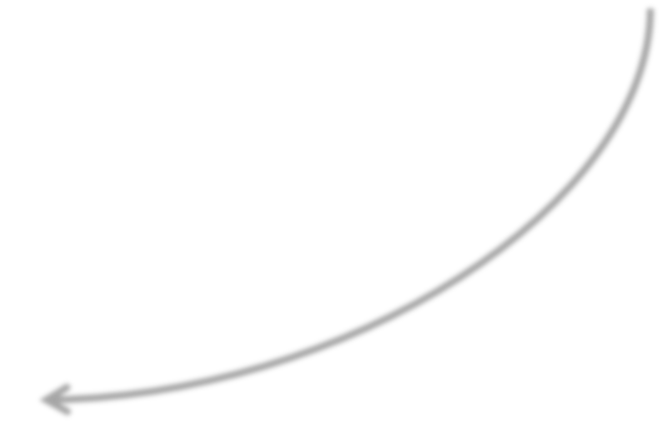
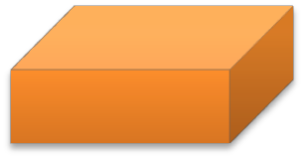



OpenNF overview
ex) Elastic scaling
Hot standby
Dynamic enhancement
Control Application
move/copy/share state
OpenNF
Controller
NF State Manager
Flow Manager
export/import
state
NF1
NF2
10

Slide 12






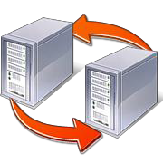
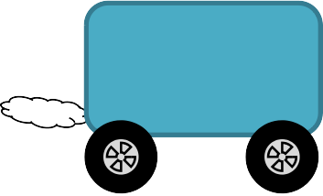
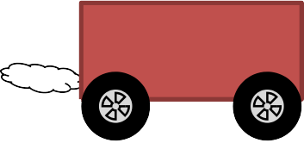

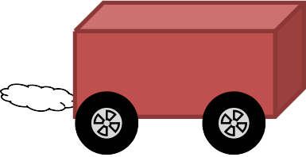


Challenges
Many NFs, minimal changes
- state operations at different granularities
2. Reigning in race conditions
Route
Update
Packet
State
3. Ensure application’s flexibility
- state operations at different granularities
- flexibility in choosing guarantees

Slide 13
NF state taxonomy
State created or updated by an NF applies to
either a single flow or a collection of flows
Per-flow state Multi-flow state
TcpAnalyzer
Connection HttpAnalyzer
Connection TcpAnalyzer
ConnCount
HttpAnalyzer
All-flows state
Statistics

Slide 14






NF API: export/import state
Functions: get, put, delete
put
Per
Scope
Multi
All
Filter
get
NF
No need to expose/change internal state organization!
12

Slide 15














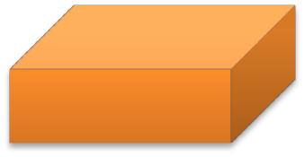

Control operations: move
Control Application Flow Manager
1. move (port=80, Bro₁, Bro₂) 6. forward(port=80, Bro₂)
NF State Manager
2. get(per, port=80)
4. del(per, port=80)
5. put (per, Chunk1)
put (per, Chunk2)
3. [Chunk1]
[Chunk2]
Bro₁
Bro₂
Also provide copy and share
13

Slide 16














Lost updates during move
move(red,Bro₁ ,Bro₂ )
detect-
MHR
Missing
state
Missing
updates
R2
R1
B1
R3
Bro₁ Bro₂
Loss-free: All state updates should be reflected in the transferred state, and all packets should be processed
Split/Merge [NSDI ‘13]: pause traffic, buffer packets
– Packets in-transit when buffering starts are dropped
14

Slide 17


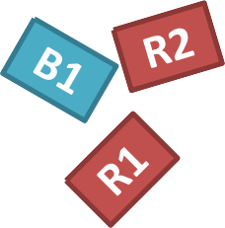








NF API: observe/prevent updates using events
NF
R1
Only need to change an NF’s receive packet function!

Slide 18

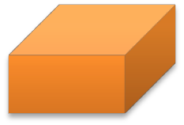

Use events for loss-free move
1. enableEvents(red,drop) on Bro₁
R1
Drop
Bro₁
Bro₂
16

Slide 19
Use events for loss-free move
enableEvents(red,drop) on Bro₁
get/delete on Bro₁
Drop
Bro₁
Bro₂
R1
16

Slide 20
Use events for loss-free move
enableEvents(red,drop) on Bro₁
get/delete on Bro₁
Drop
R2
Bro₁
Bro₂
R1
16

Slide 21
Use events for loss-free move
enableEvents(red,drop) on Bro₁
get/delete on Bro₁
Buffer events at controller
Drop
Bro₁
Bro₂
R1
R2
16

Slide 22
Use events for loss-free move
enableEvents(red,drop) on Bro₁
get/delete on Bro₁
Buffer events at controller
put on Bro₂
Drop
R1
Bro₁
Bro₂
R2
16

Slide 23
Use events for loss-free move
enableEvents(red,drop) on Bro₁
get/delete on Bro₁
Buffer events at controller
put on Bro₂
5. Flush packets in
events to Bro₂
R1,R2
Drop
R1
Bro₁
Bro₂
16

Slide 24

Use events for loss-free move
enableEvents(red,drop) on Bro₁
get/delete on Bro₁
Buffer events at controller
put on Bro₂
Flush packets in
events to Bro₂
Update
forwarding
R1,R2
Drop
R1
Bro₁
Bro₂
16

Slide 25
Use events for loss-free move
enableEvents(red,drop) on Bro₁
get/delete on Bro₁
Buffer events at controller
put on Bro₂
Flush packets in
events to Bro₂
Update
forwarding
R1,R2
R1,R2,R3
Drop
R1
Bro₁
Bro₂
17

Slide 26





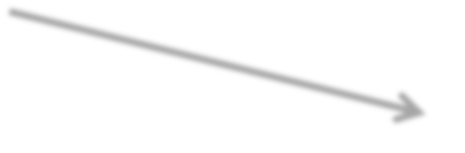
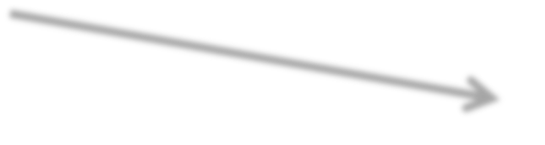



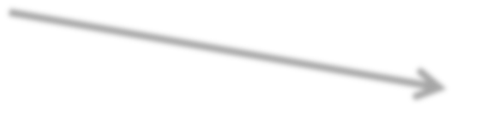
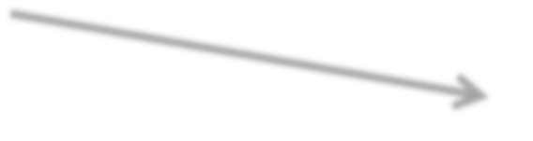
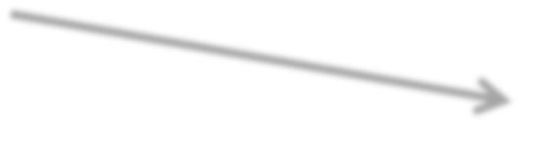



Re-ordering of packets
False positives from Bro’s weird script
Bro₁
Controller
Switch
Bro₂
Flush buffer
Request
R2
forwarding update
R2
R3
R2
R3
R4
R3
R4
R3
R3
Order-preserving: All packets should be processed
in the order they were forwarded by the switch
17

Slide 27



OpenNF: SLAs + cost + accuracy
Dealing with diversity
Export/import state based
on its association with flows
Dealing with race conditions
+
Events
Lock-step forwarding updates

Slide 28






Implementation
Controller (3.8K lines of Java)
Communication library (2.6K lines of C)
Modified NFs (3-8% increase in code)
Bro IDS
iptables
Squid Cache
PRADS

Slide 29


Overall benefits for elastic scaling
Bro IDS processing 10K pkts/sec
  At 180 sec: move HTTP flows (489) to new IDS
  At 360 sec: move back to old IDS
SLAs: 260ms to move (loss-free)
Accuracy: same log entries as using one IDS
  VM replication: incorrect log entries
Cost: scale down after state is moved
  Stratos: scale down delayed 25+ minutes
[arXiv:1305.0209]
20

Slide 30
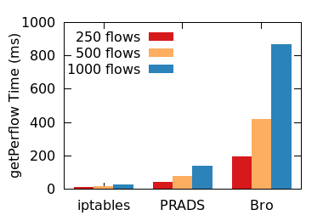
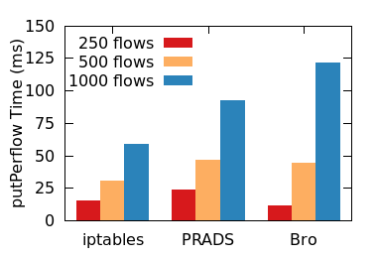

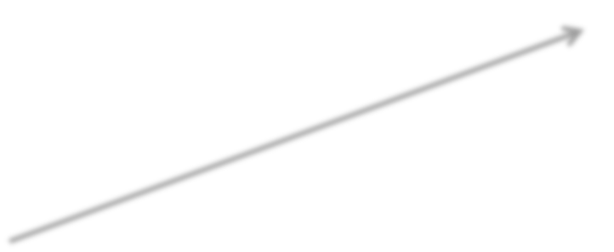



Evaluation: state export/import
Cost grows with
state complexity
Serialization/deserialization
costs dominate

Slide 31







Evaluation: operations
PRADS asset detector processing 5K pkts/sec
Move per-flow state for 500 flows
881 packets
in events
500
400
300
200
100
0
200
Move Time (ms)
Packets
dropped! 686
Per-packet Latency
Increase (ms)
150
462
100
50
0
NG NG PL LF PL+ER OP PL+ER
Average
Maximum
NG NG PL LF PL+ER
838 pkts
1120 pkts
Operations are efficient, but
guarantees come at a cost!
+
in events buffered

Slide 32





Conclusion
Dynamic reallocation of packet
processing enables new services
Realizing SLAs + cost + accuracy requires quick, safe control of internal NF state
OpenNF provides flexible and efficient control with few NF modifications
http://opennf.cs.wisc.edu

Slide 33
Discussion
Is it feasible to modify NFs to support OpenNF?
  Serialization/Deserialization is trivial parts
  We need to know internal data structure / allocation or accessing strategies / algorithm
  How to merge multiple states into one or split single state to multiple?
    It may merge two hash tables, split linked list into multiple, or merge B+ tree….
  It may require locking data structures → Blocking NF processing during locking!

Slide 34
Discussion
Is the performance enough to use in the real network?
  In paper, 2500 pps, up to 1000 flows migrations
  In real network, millions pps, hundred thousand flows..
  Per-packet latency will be increase from lock-step forwarding and state update
Linearly increases with # flows
State complexity add the delay

