Slide 1
Design and Implementation of a Consolidated Middlebox Architecture (CoMb)
EE807 – Software-defined Networked Computing
Vyas Sekar, Norbert Egi, Sylvia Ratnasamy Michael K. Reiter, Guangyu Shi
Intel Labs, UC Berkeley, UNC Capel Hill, Huawei
Presenter: Giyoung Nam
Some slides are brought from the author’s presentation
Notes:
Hi my name is giyoung nam and I’ll talk about the consolidated middlebox architecture which called Comb.

Slide 2





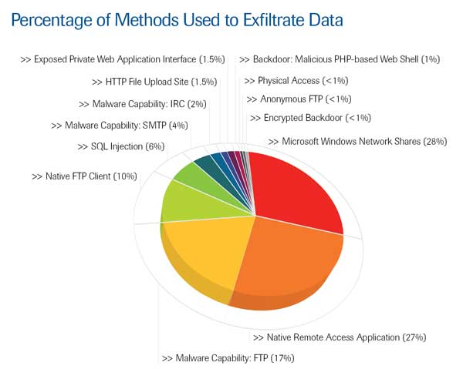




Need for Network Evolution
New applications
Evolving
threats
Policy
constraints
Performance, Security
New devices
Notes:
Due to evolve the network, there are a lot of new applications, and devices to support on network.
Also, degree of network threats are also evolving and policy constraints being complicate.
Based on these network evolution, network nodes should be smart and needs high functionality, security, and performance.

Slide 3
Era of Middleboxes
Exponentially growth middlebox market
Reaching the number of middleboxes to number of L3 network devices
Type of appliance | Number
Firewalls | 166
NIDS | 127
Media gateways | 110
Load balancers | 67
Proxies | 66
VPN gateways | 45
WAN Optimizers | 44
Voice gateways | 11
Total Middleboxes | 636
Total routers | ~900
Notes:
Rather than modifying exist network routers and switches, commercial trends heading to deploy middlebox to give high functionality on network.
Actually many type of middleboxes are already deployed widly and its market is already exponentially growth.
Some network enterprizes reports that the number of middleboxes are reaching to number of routers.

Slide 4
Messy Middlebox Infrastructure
Developed uncoordinated manner
  Acquired from independent vendors
  Closed system
Specialized boxes
  One device, one functionality
No unified interfaces
  Hard to manage
Increases CapEx
Increases OpEx
No unified view or management middleboxes across the network
Notes:
However there are some problems on middlebox era.
Because deploying middleboxes are exponentialy growth, it deployed uncoordinated manner.
There are lots of middleboxes which owned independent venders, and its middlebox is expensive and shows closed system.
These situations brings hugh problem on management and efficiency manner.
[click]
First, each middleboxes are specialized, we need to deploy additional boxes physically on network to add functionality. And it increases capital expenditures. This expenditures extreamly increases when there are many nodes to upgred.
And second, because each type of middleboxes has no unified interfaces, managing various type of middleboxes on global view become very hard. It also increases operational expenditures.
Expensive and closed stystem
Difficult to expand & manage
Capital expenditures
Operational expenditures

Slide 5
CoMb: Consolidate Middleboxes
CoMb consolidates at two levels
  Platform – decuples the hardware and software
  Network management
Network-wide
Controller
Load distribution
Multiplexing & reusability
Notes:
So, in this paper, authors want to solve these problems with consolidating middleboxes with software-centric implementions.
This consolidated middleboxes, called Comb consolidated into two levels, is platform level and network level.
The main goal of platform level is decuples the hardware and software to allow multiplexing the middlebox applications, and enhance reusability between common functionality of middleboxes apps such as packet parser.
And in network level, Comb want to distribute middleboxes’ load.
I’ll talk about the platform level first.
Shared hardware
Controlled by network-wide controller

Slide 6
Consolidation at Platform-Level
Reduces CapEx
Enables extensibility
Proxy
Firewall
IDS/IPS
AppFilter
Decouple
Hardware and
Software
Notes:
As I mentioned before, the main idea of platform level consolidation is decoupling hardware and software.
In normal middleboxes, one physical nodes only have one middlebox functionality. And comb want to increase flexability on middleboxes to allow run multiple middlebox applications into single nodes.
With this, to add new functionality on existing node, venders just install new application into comb middleboxes rather than deploying new hardware. So it reduces capex and also enables extensibility.

Slide 7
Application Multiplexing
Different peak time shows a possibility of multiplexing’s benefit
Notes:
Also, multiplexing on CoMb reduces capex on different point view.
This graph shows a time series of the utilization of four middleboxes at an enterprise site, each normalized by its maximum observed value.
Based on graph, we can see middleboxe utilization peak at different times for each application. So we can show that we get benefits of multiplexing.
From the paper, we can reduce 26% of total resources using application multiplexing.
Multiplexing benefit = Sum_of_MaxUtilizations/ Max_of_TotalUtilization
Reduces Cap Ex

Slide 8
Reusing Software Elements
Low-level modules can be shared each other
Enables extensibility
VPN Web Mail IDS Proxy
Firewall
Protocol Parsers
Session Management
Notes:
Second way to earn capex benefit is reusing software elements.
Each middelbox typically needs low-level modules for packet capture, parsing headers, parsing applicaton-layer protocol and so on. So if the same traffic is processed by many applications, each application has to repeate these common acctions for every packet.
In comb, they suggest the reusing software elements that share low-level modules each other if applications are located same node. Based on their research, there are 30 to 80 % of functions are overlap across applications.
Contribution of reusable modules: 30 – 80 %
Each appliance has to repeat these common actions for every packet

Slide 9
CoMb: Consolidate Middleboxes
CoMb consolidates at two levels
  Platform – decuples the hardware and software
  Network management
Network-wide
Controller
Load distribution
Multiplexing & reusability
Notes:
Until now, we talk about the benefit on platform side, and Let’s move on to load distribution in network-wide controller

Slide 10
Spatial Distribution
Management consolidation enables flexible resource allocation
N2
‘s Capacity: 100 unit
Path: N1→ N3
Overload!
Incoming 150 unit
N1
N3
Distribute loads
Network-wide
Controller
Notes:
Let assume that there are three nodes whitn the some packet path, and there are one middlebox at node 1.
If Node 1 deploys a middlebox application, (well, let’s assume that it is IDS), and its capacity is 100 unit.
When there are 100 unit of packet coming on N1. the middlebox on N1 become overload.
In CoMb, it allows to deploy multiple applications dynamically on different node, and adjust its processing capacity to distribute load on network-wide level.
So these management consolidation enables flexible resource allocation.

Slide 11
Outline
Motivation
Overview of CoMb
Design
  Management layer
  Platform layer
Evaluation & Conclusion
xOMB
Discussion
Notes:
Until now I’m talk about the overview of coMb, and I’ll move on the design part.
In this time, I’ll talk about management layer first.

Slide 12
CoMb Management Layer
Goal: balance load across network, exploit multiplexing, reuse, distribution
Require three inputs
  AppSpec: Policy constraints for middlebox application
  NetworkSpec: Routing path, middleboxes’ location, traffic classification information
  BoxSpec: Resource requirements for each application
Policy
Constraints
Resource
Requirements
Routing,
Traffic
Network-wide
Controller
Notes:
The goal of management layer is balance the load across network, exploit mupliplexinag, resue and distribution.
To achieve these goals, network-wide controller requires three kind of input, Appspec, networkspec, and boxspec.
First, application spec defines the policy constraints for middlebox, for example, it specifies the processing order for each packet, such as all web traffic goes through a firewall and then IDS, and finally go to proxy.
Network spec defines end-to-end routing path and the location of the middlebox nodes on each path, and define traffic into classes. In this paper, class is definded based on high-level flow information such as port 80 sessions initated by host at A from B. or discrbed based on 5-tuple information.
Finally, BoxSpec cpatures the haredware capabilities of the middlebox hardware such as CPU and memory. And also it captures resource footprint of each middlebox applications.

Slide 13
Constrains of Management Layer
Processing coverage
  Each middlebox application should define interested sessions
Policy dependences
  Respect the policy ordering constraints across middlebox applications
Reuse dependences
  Model the potential for reusing common actions
Notes:
So, given these inputs, controller assign processing responsibilities to middleboxes across the network.
To acheve theis goal, there are three constraints to satisfy.
First one is each middlebox application should define interested sessions’s routing path
Second one is that respect the policy ordering constraints across middlebox applications that need to process this session.
And the final one is model the potential for reusing common actions across middlebox applications.

Slide 14
Constrains of Management Layer
All applications pertaining to a given session run on the same node for a practical reason
HTTP
UDP
HTTP
NFS
For HTTP session, IDS and Proxy must locate on a same
node
IDS
Proxy
2
3
1
1
common
CPU
Memory
Need to Identify the exact sequence of applications for each session: HyperApp
HTTP
Footprint on
resource
Notes:
Before we move on the resource footprint part there are some important ideas to deploying applications into node.
achieving this policy and reuse dependences is hard on optimization point, they constraint that all applications pertaining to a given session run on the same node.
So, to minimizing the provisioning cost and load balancing with these constraints, first we need to know application’s resource footprint information.
This figure shows an example of resource footprint for two middlebox applications, IDS and Proxy.
But in this paper, they found that they cannot utilize loads with applications resource footprint only.
Because these network applications supports multiple class of session and each session can be pass multiple middlebox.
For example, for HTTP session, it crocess both IDS and Proxy middleboxes, and it requires 3 units of CPU and 4 units of memory resource.
On the other hand, UDP session only passes IDS and it requires 3 uiits of CPU only.
So, we need to identify the exact of applicatios for each session byond the application’s resource footprint. So they create new concept called HyperApp.
For a practical reason, 디펜던시를 없앤다.
한 session에 대해선 동일 노드를 써야한다

Slide 15
Capturing Reuse with HyperApps
HTTP:
1+2 unit of CPU
1+3 units of mem
HyperApp: find the union of apps to run
HTTP = IDS & Proxy
HTTP
UDP
HTTP
NFS
3
4
CPU
Memory
IDS
Proxy
2
3
UDP = IDS
1
1
3
1
common
Memory
CPU
CPU
Memory
NFS = Proxy
HTTP
Footprint on
resource
1
4
CPU
Memory
Notes:
Hyperapp finds the union of appes run, and each hyperapp also statically defines the policy order across its related applications.
Benefit of hyperapp:
it eliminates the need to capture the individual actions whithin a middlebox application and their reuse dependencies
It obviates the need to explicitly model the ordering constraints across applications
It simplifies the traffic model -> consider total volume of traffic in each class

Slide 16
Network-wide Optimization
Minimize Maximum Load, Subject to
Processing coverage for each class of traffic
→ Fraction of processed traffic adds up to 1
Load on each node
→ Sum over HyperApp responsibilities per-path
10 CPU
10 Mem
HTTP = IDS & Proxy
3
4
Memory
IDS < Proxy
0.4
CPU
IDS < Proxy
0.3
IDS < Proxy
0.3
HTTP
N1 → N3
Max{Load} = 12% CPU, 16% Mem
1.2 CPU, 1.6 Mem 0.9 CPU, 1.2 Mem 0.9 CPU, 1.2 Mem
load = 12% CPU, 16% Mem 9% CPU, 12% Mem 9% CPU, 12% Mem
N1
N2
N3
Notes:
`So, based on the hyperapp’s resource footprint information, we can finally optimize middleboxes in network-wide level.
These optimization problem is soved using linear program. I’ll show a simple example.
So, there are three nodes and there are HTTP session which passes N1 to N3.
First, controller set fraction ratio of processed traffic and make it addes up to 1.
After that, bring up Hyperapp’s footprint information multiply resources and its load on each node.
Finally, they calculate each loads, and repeat these sequence to make minimal the maximum load value.

Slide 17
CoMb Platform Layer
Applications
IDS
…
Proxy
Performance
Parallelize
Isolation
Core1
…
Core4
Policy Enforcer
Policy Shim (Pshim)
Lightweight
Parallelize
IDS -> Proxy
NIC
Classification:
HTTP
Fast classification
Traffic
Notes:
Let’s move on to Platform layer
In this layer, they want to utilize the application multiplexing inside of single CoMb box.
This picture brefly shows an example of packet processing on CoMb.
First, when a packet comes into NIC, it calassifies and sends to virtual queues which designated to proper policy shim layer.
The role of policy shim layer is enforce the policy to steering packet such as a processing sequence based on class.
Due to policy shim, each application does not need to aware other applications so it enables isolation.
There are several goals for each sub layers in platform layer.
First, applications needs high performance with parallizing and it require isolation. As I mentioned above, isolation can be solved due to policy shim.
Policy shim require lightweight workload. And it also needs parallelize.
Policy Shim is lightweight Because policy shim only stores policy sequence and it only receives packet for a single app so it does not have to store per-session state.
and finally NIC needs fast classification.
For fast classification, CoMb uses hardware classification which uses existing commodity NICs multiple queues.
NIC: hardware classifcaiton

Slide 18
Parallelizing Application Instances
App-per-core
HyperApp-per-core
M1
M2
M3
M1
M2
M2
M3
Core1
Core2
Core3
Core1
Core2
PShim
PShim
PShim
PShim
Inter-core communication
+ No in-core context switch
+ Keeps structures core-local
+ Better for reuse
- But incurs context-switch
- Need replicas
Notes:
So, to achieve platform layers requirement especially on parallization, they compare two major designs, App per core, and hyperapp per core.
Main idea of App-per core is affinities each application in core. In this case, it requires inter-core communications between sequential applications.
On the other hand, Hyperapp per core is affinitis each hyperapp in core. In this case, it needs context switch between related applications and it also needs extra applicaton copy. But it does not need to inter-core communication an easy to share the resources on a single core such.
Normally intercore communication overhead is larger than context switch overhead except for virtual machine, CoMb selects hyperapp-per-core design for parallizing application instances.

Slide 19
CoMb Platform Design
Core-local processing
Workload balancing
Core 1
Core 2
Core 3
M1
M2
M3
M1
M4
M5
M1
M4
Hyper
App1
Hyper
App2
Hyper
App3
Hyper
App4
Hyper
App3
PShim
PShim
PShim
PShim
PShim
Q1
Q2
Q3
Q4
Q5
NIC hardware
Parallel, core-local
Contention-free network I/O
Notes:
So, this is the summary of comb platform desing.
We have contention-free network I/O using hardware classification, and enable core-local processing using hyper-app per core design.
Also, comb designate pshim for each hyper app to increase parallelize.
Fianlly, comb allow to place multiple hyperapps on multiple cores to balance workload in single Comb box level.

Slide 20
Outline
Motivation
Overview of CoMb
Design
  Management layer
  Platform layer
Evaluation & Conclusion
xOMB
Discussion
Notes:
So I’ll move on to evaluation section and conclude the CoMb paper.

Slide 21
Implementation
CoMb Controller
  Use CPLEX (mathematical solver for liner programming)
CoMb box prototype
  Classification is done by NIC
  Policy enforcer is implemented in kernel-mode Click
CoMb application
  Session reconstruction & protocol parser
    Port these logic from Bro to Click
  For standalone applications
    Enable DMA or virtual network interfaces
Notes:
Before to talk about evaluation, I’ll briefly explain its implementation.
To calculate the network-wide load distribution, comb controller uses CPLEX which is mathematical solver for liner programming.
And basic function of comb box prototype is implemented in kenel-mode click, and it uses hardware classification by NIC.
CoMb application is ported from Bro to click. For standlone applicaton, it allows directed memory allocation from virtual NIC queue, or use virtual network interfaces.

Slide 22
Reduction in Provisioning Cost
Relative savings = Provisioning_{Today} /Provisioning_{Consolidated}
Consolidation reduces provisioning cost 1.8-2.5X
Notes:
I’ll talk about the evaluation part for network-wide benefit only.
This graph shows the provisioning cost saving using Comb.
To evaluatie this, they use real topologyies from education backbone and the enterprise network, and PoP level AS topologies. x-axis of this graph shows the type of topologes.
Based on these topology they emulate traffic using their own traffic matrices. And compare between current deployment of middlebox and CoMb with reusable modules. They deploy 4 applications : flow mornitoring, load balancer, IDS, and cache.
This evaluation shows that CoMb shows up to 2.5 time about provisioning cost saving rather than current deployement.
Controller takes <1.6 seconds for 52-node topology (5-min refresh)
----- Meeting Notes (14. 11. 5. 09:23) -----
PoP: point of resence

Slide 23
Reduction in Maximum Load
Relative savings = MaxLoad_{Today} /MaxLoad_{Consolidated}
Consolidation reduces maximum load by 2.5-25X
Notes:
For the benefit form the maximum load reduction, ComB reduces maximum load bt 2.5 to 25 times rather than current deployment.

Slide 24
Conclusion
Most network evolution occurs via middleboxes
  Current middleboxes is inflexible and difficult to extend
  High CapEx, OpEx
CoMb: Consolidated Middlebox
  Decouple software and hardware
  Application multiplexing
  Spatial load distribution
  Resource reuse
Notes:
Expenditure
Key idea: decouple software and hardware
Allowing

Slide 25
xOMB: Extensible Open Middleboxes with Commodity Servers
James Anderson, Ryan Braud, Rishi Kapoor, George Porter and Amin Vahdat
Notes:
Let’s move on the another paper xomb. I’ll briefly explain about this paper.

Slide 26
xOMB: eXtensible Open Middlebox
Framework for programmable middleboxes using commodity servers
  Focused on programmability and extensibility
Provides a programmable pipeline
  CoMb: Per-packet processing
  xOMB allows byte stream level
Provides low-level functionality necessary for high performance processing
User defined functionality on top of basic xOMB
blocks
It currently working for TCP only
Notes:
Unlike CoMb focused on consolidated deployment of middleboxes and simplifying network deployment.
Xomb focused on the its programmability and extensiblity.
The key point of xomb is the programmable pipline.
Each packet needs to pass policy shim layer between every application in CoMb , but xOMB does not need to do this using pipelining so it allows byte stream level.
It brings a benefit for re-packetizing between modules.
And it automatically handles low-level functionality necessary for high-performance processing, allowing the programmer to concentrate on the application logic.
모듈간에 패킷타이즈를 안해도 된다!

Slide 27
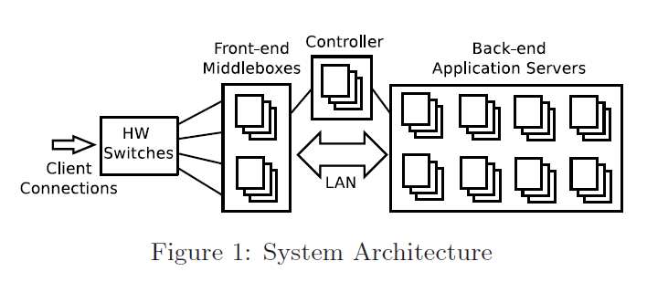
xOMB Architecture
Notes:
The major components include commodity hardware switches, front-end software middleboxes, back-end application servers, and a controller for coordiantion.
Front-end Softwaare middleboxes is the core of the xOMB framework.

Slide 28
Design of xOMB Server
Pipeline
Socket I/O
User or xOMB
defined modules
Basic
Functionality
Buffer
Manager
Connection
Manager
Message
Reorder Buffer
Control
Plane
Client TCP
Backend
TCP
Notes:
Because it runs on per-flow byte stream, not the packet level, it needs to manage TCP connections and message re-ordering.

Slide 29
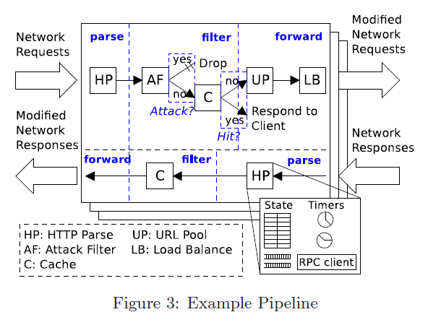
Example of Pipeline: HTTP
Notes:
Example of HTTP piplining including protocol parsing, HTTP version filtering, forwarding . Programmers can implement these pipleines using provided API.

Slide 30
Discussion
Missing explanation about “reusable modules” in design
  Hyperapp only identifying application sequence and resource
  footprint
  Shows an opportunity of reusable modules in evaluation only
How to classify traffic which has already processed from other middlebox?
Identifying hyperapp requires huge pre-processing time
  “handful of applications” does not fit on future network
Tradeoff of batching
  Batching packet on each hyperapp can reduce overhead of
  context switching
  Pshim (or some layer between app and pshim) needs additional buffer to store mid-stage
Notes:
I found some discussion point on comb paper.
First on is the missing concept about the “reusable modules” in design section. Sharing overlapped module is the one of the main concept of this paper, but I cannot found about how to find and locate ueusable modules inside of hyperapp. Hyperapp only identifying application sequence and resource footprint. Well, and this concept is re shown in implementation and evaluation, but it shows an opportunity of reusable modules. There are no solid implementation about this.
And in this paper, there is no explanantion about how to classify traffic which ahas already processed from other middlebox when spatial load distribution. Well, I assume that it can be handled with fine-grained classification using 5 tuple, but I think there are possibility about synchronization problem.
Also, on the calculationg hyperapp resource footprint, they mentions about its processing time is resonable becouse there are under 10 network middlebox applications exist. But I cannot agree this point.
Finally I want to suggest about reducing the overhead of context switching. As you know, the main overhead about hyper-app- per core is the context switching, but I think it can reduce context switching overhead.
Hyperapp 코어 지정 또는 미들박스 어사인하는 빈도같은거? 안정하나?
전체적으로 좀 임플리멘테이션이 빈약하다. Hyperapp 코어벌 지정이나 이런건 잘 안되어있는듯

Slide 31
Load Balancing Switches
Although xOMB design is for general middlebox, we will examine it with load balancing switch scenario
LBS with xOMB
  Packet-payload granularity
  Additional functionalities:
    Re-writing HTTP 1.0 requests as 1.1
    Connection collapsing

