Slide 1
FlowVisor Can the Production Network Be the Testbed?
Rob Sherwood, Glen Gibb, Kok-Kiong Yap, Guido Appenzeller,
Martin Casado, Nick McKeown, Guru Parulkar
Presented by: Choong-Hee Cho

Slide 2
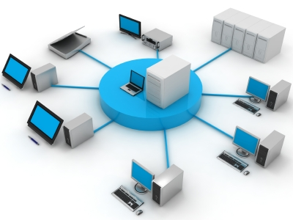
Validation?
"A persistent problem in computer network research is validation."
new research ideas
Real-world network
The validation is a conversion of the discovered idea in theory to real network.
The validation environment we called “testbed”

Slide 3
Difference between the real network and the test environment
Difficulties of building a realistic testbed
Larger scale
More money
real user traffic on testbed network
Requires downtime.
Vendor adoption can take years
using real equipment
The limitations of test environment
using software switches
takes a long time
Simulation and emulation
lack scale and realism
Special isolated testbeds
Dedicated to a particular
type of experiment and
exceed research budget

Slide 4
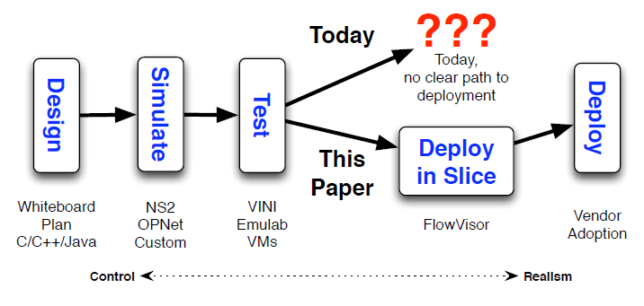
Limitations of current evaluation process
Network vendors have been thoroughly tested at scale in
realistic conditions with real user traffic
It needs its own location, support and dedicated links.
Notes:
새로운 아이디어 발견 -> 이론을 시뮬레이션으로 검증함 -> 테스트를 위한 현실적인 테스트 베드를 찾음 -> 최대한 현실적인 조건에서 테스트된 만큼 기술의 신뢰도와 발전이 성장함

Slide 5
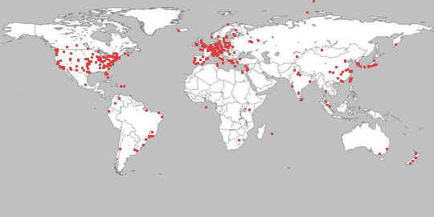
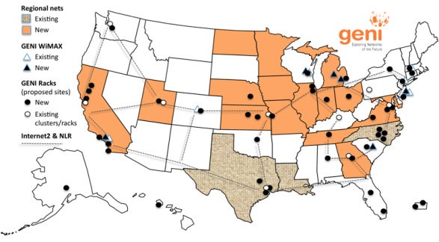
Today’s successful case
PlanetLab: can test new distributed applications
with scale (over 1,000 nodes worldwide),
realistically (it runs real services, and real users opt in)
offers a straightforward path to real deployment
(services developed in a PlanetLab slice are
easily ported to dedicated servers).
GENI: Global Environment for Network Innovations in US.
GENI is a shared testbed using ” Slice” and
aggregate provides resources to GENI experimenters.
provides standard API to use GENI
FIRE: concept of experimentally-driven research.
Create a dynamic, sustainable, large scale European Experimental Facility
Notes:
새로운 아이디어 발견 -> 이론을 시뮬레이션으로 검증함 -> 테스트를 위한 현실적인 테스트 베드를 찾음 -> 최대한 현실적인 조건에서 테스트된 만큼 기술의 신뢰도와 발전이 성장함

Slide 6
Goal of new Testbed
The goal is to allow new network algorithms, features, protocols or services to be deployed at scale, with real user traffic, on a real topology, at line-rate, with real users; and to support the prototype service can easily be transferred to run in a production network.
New Idea
New network algorithms
New Features
easily
New Protocols
New Services
Real user traffic, real topology
real line-rate, real users.

Slide 7
Examples of experimental new services
New routing protocol
Network load-balancer
Novel methods for data center
Routing
Access control
Novel hand-off schemes for mobile users or mobile virtual machines
Network energy managers
Etc.
Notes:
엑세드라.

Slide 8
VINI and Emulab
VINI and Emulab, the network testbeds, that come closest to achieving this today.
Common Features:
Multiple simultaneous experiments
Topology code can be applied to data plane and the control plane
Differences:
Emulab is concentrated in one location, whereas
VINI is spread out across a wide area network.

Slide 9
VINI and Emulab
VINI and Emulab trade off realism for flexibility in three main ways.
Speed, Scale, Technology transfer
Speed
VINI and Emulab: These are implemented as a software and treated as a CPU.
Real network: Switches and routers of real network are implemented in ASICs
ASICs consistently outperform CPU-based devices in terms of data-rate, cost and power.

Slide 10
VINI and Emulab
Speed, Scale, Technology transfer
Scale
VINI and Emulab are impossible for a large network tests due to limitations in the performance.
(need parallel testbed -> limits their scale)
VINI’s geographic scope is limited by the locations willing to host special servers. (need enormous investment)
Emulab can grow larger than VINI but still has limitation of scale.

Slide 11
VINI and Emulab
Speed, Scale, Technology transfer
Technology transfer
An experiment running on a network of CPUs takes considerable effort to transfer to specialized hardware.
Takes many years and requires many millions of dollars.
The hardware has to be developed, deployed, maintained and supported periodically.

Slide 12
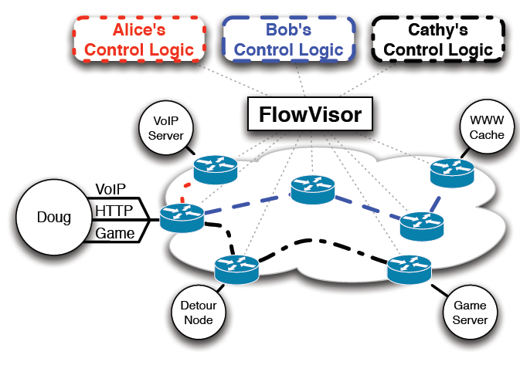
The goals of FlowVisor
FlowVisor allows experimenters to evaluate ideas directly in the production network by “slicing” the hardware already installed.
Experimenters can try out their ideas in an isolated slice, without the need for dedicated servers or specialized hardware.

Slide 13
The Contributions of FlowVisor
Runs on deployed hardware and at real line-rates
Software slicing layer
Slice any control plane message format with OpenFlow.
VLAN cannot support control the forwarding plane
Allows real users to opt-in on a per-flow basis
Mapping flows to slices with policy language
Ports easily to non-sliced networks
FlowVisor is transparent to both OpenFlow switches and the controllers.
Not vendor-dependent implementation
Enforces strong isolation between slices.
coexist independently
Operates on deployed networks
With 20+ users, 40+ network devices, a production traffic slice, and four standing experimental slices

Slide 14
Slicing Control & Data Planes
Commercial switches and routers
The control plane and data planes physically co-located.
FlowVisor
Separates between the planes with slicing communication.
Advantage: single data plane <-> multiple control
For running experiment in the slice of the network
Requesting a network slice to administrator.
With topology, bandwidth, and the set of traffic
Slice do not impact other slices

Slide 15
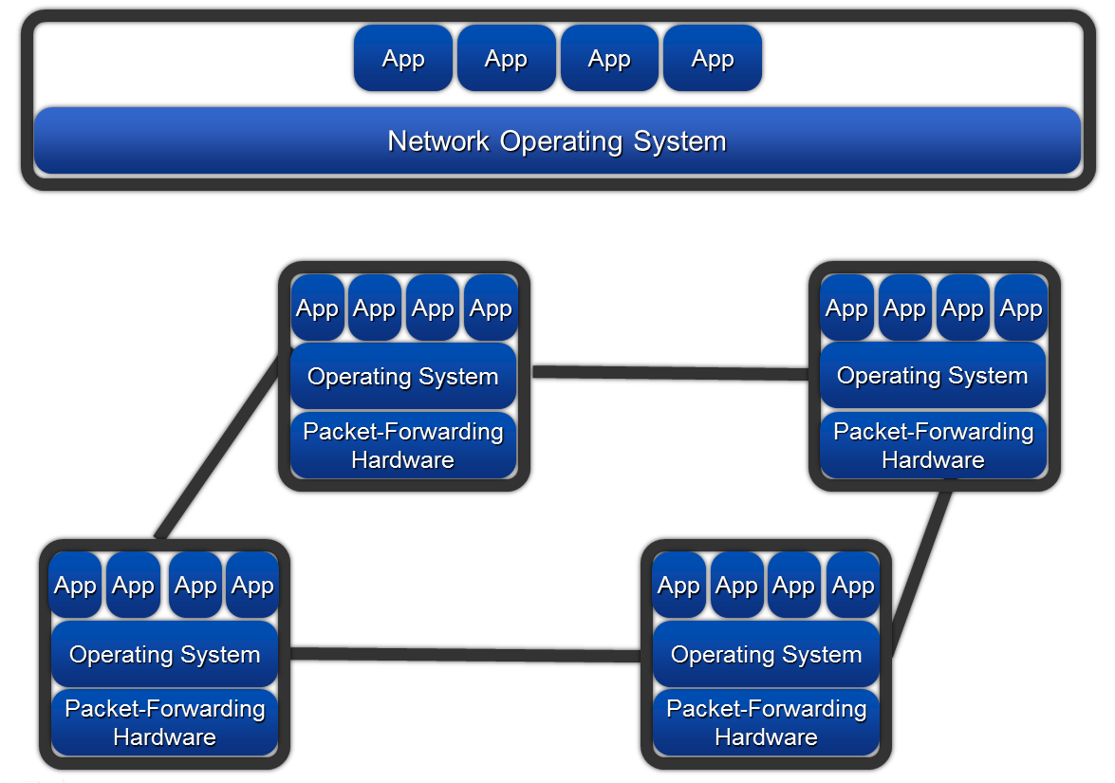
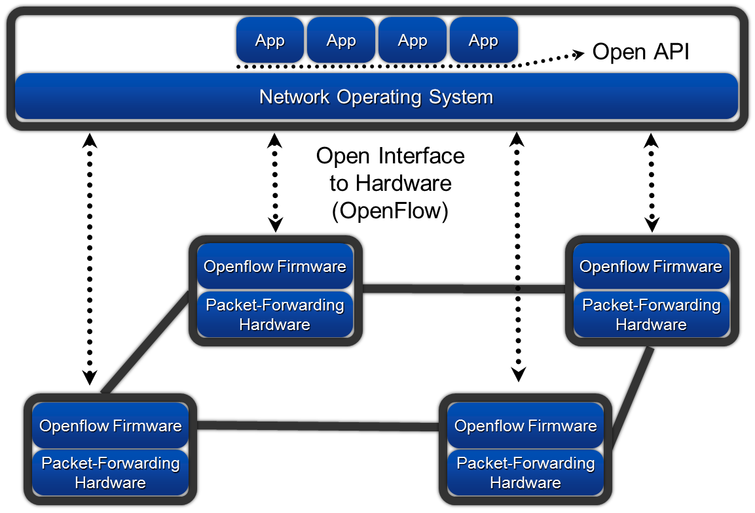
OpenFlow
OpenFlow is an open standard that allows researchers to directly control the way packets are routed in the network.
Legacy network structure
SDN network structure
Match Fields | Counters | Action
It supports only one control logic it is limited to one isolated testbeds and limiting its scope and realism.

Slide 16
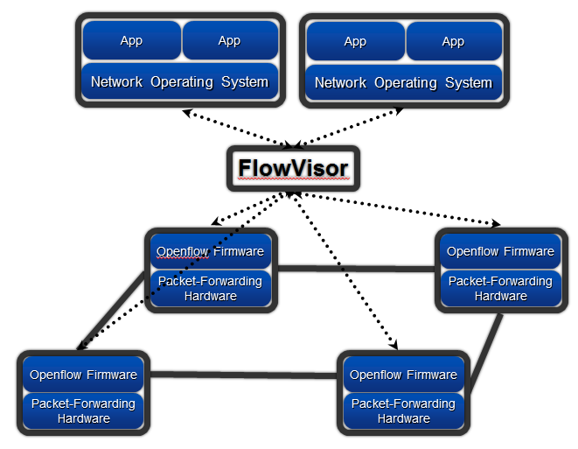
Slicing OpenFlow
FlowVisor supports the environment that can be applied to a number of experiments in one physical topology.
SDN network structure with FlowVisor

Slide 17
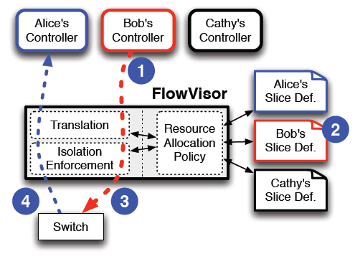
FlowVisor Design
Network resources are sliced.
Each informations about slices belong to each "flowspace" in the FlowVisor
Proxying connections
Slices are defined using a slice definition policy language.

Slide 18
Slicing Network Resources
The separation of network traffic means the separation of the various network resource.
Topology
Bandwidth
Device CPU
Forwarding Tables(e.g., TCAM entries)

Slide 19
Flowspace and Opt-In
A slice controls a subset of traffic in the network.
1 slice = 1 flowspace
If someone want to add a subset of their flows to a slice’s flowspace
Users signal to the network administrator.
Determine level of involvement in an experiment
ex) all of their traffic to a single experiment or
just one application(related to port number) or
just a specific flow(specifying all of the fields of a header)
The allocation of slice can be done manually or automatically. (depends on implementation)
it uses flow-level opt-in

Slide 20
Control Message Slicing
FlowVisor's transparent proxy
FlowVisor’s operation example
App
App
App
App
Bob’s controller
Network Operating System
Network Operating System
Bob’s control message
All packet forward to port 1
"spread all HTTP traffic over a set of web servers.“
flowspace: Allow tcp port:80
, Ip=Webserver, host1
FlowVisor
Bob’s control message
The other Slice
Policy
Translation
Resourc
Allocation
Policy
Bob Slice
Policy
Only Port 80 packet
forward to port 1
Forwarding
New flow Message
Openflow Firmware
port1
Openflow Firmware
Packet-Forwarding Hardware
Web server
Packet-Forwarding Hardware
Host1

Slide 21
Slice Definition Policy
Slice policy = network resources + flowspace + allocated controller info (one file per slice)
Network resources = link bandwidth available + the budget for switch CPU + forwarding table entries + Network topology(list of network nodes and ports)
Flowspace(for each slice) = an ordered list of tuples
flowspace has "allow, read-only, or deny" actions
ex) Allow: tcp port:80 and ip=user ip.
Deny: tcp port:80 and ip=user ip.
Read-only: all.

Slide 22
FlowVisor Implementation
The code of FlowVisor is C language and it can be download on the www.openflow.org
The notable parts of the implementation are the transparency and isolation mechanisms. Let’s consider the following things:
Messages to Control Plane
Messages to Forwarding Plane
Bandwidth Isolation
Device CPU Isolation
Flow Entry Isolation

Slide 23
FlowVisor Implementation
Messages to Control Plane
The slice controller can receive Control plane messages
Flow feature negotiation messages
Port up/port down messages
Send a received message to the controller that associated with the switch and port managed by each slice.
Simulate network events(such as link and node failures) can easily be simulated by FlowVisor.

Slide 24
FlowVisor Implementation
Messages to Forwarding Plane
To ensure both transparency and isolation, the FlowVisor rewrites both the flow definition and the set of actions.
The FlowVisor rewrites the flow definition to intersect with the slice’s flowspace.
Ex)
Controller
FlowVisor
Switch
Flow rule A,B
Flow rule A
Allow
Policy A
Controller
FlowVisor
Switch
Flow rule B
Error msg
Allow
Policy A

Slide 25
FlowVisor Implementation
Bandwidth Isolation
OpenFlow expose native bandwidth slicing capabilities
The FlowVisor creates a per-slice queue on each port on the switch.
The FlowVisor rewrites all slice forwarding table with slice-specific queue ID
Ex) “sendout port X” -> “send out queue Y on port X”
FlowVisor uses minimum bandwidth queues(FlowVisor gives the percentage of the minimum bandwidth.)

Slide 26
FlowVisor Implementation
Device CPU Isolation
a highly loaded switch CPU will significantly disrupt the network.
A long-term solution of CPU Isolation:
Process scheduling, Rate-limiting features
Four main problem of CPU Isolation:
New Flow Messages: FlowVisor rate limits the new flow message arrival rate to prevent quite often message generation (e.g. FlowVisor keeps a token-bucket style counter for each flow space rule.)
Controller Requests: It is controller message to edit the forwarding table or query statistics

Slide 27
FlowVisor Implementation
Device CPU Isolation
Four main problem of CPU Isolation(cont.):
Slow-Path Forwarding: It seem like the slow path means forwarding packet not using the ASIC process. (e.g. sending one packet out exactly two ports)
Way of Reducing the slow-path forwarding rules: one-time packet forwarding events as “packet out” message.
Internal Bookkeeping: e.g. internal counters, process events, update counters, etc.

Slide 28
Flow Entry Isolation
Count the number of flow entries used per slice.
Check whether the flow entries exceed a preset limit.
Counter increment: when a guest controller inserts a rule into the switch.
Counter decrement: when a rule expires.
Special case: expand rules that match multiple input ports.
The controller will receive a “table full” error message when the flow entry exceeded the limitation.

Slide 29
Evaluation
Evaluate the FlowVisor’s scalability, performance, and isolation properties.
Scalability
A single FlowVisor instance sufficiently cover 40+ switch and 7 slice.
Factors of The FlowVisor's workload: # of switches and slices, and flowspace rules per slice, the rate of new flow messages.
Two types of workloads
Case＼workload factors | slice | rules per slice | switches | new flows per second per switch
General observed Environment case | 1 | 35 | 28 | 1.55
A synthetic workload case | 1 | 1000 | 10 | 100

Slide 30
Evaluation
Scalability(cont.)
Test time: 5 minutes, Measured value: CPU utilization
Results
The high workload shows that CPU utilization increases linearly.
high workload(with 10 switchs x 100 new flows/s = 1000 new flows/s) ≒
the peak rate of published real-world enterprise networks
(an 8,000 host network generated a peak rate of 1,200 new flows per second)
The observed workload showed a value within 0% to 10%. = General observed Environment case roughly independent of the experimental variable.

Slide 31
Evaluation
Performance Overhead
FlowVisor only adds overhead to actions that cross between the control and data plane layers.
Measure latency of new flow message between the switch and controller with and without the FlowVisor.
Experiment environment:
Machine with two interfaces to a switch.
One interface sends a packet every 20ms (50 packets per second)
The other interface is the OpenFlow control channel.
Results
latency(average) between the switch and controller with FlowVisor = 16ms
latency(average) between the switch and controller without FlowVisor = 12ms
These two result of test are too much overhead.

Slide 32
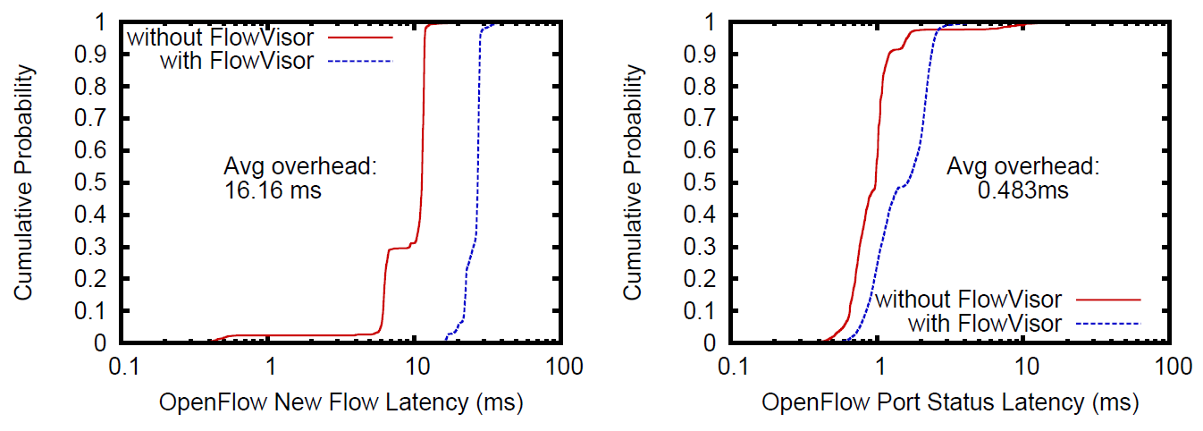
Evaluation
Performance Overhead(Cont.)
Measure latency of a port status request message between the switch and controller with and without the FlowVisor.
Experiment environment:
200 port status requests per second.
the maximum request rate supported by the hardware
The controller and the FlowVisor allocated in each seperated PC.
Results
latency(average) between the switch and controller with FlowVisor = 0.48
port status response time being faster than new flow processing time

Slide 33
Evaluation
Bandwidth isolation
Measure the link bandwidths of experiment that two slices compete for bandwidth on a shared link.
Experiment environment:
first slice sends TCP friendly traffic
other slice sends TCP-unfriendly constant-bit-rate (CBR) traffic at full link speed (1Gbps).
Results
With the bandwidth isolation disabled (“without Slicing”): The CBR traffic consumes nearly all the bandwidth and the TCP traffic averages 1.2% of the link bandwidth.
With the traffic isolation features enabled (“with 30/70% reservation”):
TCP slice's bandwidth = 70%(average of 64.2%)
CBR slice's bandwidth = 30%(average of 28.5%)

Slide 34
Evaluation
Switch CPU isolation
Measure the Switch CPU Utilization of experiment with and without CPU isolation.
Experiment environment(two experiments):
The Open-Flow controller maliciously sends port stats request messages at increasing speeds.
The switch generates new flow messages faster than its CPU can handle.
Results
FlowVisor’s isolation reduce a large amount of the Switch CPU Utilization when the request rate hits 256 requests per second.
The bursts shape of Switch CPU Utilization means that the FlowVisor inserts a forwarding rule to drop the offending packets for a short period when CPU exceeds a certain limit.

Slide 35
Trade-offs and Caveats
Limitations on new feature assigned to the open-flow.
Openflow with hardware capabilities.
(does not support VPNs, GRE tunnels, MPLS etc.)
So we should wait for the function updates of Openflow or consider the following things.
A switch or router manufacturer can expose more features to the experimenter.
Arbitrary processing in novel ways at every switch in the network → The Openflow and FlowVisor become useless.
Middlebox can be used. But if number of Middlebox increases, the FlowVisor functions become weak.
And there is currently no standardized way to how to deal with physical switch is to appear multiple times in a slice’s topology with Openflow.

Slide 36
Conclusion
The project removes tesbed for only testing network and reduced the evaluation process of the idea and experimenters completely can share a single physical topology.
There are some limitation on the implementation of function depends on the Openflow. But Exposing more finegrained control of the forwarding elements will allow us to solve the remaining isolation issues.

Slide 37
Discussion Points
What if the number of slice's controller share some users?
How control the user traffic in the switch dealing with the user's packet?
How define the threshold of slice's resource(such as CPU, Flow entry)?
The more the number of rate limiting increases, the more packets will be dropped in the network.
Is this the correct approach about Testbed?
FlowVisor is highly dependent on the Openflow.
Is this Advantage? or disadvantage?
Co-exist with a non-OpenFlow switch or router.

Slide 38
Appendix

Slide 39
Deployment Experience
Stanford Deployment
Network Components: 25+ users, 5 NEC IP8800 switches, 2 HP ProCurve 5400s, 30 wireless access points, 5 NetFPGA [15] cards acting as OpenFlow switches, and a WiMAX base station.
Features: Trunks over 10 VLANs, only three of those VLANs are OpenFlow-enabled, two are sliced by FlowVisor, NOX’s routing module to perform basic forwarding in the network.
Deploying on Other Networks
GENI “meso-scale” project deployed FlowVisor onto test networks on six university campuses, University of Washington, Wisconsin, Princeton, Indiana, Clemson, Rutgers.
Goal: extending the existing OpenFlow and FlowVisor test network to their production networks

Slide 40
Experience of Slicing Trouble
Case 1
Cause: virtual IP feature of the router: multiple physical interfaces to act as a single, logical interface for redundancy.
Symptom: Mac addresses of the response to ARP requests are different each time.
Handling: revise the flowspace assigned to the production slice to include all four MAC addresses.
Case 2
Cause: periodically receives the amount of broadcast LLDP, Spanning Tree, and other packets from non-OpenFlow devices.
Problem: debugging more difficult and not supports the non-OpenFlow-bases spanning tree algorithms
Case 3
Cause: when one slice would insert a forwarding rule that could only be handled via the switch’s slow path.
Problem: would push the CPU utilization to 100%, preventing slices from updating their forwarding rules.

Slide 41
Related Work
TestBed Name | Description | Comments
PlanetLab | Primary function has been that of an overlay testbed, hosting software services on nodes deployed around the globe.
Emulab | Emulab is targeted more at localized and controlled experiments run from arbitrary switch-level topologies connected by PCs.
ShadowNet | It has virtualization features of specific high-end routers. | Not provide per-flow forwarding control or user opt-in.
VINI | It provides the ability for multiple researchers to construct arbitrary topologies of software routers while sharing the same physical infrastructure. | Affiliated with PlanetLab
Supercharged PlanetLab | a network experimentation platform designed around CPUs and NPUs (network processors). | per-packet processing
VLANs | VLANs are widely used for segmentation and isolation in networks. It supports L2 forwarding and learning over a spanning tree. | Can use only single slice, and can’t define user-define control Logic
Prospero ATM Switch Divider Controller | It allow multiple control planes to operate on the same data plane. | Slices individual ATM switches, Matching a ATM-related fields

Slide 42
The END

