Slide 1
OpenFlow & NOX (& how the SDN era started) CCR 2008 Whitepapers
Nick McKeown & Natasha Gude et al.
Presented by: M. Asim Jamshed
Some slides have been derived from Nick McKeown’s talk in the Stanford Clean
Slate Program & Scott Shenker’s talk in the Open Networking Summit, 2011

Slide 2
Intro: Need for a Programmable Switch
Alice wants to test a new network protocol
Asks administrator to create network paths b/w set of machines spanning the entire campus network

Slide 3
Intro: Need for a Programmable Switch
Control plane elements difficult to configure
E.g. Network paths are fixed in L2/L3 boxes
Flow tables in switches/routers vendor-specific
Each L2/L3 path needs to be updated manually on each switch

Slide 4
Approach I: Updating switch internally
VENDOR’S
NIGHTMARE
Standard
Network
Processing
User-
defined
Processing
sw
Experimenter writes experimental code on switch/router
hw
*Figure taken from Nick McKoewn’s talk: “OpenFlow (Or: “Why can’t I innovate in my wiring closet?”)” (2008)
Notes:
Commercial vendor won’t open software and hardware development environment
Complexity of support
Market protection and barrier to entry

Slide 5
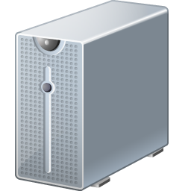
Approach II: Open-S/W Platforms
FANOUT
COMPACT SOLUTION
Experimenter
uses Click
(or its equivalent)
Notes:
Hardware/software: Fanout too small (need >100 ports for wiring closet)

Slide 6
OpenFlow Goals
Allow admins to program the control (forwarding) plane without exposing the IP rights of the vendors’
switches/routers
An open protocol that dynamically programs the flow tables in switches/routers

Slide 7
OpenFlow Switching Approach
OpenFlow Switch
OpenFlow Switch specification
(SSL)
PC
OpenFlow Protocol
Secure
Channel
Commands/Packets
Controller
sw
Flow
Table
hw
*Figure taken from Nick McKoewn’s talk: “OpenFlow (Or: “Why can’t I innovate in my wiring closet?”)” (2008)
Notes:
Amenable to high performance and low-cost implementations
Capable of supporting a broad range of research
Assured to isolate experimental traffic from production traffic
Consistent with vendors’ need for closed platforms

Slide 8
Controller
Fine-grained management of the control plane
Flows processed according to admin’s policies
Controller commands
Forward packets to ports/controller
Drop packets
Rewrite headers
Flexible header manipulation
Arbitrary matching of first few bytes of payload
Arbitrary rewriting of first few bytes of payload
Support load balancing b/w multiple controllers

Slide 9
Secure Channel
SSL Connection, site-specific key
Controller discovery protocol
Encapsulate packets for controller
Send link/port state to controller

Slide 10
Flow Table
Flow Table Entry
Rule
Action
Stats
Packet + Byte counters
Forward packet to port(s)
Encapsulate and forward to controller
Drop packet
Send to normal processing pipeline
Switch
Port
MAC
src
MAC
dst
Eth
type
VLAN
ID
IP
Src
IP
Dst
IP
Prot
TCP
sport
TCP
dport
+ mask
*Figure taken from Nick McKoewn’s talk: “OpenFlow (Or: “Why can’t I innovate in my wiring closet?”)” (2008)

Slide 11
End Targets
Amenable to
High performance
Low-cost implementations
Isolation of experimental from normal traffic
Vendor’s need for closed platforms retained
Notes:
Amenable to high performance and low-cost implementations
Capable of supporting a broad range of research
Assured to isolate experimental traffic from production traffic
Consistent with vendors’ need for closed platforms

Slide 12
The Bigger Question
Configuring each switch of the network for
Path updates
Access control
VLAN tagging
Traffic conditioning
Traffic mirroring
Extremely cumbersome
Manage control plane via programmable switches
from a centralized node

Slide 13
NOS Fundamentals
Present apps a centralized programming model
Manages the controller
Programs written as if the entire network is on a single machine
High level abstractions
IP and MAC address
Hostnames and usernames
Manage bindings between abstractions & low-level bindings
NOS network view → Entire network abstraction
An example of NOS → NOX (open source)

Slide 14
SDN Hierarchy – The Big Picture
3. Well-defined open API
2. At least one good operating system
Extensible, possibly open-source
App
(Routing)
App
(CDN)
App
(AC)
ABSTRACT NETWORK MODEL
Global Network View (DB)
Network Operating System (NOX)
1. Open interface to hardware
Simple Packet Forwarding (e.g. OpenFlow) H/W Switch
Simple Packet Forwarding (e.g. OpenFlow) H/W Switch
Simple Packet Forwarding (e.g. OpenFlow) H/W Switch
Simple Packet Forwarding (e.g. OpenFlow) H/W Switch
Simple Packet Forwarding (e.g. OpenFlow) H/W Switch
*Figure taken from Nick McKoewn’s FCC talk: “Software-Defined Networks” (2009)
Notes:
App = Control Program

Slide 15
NOX Network Operations
Incoming new packet at switch
Does flow entry for the corresponding flow exist?
If yes:
Perform the action
If no:
Forward it to the NOX controller
Process the packet in the controller based on the policy written by the control program (app)
Send NOX command to the switch to add new flow entry (optional)
Notes:
- No command sent back for protocols such as DNS, DHCP etc.

Slide 16
What more can NOX do?
Finer Admission Control
“Guests can comm. using HTTP only via a web proxy”
VLANs
“Create your own isolated network”
A non-IP network
“Evaluate your own L3 protocol”
Simplistic scan detection
How to detect scanning hosts
Count # of unique L2 & L3 conn. initiation queries
Concise (only 11 SLOC)

Slide 17
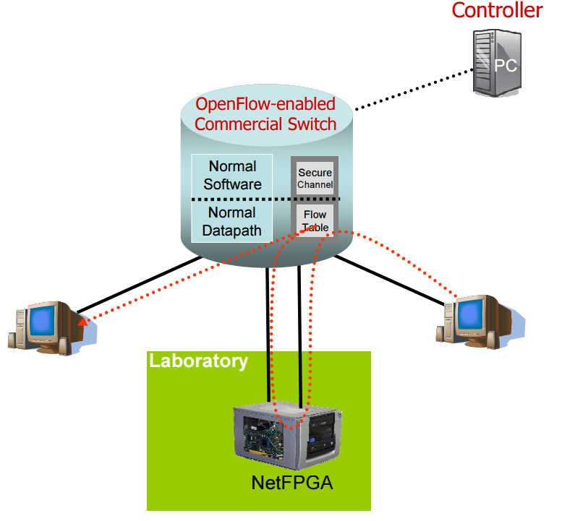
Experiment at Packet Level
Deep Packet Inspection using a middlebox
*Figure taken from “OpenFlow: Enabling Innovation in Campus Networks” (2008)

Slide 18
Experiment: Power Management

Slide 19
Discussion Forum
Making the network more manageable
But also,
Making the network more intelligent
Concept of “keeping the control plane simple” lost??
Notes:
http://blog.silver-peak.com/an-insurmountable-problem-for-sdn

Slide 20
Discussion Points
Data plane -> Control plane -> Data plane
Latency issues?
Concept of security? (flow poisoning attacks)
Downside of using centralized management
DDoS attack on the SDN controller
100K DNS/DHCP requests per sec??
Scalability
Difference between Ethane/NOX

Slide 21
Appendix

Slide 22
OpenFlow Switch Vendors
Alcatel-Lucent
Big Switch Networks
Brocade Communications
Arista Networks
Pica8
Cisco
Dell Force10
Extreme Networks
IBM
Juniper Networks
Hewlett-Packard
NEC
MikroTik
& many more…

Slide 23
OpenFlow Type Switches
OpenFlow Switch Specification
Current version 1.4 (2013)
Notes:
Scalability? : Ethane controller can manage 10K new flows per second

Slide 24
NOX Port Detection Example Code
scans = defaultdict(dict)
def check_for_scans(dp, inport, packet):
dstid = nox.resolve_host_dest(packet)
if dstid == None:
scans[packet.l2.srcaddr][packet.l2.dstaddr] = 1
if packet.l3 != None:
scans[packet.l2.srcaddr][packet.l3.dstaddr] = 1
if len(scans[packet.l2.srcaddr].keys()) > THRESHOLD:
print nox.resolve_user_source_name(packet)
print nox.resolve_host_source_name(packet)
# To be called on all packet-in events
nox.register_for_packet_in(check_for_scans)

