Slide 1
EE807 Software-defined Networked Computing
KyoungSoo Park
Department of Electrical Engineering
KAIST

Slide 2
Class Overview
Recent hot topics in networking/networked systems research
Software-defined networking (SDN)
Network functions virtualization (NFV)
Activity: read and discuss research papers
SIGCOMM, NSDI, CCR, NDSS, OSDI, SOSP, …
Goal: understand the concepts & develop and execute your own research ideas

Slide 3
Administrativia
Lecturer: KyoungSoo Park
Office: N1-813
email: kyoungsoo@ee.kaist.ac.kr
Homepage: http://www.ndsl.kaist.edu/~kyoungsoo/
No TAs for the course
We may take turns if needed, but probably not

Slide 4
Administrativia
Meeting time & Place
M/W 10:30-11:45am
Classroom: N1-114 (here)
Class homepage
http://www.ndsl.kaist.edu/~kyoungsoo/ee807/
Piazza
https://piazza.com/kaist.ac.kr/fall2014/ee807/home
Paper review submission
Online discussion

Slide 5
Course Component: Paper Review
(1-)2 papers per class
0.5 to 1 page for each review
Typical review format
(1) summary of the paper
(2) overall strength/weakness of the paper
(3) in-depth review: most important
Read “how to read a paper” by S. Keshav
Linked to the syllabus page

Slide 6
Course Component: Discussion Leading
Discussion leading
Present a paper at each class (the first one)
Defend the work as if it’s yours
2 per semester, each graded by fellow students
Important: introduce discussion points at the end
How to prepare your slides?
Make your own slides: do not simply copy & paste original presenter’s slides
You can borrow graphs and pictures with proper acknowledgement
Read “how to give a good presentation”
Linked to syllabus page (as well as other links)

Slide 7
Course Component: Project
The most important part of the course
You develop/execute your own research idea
By reading other ideas and how they execute
In a group of one or two people (no more than two)
From idea inception to result presentation
Motivation, design, implementation, evaluation
Final paper: two-column, 10pt, 10+ pages
Don’t wait until the last minute
Start thinking what would be intellectually challenging and useful, and fun!
Discuss with me a rough idea before proposal

Slide 8
Project Can be Literature Review
Pick a subject & read at least 10 papers (not discussed in class) around it
Literature review should be an individual work
You review the subject
Think of writing a survey paper
10+ paper reviews + 1 final summary paper
Proposal: what subject to review, why is it important, points to compare,…
Presentation: overall review on the subject

Slide 9
Grading
Discussion leading: 10%
Graded by fellow students (by filling in a grading sheet)
Discussion participation: 10%
Graded by professor (your grading sheet)
Might take quizzes in case of lack of participation
Paper review: 30%
1-2 papers per class, upload reviews to piazza before class starts (any late reviews are not counted)
You have an option to skip two times (=1 week) throughout the semester (let me know when you skip)
Project proposal: 10%
2-page write-up due 9pm on 10/18
Final presentation & paper: 30%

Slide 10
Topics and Tentative Schedule
Introduction & preliminaries: 1 week
SDN technologies: 3 weeks
Verification, testing, debugging: 1.5 weeks
Project proposal (10/15)
Middleboxes and NFV: 5 weeks
Security issues: 1 week
Final presentation (12/10)

Slide 11
Discussion Leading
Skim through the syllabus page
Let me know what paper to present ASAP
Slots filled on a first-come-first-served basis
Before your presentation, meet me
Set up an appointment by email
At least 2-3 days before the presentation
We’ll do practice talk with me with your slides
I’ll give you feedback on your slides/presentation
I’ll will check out the discussion points
Any questions?

Slide 12
Computer Networks Review: (Some Important) Building Blocks

Slide 13
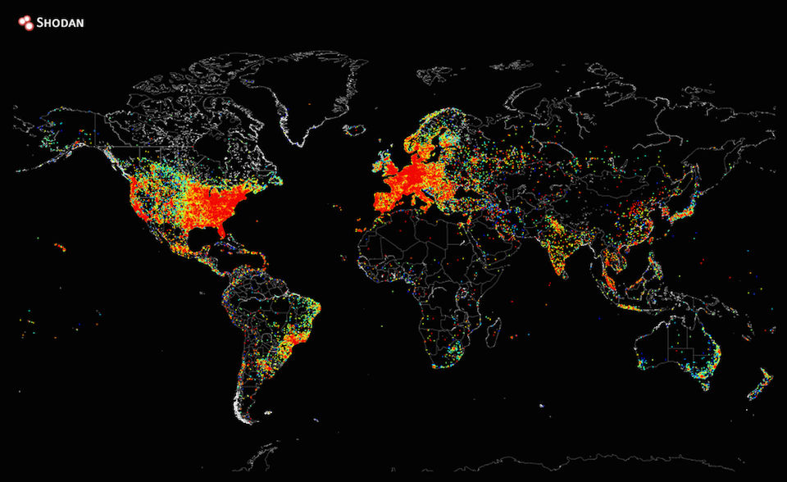
Heat Map of the Entire Internet
From http://www.engadget.com/2014/08/29/internet-heat-map/

Slide 14
Multiplexing
Cost-effective resource sharing
Full-mesh network is not scalable: n(n-1) links
Sharing links among multiple inputs/outputs
Statistical multiplexing
Send from any available input sources
No reservation needed for link use
Utilize the pipe as much as possible
How to prevent starvation?
Smaller pieces: packets

Slide 15
Switching and Forwarding
Send data from a src port to a dest port
Bridge, switch, router, etc.
Forwarding vs. routing?
Forwarding: process of finding the right dest port by looking up the addr in the forwarding table
Routing: process of building the forwarding table
Switching modes
Circuit switching
Packet switching
Virtual circuit switching

Slide 16
Circuit Switching
Exclusive dedication of a portion of the available bandwidth to carry traffic between src & dest
Bandwidth is allocated using:
Frequency Division Multiplexing (FDM)
Time Division Multiplexing (TDM)
Call requires three phases:
Connection phase
A circuit is set up between source and destination
Transmission phase
Traffic exchange takes place
Termination phase
The call is disconnected
Legacy telephone network, a typical example

Slide 17
Circuit Switching
Advantages
Guranateed bandwidth
Simple abstraction: in-order delivery
Fast forwarding: no need to look at header
Low per-packet overhead
Disadvantages
Wasted bandwidths
Blocked connections when all resources are reserved
Connection setup delay (RTT)
Network state – per-connection state

Slide 18
Packet Switching
No transmission capacity is dedicated along the routing path (efficient bandwidth utilization)
No call setup needed before data transmission
Data is transmitted in a sequence of packets
Store and forward
Best-effort packet delivery
Each packet is independent of each other
Out-of-order delivery is possible
No delivery guarantee
No state preserved at the network

Slide 19
Virtual Circuit Packet Switching
An initial phase is used to setup a fixed route
Similar to circuit switching, except that a delay occurs at each node
Call request and Call accept must both wait their turns for transmission
Upon path set-up, the virtual circuit appears to the user as a dedicated circuit
The circuit is actually shared among multiple users
Destination address no longer required
Only a virtual circuit number is needed
Packets have shorter headers
Faster forwarding
Packets follow the same routing path
no order disruption
X.25, Frame Relay, ATM, MPLS, etc.

Slide 20
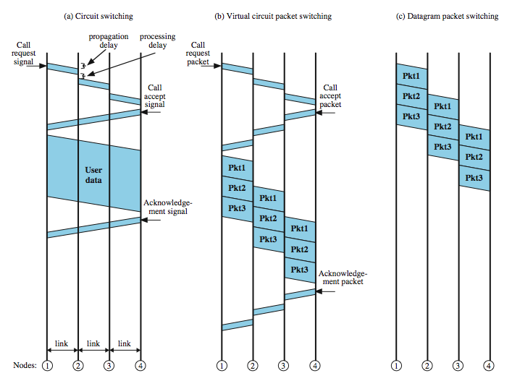
Timing comparison

Slide 21
Addressing
Providing suitable identifiers to nodes
So you can direct data to a node (dest)
So you know which node sent the data (src)
…and how to send back to that node
Key concepts in addressing
Number of unique addresses
Flat vs. hierarchical structure
Persistent vs. temporary identifiers
Handling diminishing address space
Spoofing of source addresses

Slide 22
Comparing MAC and IP Addresses
 | MAC | IP
Assignment | Hard-coded in the adaptor | Configured or learned
Size | 48 bits | 32 bits (in v4)
Structure | Flat | Hierarchical
Portability | Constant over life of the adapter | Changes with time and location
Purpose | Delivery within a single network | Delivery across an inter-network
E.g., social security number vs. postal address

Slide 23
Flow Control & Error Control
Flow control
To prevent the receiver from overrunning
Link layer vs. transport layer
Stop-and-wait and sliding window algorithm
TCP sliding window: receiver says “I can receive this much”
Error control
Guards against loss or damage of data
Mostly error detection and retransmission
CRC-32 for Ethernet
Internet checksum for IP header, UDP & TCP payload
Should each layer independently implement its own?

Slide 24
Congestion Control
Congestion control
To prevent the network from overrunning
Reduce the rate if you see a sign of congestion(= pkt loss)
TCP : Additive Increase Multiplicative Decrease (AIMD)
Explicit congestion notification (ECN)
Router sets a bit in the TCP header
Issues with congestion control
How to infer congestion?
How to react to it?
Who should enforce it?
How to prevent malicious users?
What are the goals?

Slide 25
Performance Measures
Bandwidth vs. throughput
Bandwidth: diameter of a pipe
Throughput: measured bandwidth
Delay
Propagation delay
Transmission delay
Queuing delay
Keep the pipe full
Bandwidth-delay product
Transfer time = 1*RTT + data size/bandwidth
How long it takes for the last byte to be ACK’ed
Ignores queuing delay, errors and retransmission

